Slide 1

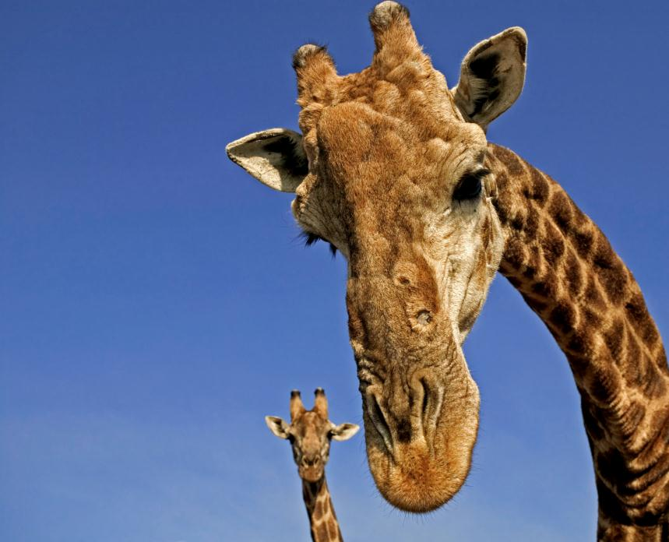
GEEF DE AARDE DOOR
De zeven rivieren van Azië, bedreigd van bron tot monding
Esther Blom, Zoetwaterprogramma 12-01-2013

Slide 2
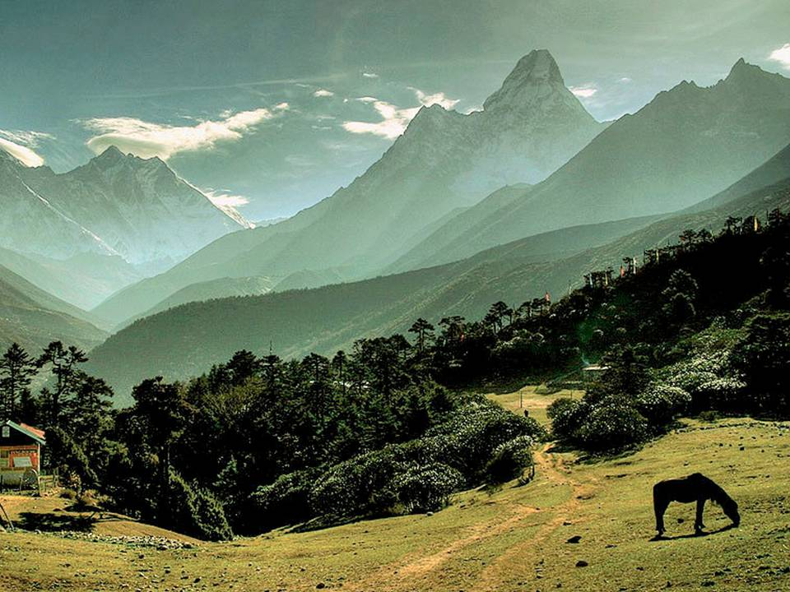
Algemeen
Het Wereld Natuur Fonds maakt deel uit van de internationale beschermings-
Organisatie WWF (World Wide Fund for Nature)
90 Kantoren in meer dan 40 landen
Wereldwijd ong. 5 miljoen donateures
Meer dan 1300 projecten in meer dan 90 landen
© Murat Selam / WWF Nepal
14 January 2013 - 2

Slide 3



Achterban
Shorter title
870.000 donateurs
van wie 120.000 jeugdleden
WNF-Bamboekidz
WNF-Rangers
WNF-Lifeguards
Bijna 3000 vrijwilligers
Secondary information can go here
XX-XX Month, Year
Additional information can run
Underneath if necessary
14 January 2013 - 3

Slide 4
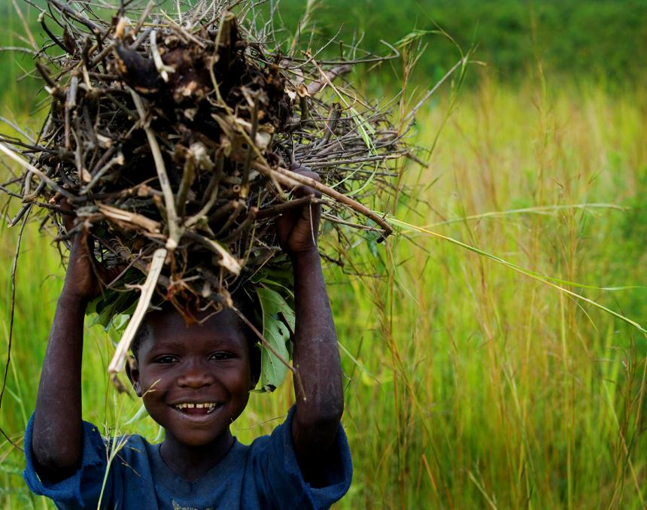
Missie
Het Wereld Natuur Fonds streeft naar een wereld waarin de mens leeft in harmonie met de natuur.
© Kate Holt / WWF-UK
14 January 2013 - 4

Slide 5
Doelstelling
Beschermen biodiversiteit op aarde door:
Beschermen/herstellen belangrijkste leefgebieden
Aanpakken belangrijkste bedreigingen
Nederlandse samenleving bewust maken dat zij actief kan bijdragen aan de bescherming
© Kate Holt / WWF-UK
14 January 2013 - 5

Slide 6

Constructief
Oplossingsgericht
Samen met anderen;
  - mensen die in en van de natuur leven
  - maatschappelijke organisaties
  - de politiek
  - het bedrijfsleven
  - de achterban (donateurs)
Aanpak
© Frank Parhizgar / WWF-Canada
14 January 2013 - 6

Slide 7
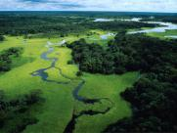
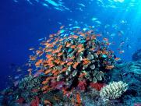
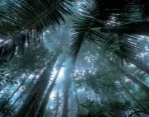
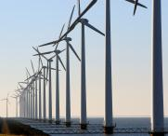
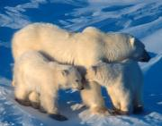
Natuurbescherming
Werkterreinen
Zoetwatergebieden
Oceanen en kusten
Bossen
Klimaat
Beschermde gebieden en soorten
Natuur en ontwikkeling
Nederlandse natuur
Duurzame markten & Voetafdruk
14 January 2013 - 7

Slide 8
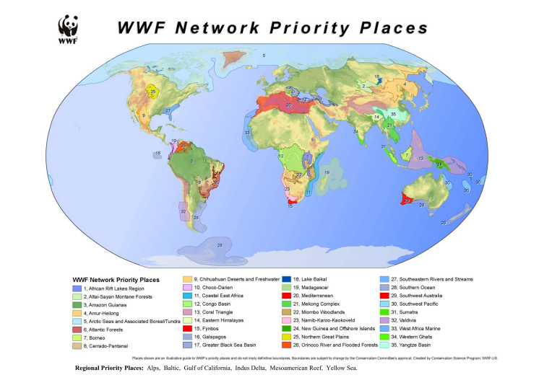

8
14 January 2013 - 8
Notes:
Another important trend is increased concentration and market power in the hands of a few multinational companies (see above examples), may they be retailers, commodity traders or food brands
There may be longer supply chains but they are fewer players—more direct contact
Finally, while developed countries dominate trade today, developing countries are likely to be at centre stage in future
8

Slide 9
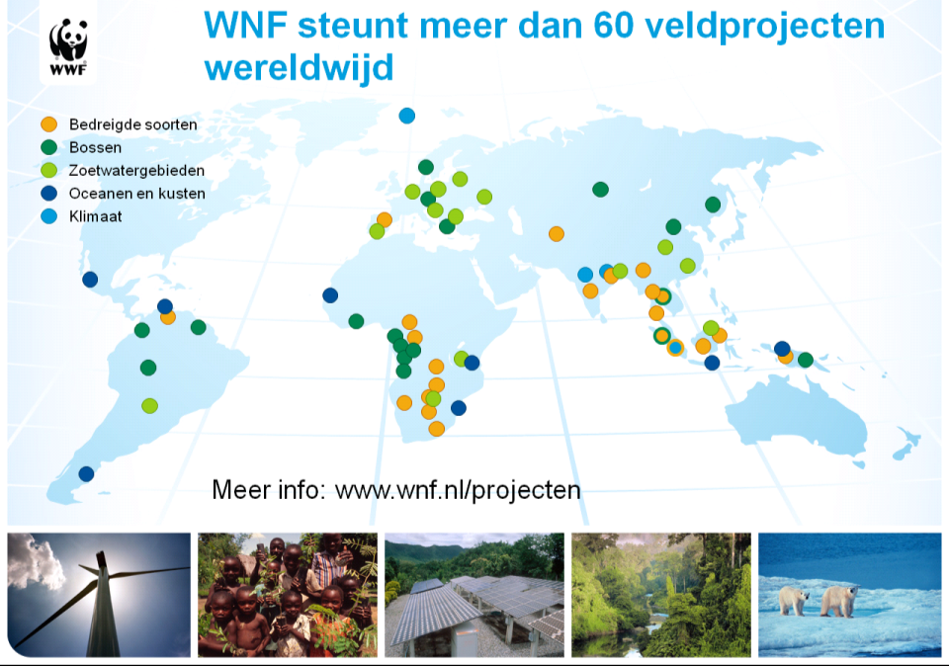
Shorter title
–
Secondary information can go here
XX-XX Month, Year
Additional information can run
Underneath if necessary
14 January 2013 - 9

Slide 10
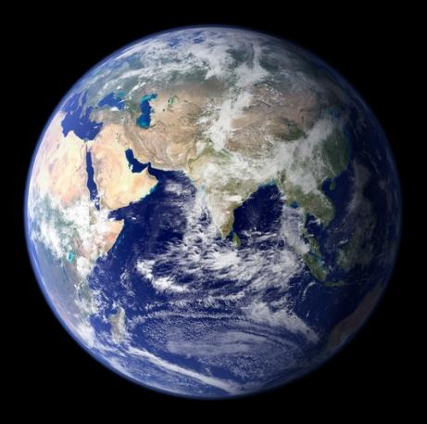
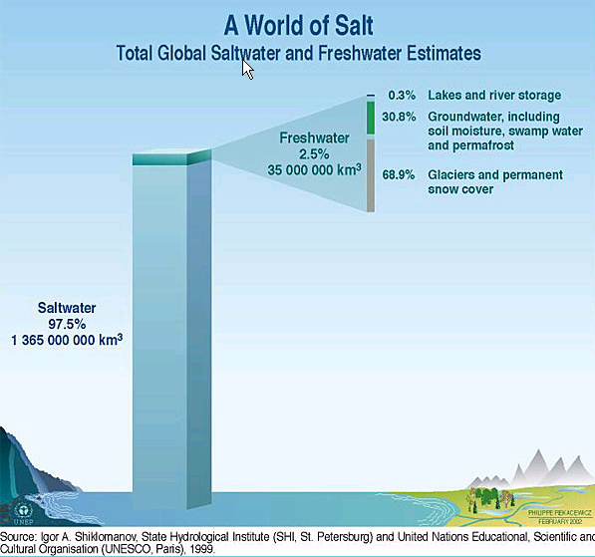
Water, water everywhere…
…
Notes:
Ours is a watery planet, but only about 1% of the world’s water is readily available for human use.

Slide 11
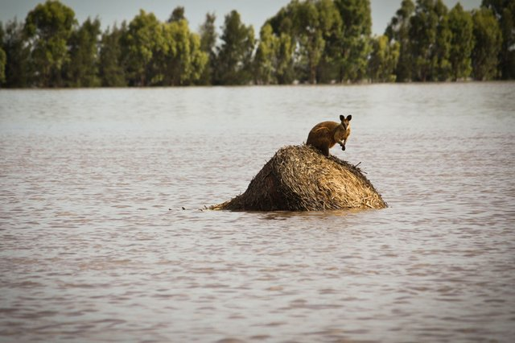

Australia

Slide 12
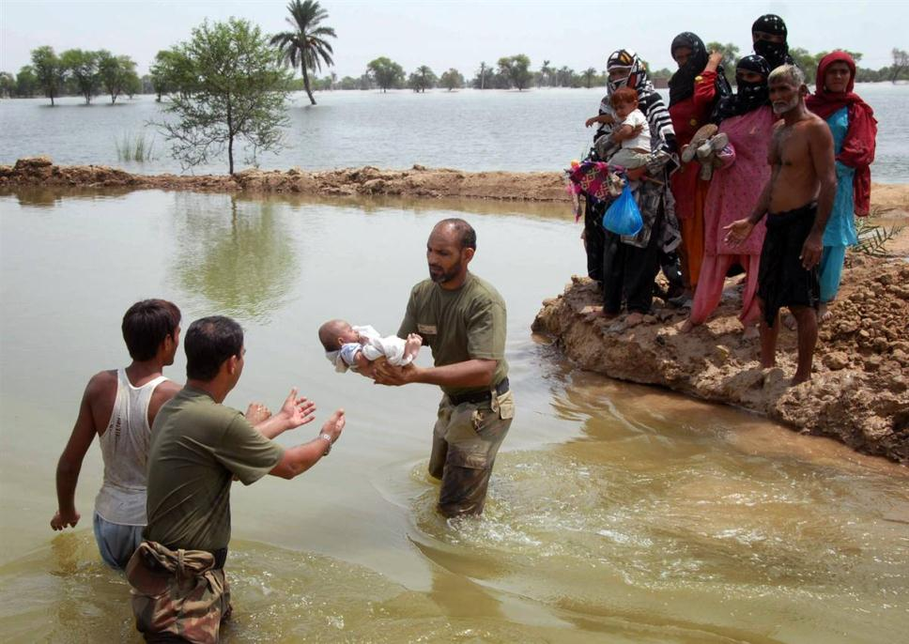
Pakistan

Slide 13
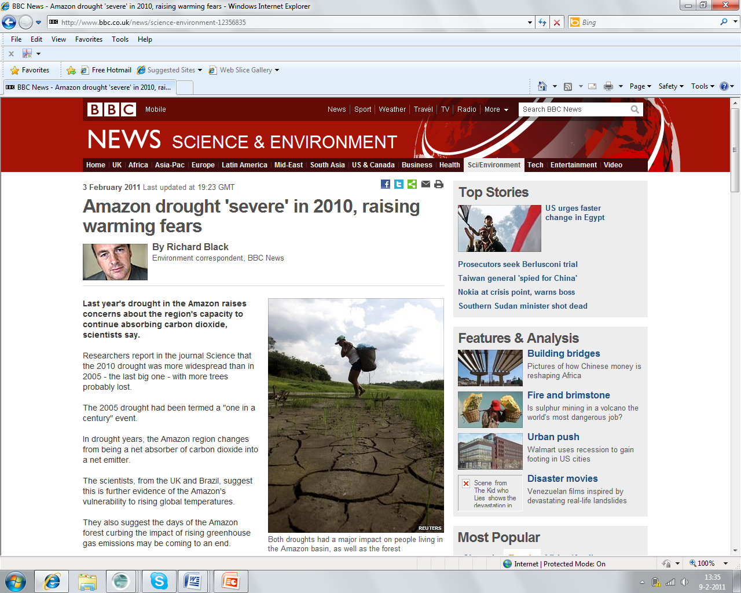

Slide 14
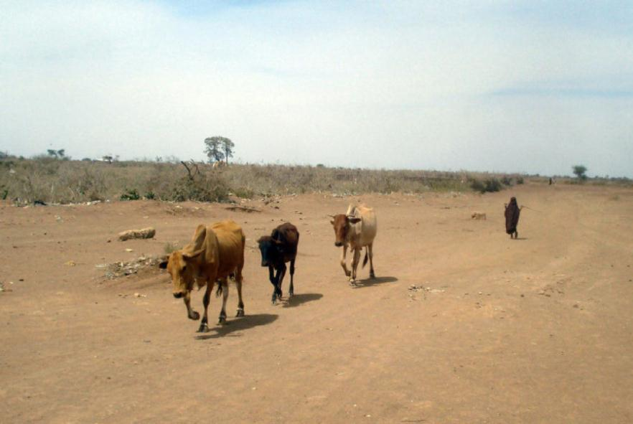
Somalia

Slide 15
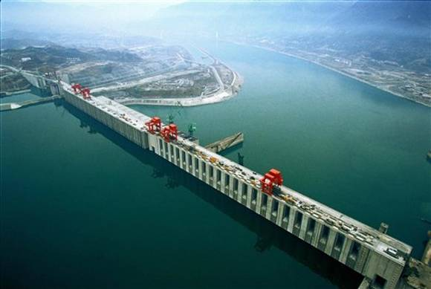

Slide 16
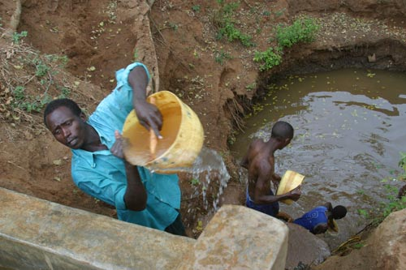

Slide 17
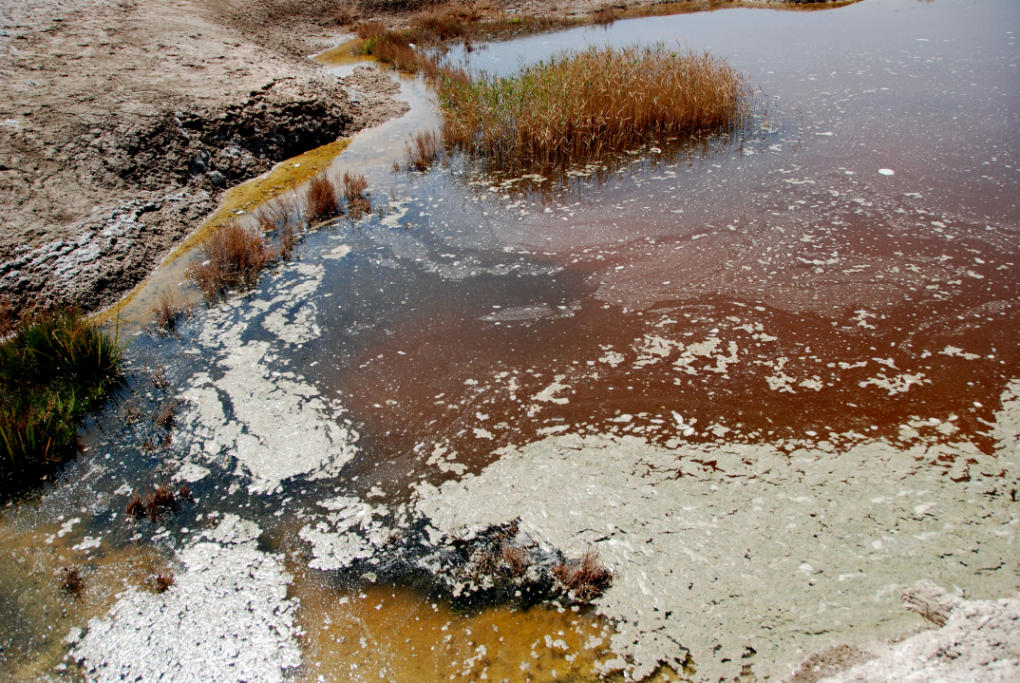

Slide 18
http://www.youtube.com/watch?v=-nekqKEsbdU&feature=player_embedded
latte

Slide 19
http://www.youtube.com/watch?feature=player_embedded&v=kxqbpPWTl6A

Slide 20
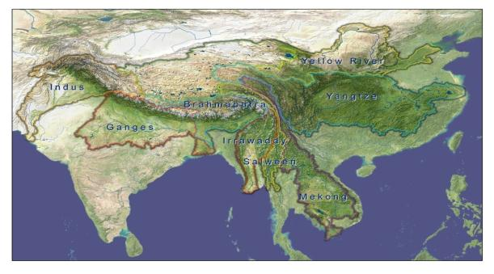
De Zeven Rivieren van Azië
© Murat Selam / WWF Nepal

Slide 21
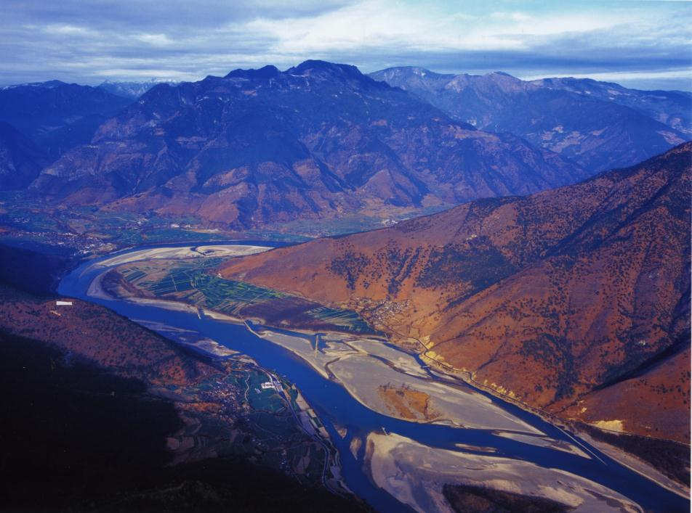
Ontwikkeling
Grote sociale en economische transformatie
Urbanisering, voedsel- en watervraag
China en India grootste veranderingen
Alle rivieren zijn internationaal/transprovinciaal, met verschillende belangen boven- en benedenstrooms (hydro vs flood)
Ongelijksoortige machtsverhoudingen
Management zelden vanuit rivierperspectief
1 miljard mensen afhankelijk van deze rivieren

Slide 22
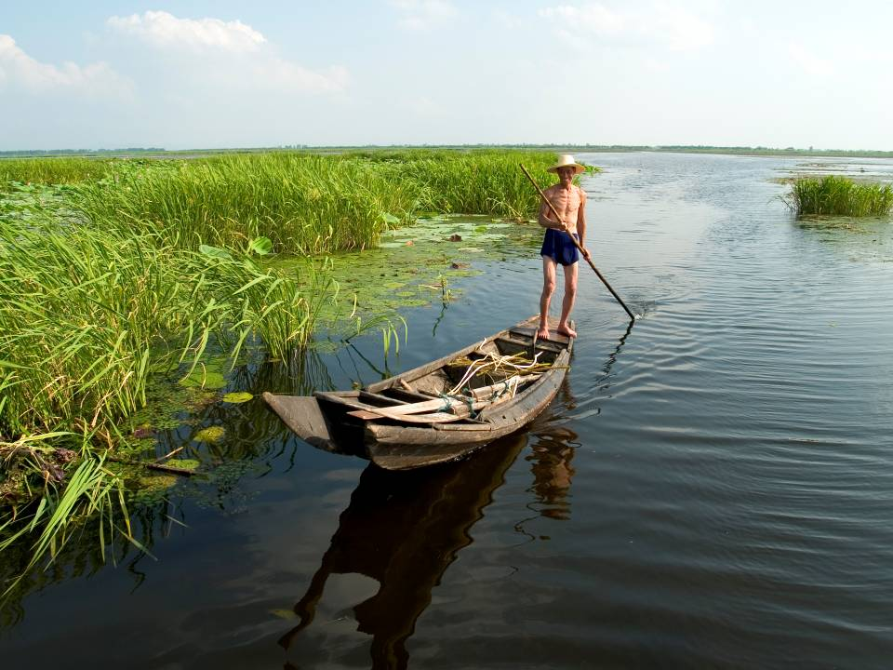
Hydrology
‘s Werelds grootste rivieren wat betreft afvoer Ganges, (2),
Yangtze (4)
Mekong (11),
Irrawaddy (14))
Allemaal sterke afvoerverschillen in seizoenen
Allen hun bron in de Himalaya/Tibet. Verschillen in aandeel van glaciers.
Afvoer sterk veranderd door landgebruik, wateropslag, klimaatverandering. Overstromingen en droogtes.
© Murat Selam / WWF Nepal

Slide 23
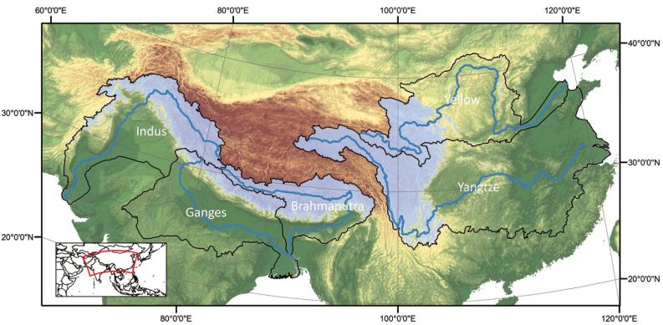
Mensen onder invloed van verandering in afvoer door klimaatverandering:
34 M Brahmaputra
26 M Indus
7 M Yangtze
2,4 M Ganges
3 M Gele Rivier (+)

Slide 24
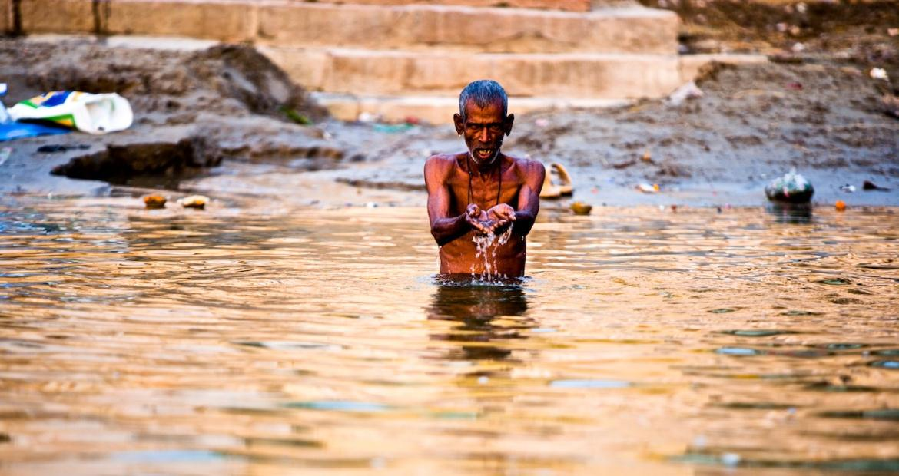
Economie & water
Indus, Ganges en de Yangtze: allen 150,000 km2 irrigatie
Steden, dorpen en industrie, vervuiling
Hydro: grote economische motor, verdamping, connectiviteit, flows, sedimenten
Minder machtige sectoren: vis, tourisme

Slide 25
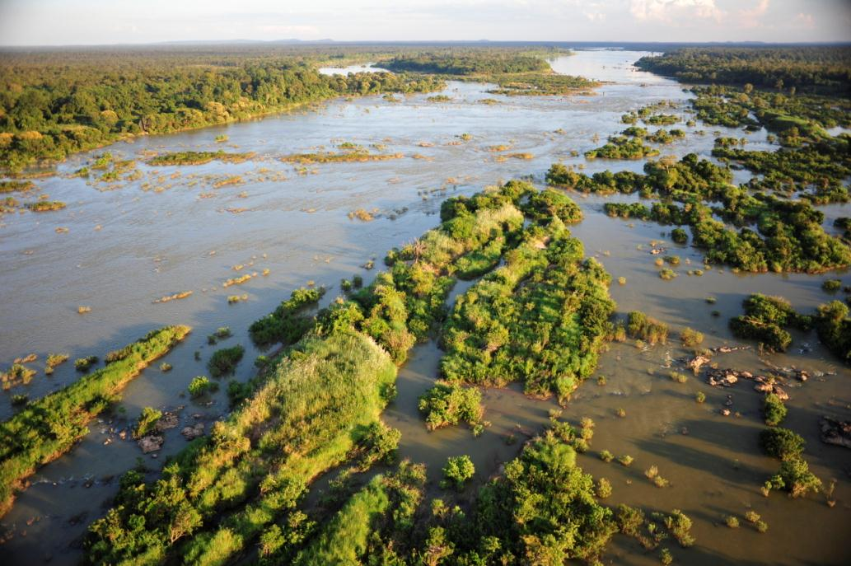
Biodiversiteit
Vis: Mekong 1300 soorten, Mekong Giant Catfish, Giant Carp, Mekong Stingray
Rivierdolfijnen: Mekongdolfijn, Irrawaddy, Chinese vlagdolfijn, Yangtze bruinvis, Gangesdolfijn, Indusdolfijn
Vogels: 50% van water/rivierafhankelijke soorten
Brongebieden: laagproductief, endemische soorten. Uiterwaarden en bossen: hoge productiviteit, hoge soortenrijkdom. Estuaria : hoogproductief , lagere diversiteit.
© Murat Selam / WWF Nepal
14 January 2013 - 25

Slide 26
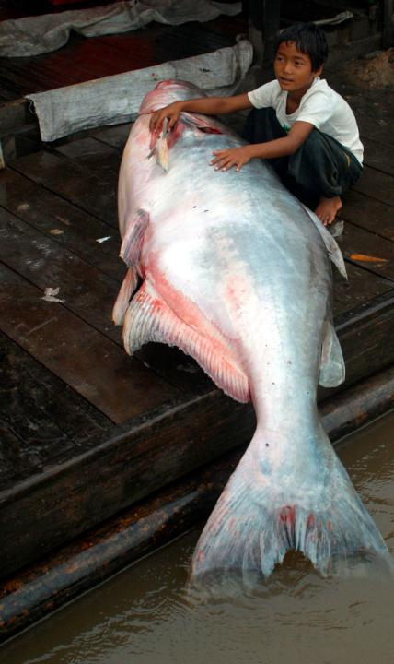

Slide 27
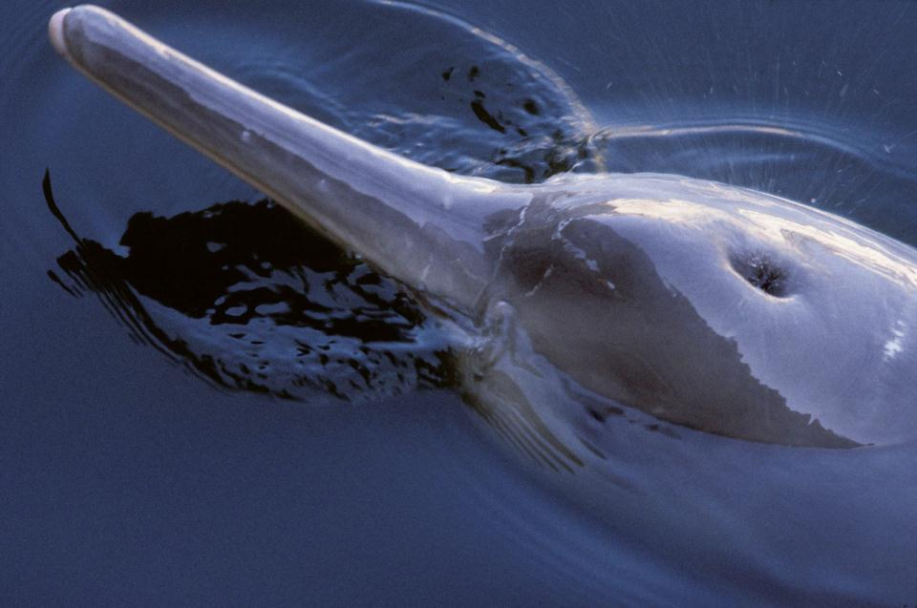

Slide 28
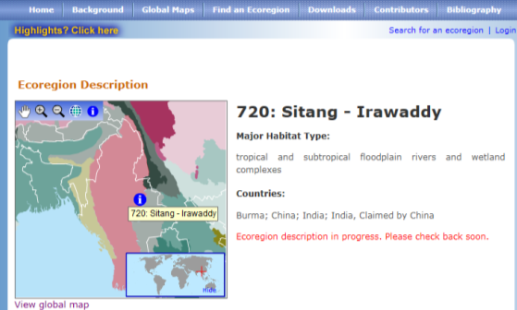
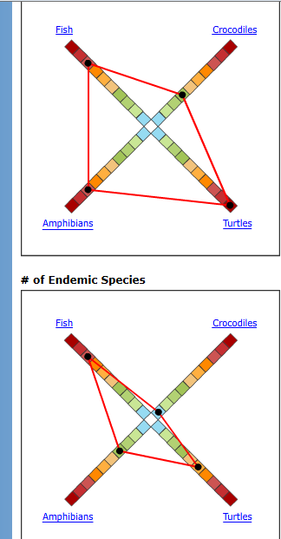

Slide 29
http://vimeo.com/23365280
Living himalayas

Slide 30
Aanpak
Eflows
Free flowing rivers
Beschermde gebieden (Ramsar)
Duurzaam gebruik natuurlijke hulpbronnen
Werken met natuur, eco-engineering
Bedrijven en water
© Murat Selam / WWF Nepal
14 January 2013 - 30

Slide 31
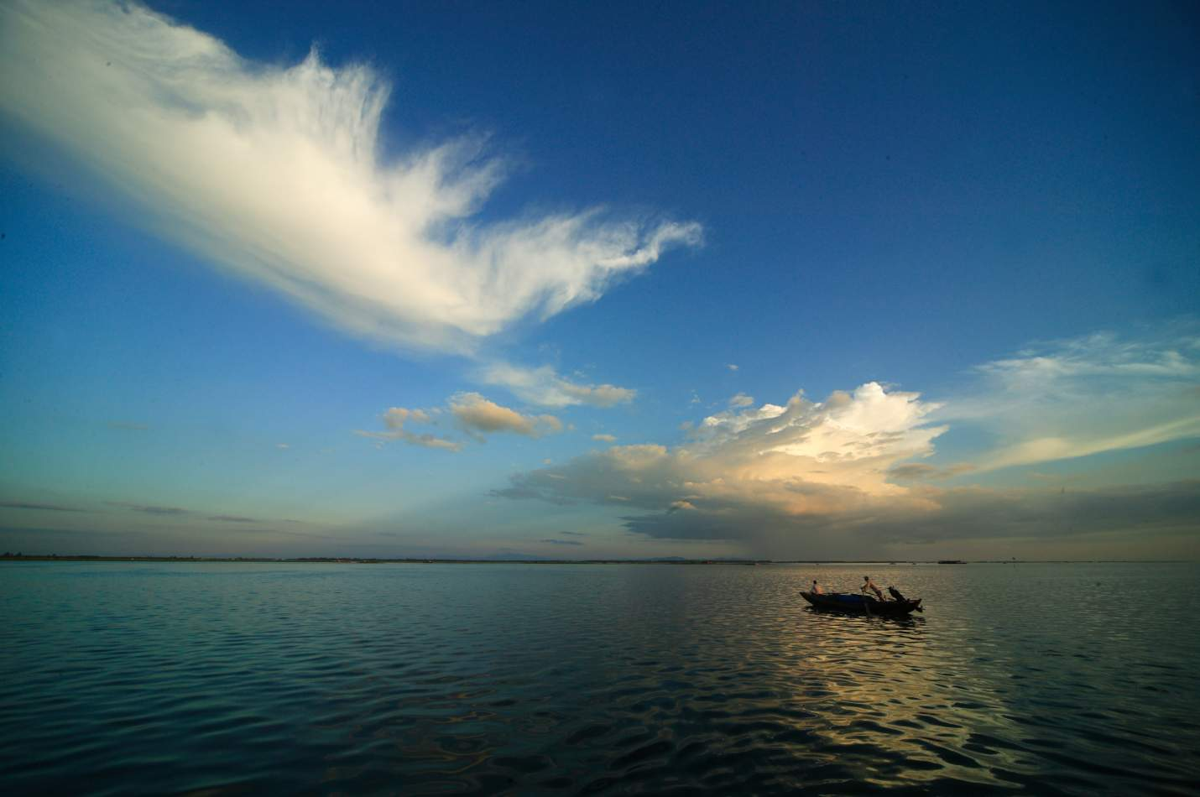

WWF-China Yangtze Programme
Action Plan for a Living Yangtze
The Yangtze Eco-Region Action Plan: Past, Present and Future
© Zhang Yifei

Slide 32
Action Plan for a Living Yangtze
The Yangtze Eco-Region Action Plan: Past, Present and Future
“A region where a living, healthy river unites the frozen terrain of the Tibetan Plateau and the blue expanse of the Pacific Ocean; where plant, fish, animal and man co-exist in a sustainable, nature-based, eco-friendly future”
WWF’s vision for the Yangtze River Basin

Slide 33
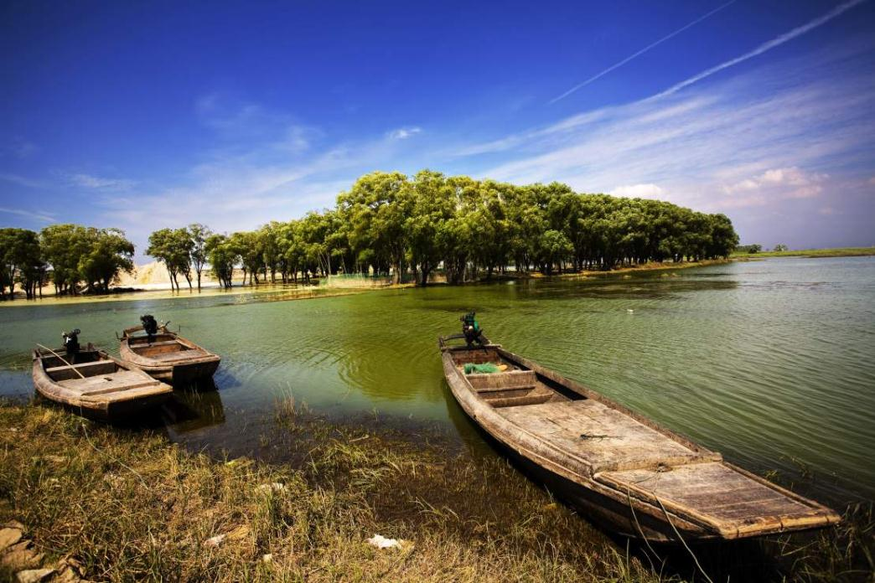
Action Plan for a Living Yangtze
The Yangtze Eco-Region Action Plan: Past, Present and Future
1
Introduction to the Yangtze River Basin
© Cat Holloway / WWF-Canon
- 33

Slide 34
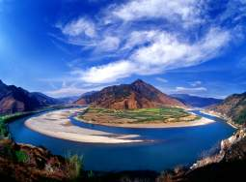
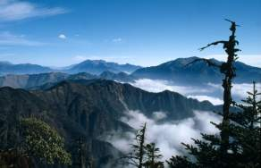

Wild Yangtze
Action Plan for a Living Yangtze
The Yangtze Eco-Region Action Plan: Past, Present and Future
6300km long – world’s 3rd longest river
7500m in altitude from source to sea
Area of 1.8million km² – almost the same size as Mexico
Unique ecosystem full of rare endemic wildlife
One of WWF’s 35 priority eco-regions (out of a total of 200)

Slide 35
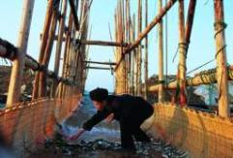
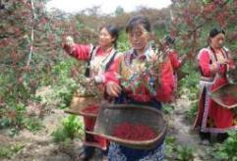
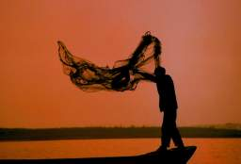
Human Yangtze
Action Plan for a Living Yangtze
The Yangtze Eco-Region Action Plan: Past, Present and Future
476 million people – 36% of population of PRC
Rich in resources – provides 70% of rice, 60% of freshwater fish, 40% of grain, 33% of cotton, 40% of hydropower and 50% of China’s industrial products
Represents 40% of GDP, annual growth rate of 15%
Yangtze Delta: “World Factory” – 400 out of top 500 companies

Slide 36
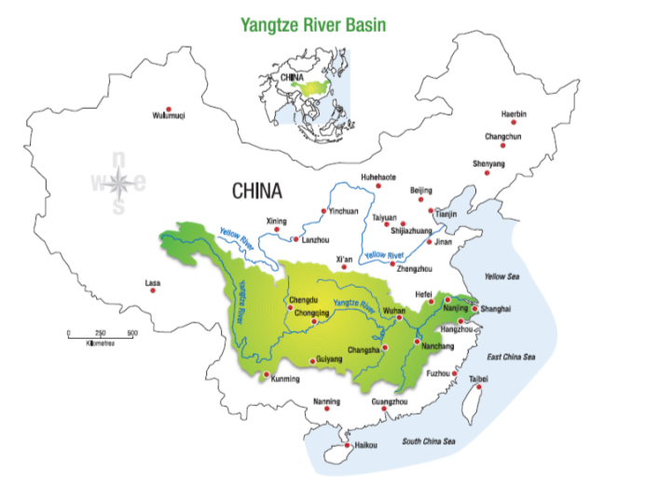
Yangtze basin

Slide 37
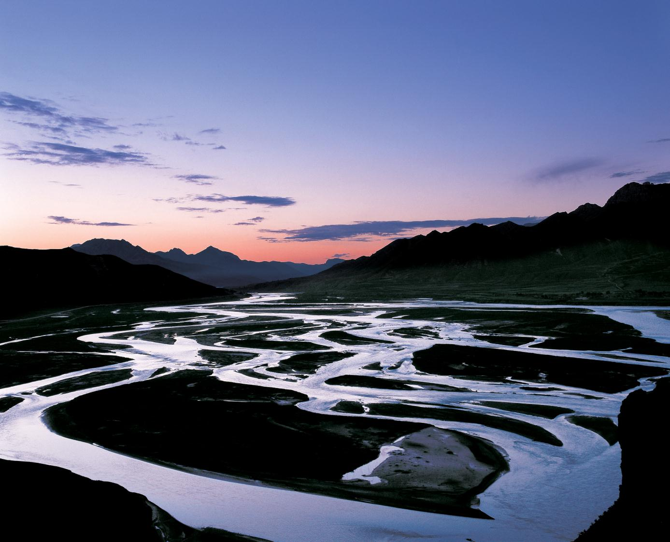
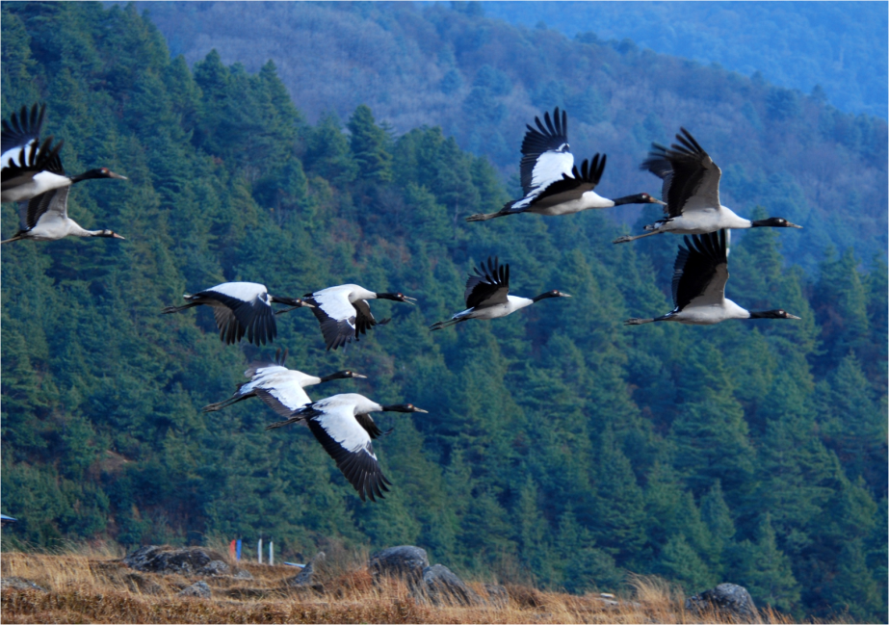
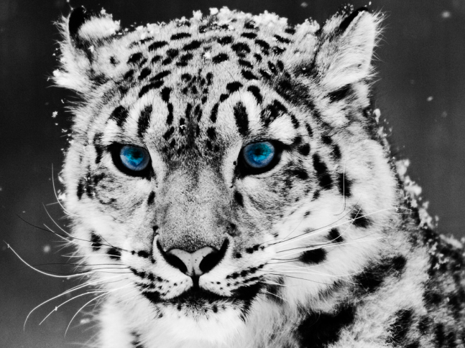

Slide 38
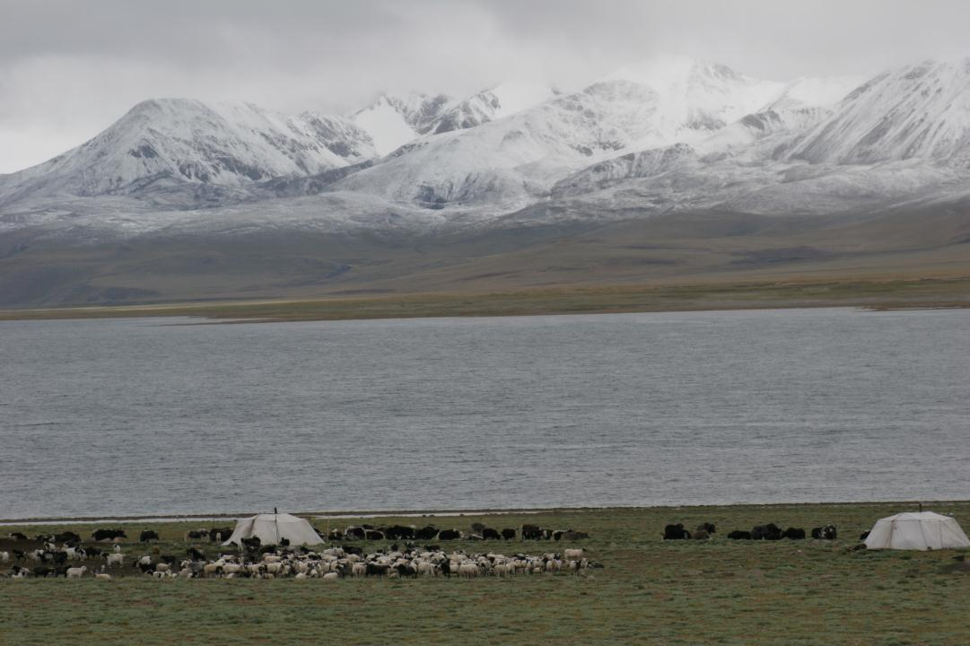

Slide 39
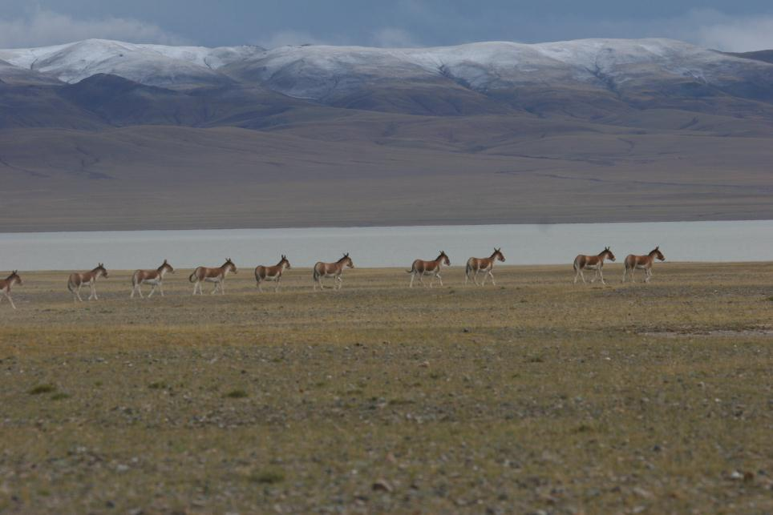

Slide 40
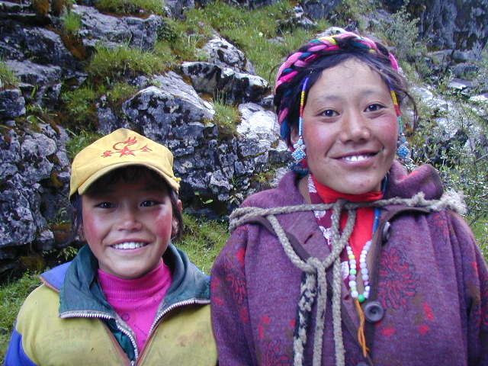

Slide 41
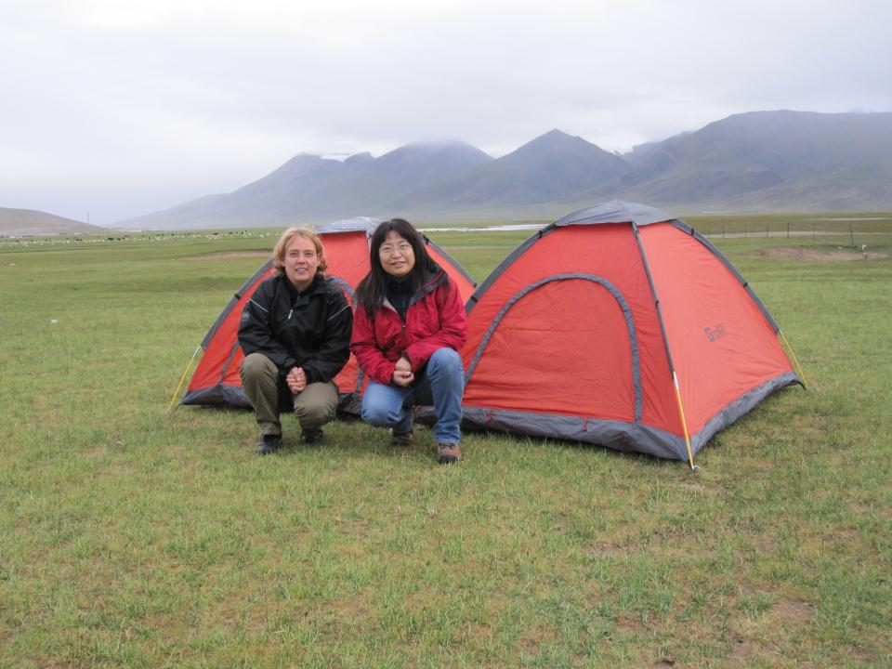

Slide 42
Yangtze basin

Slide 43
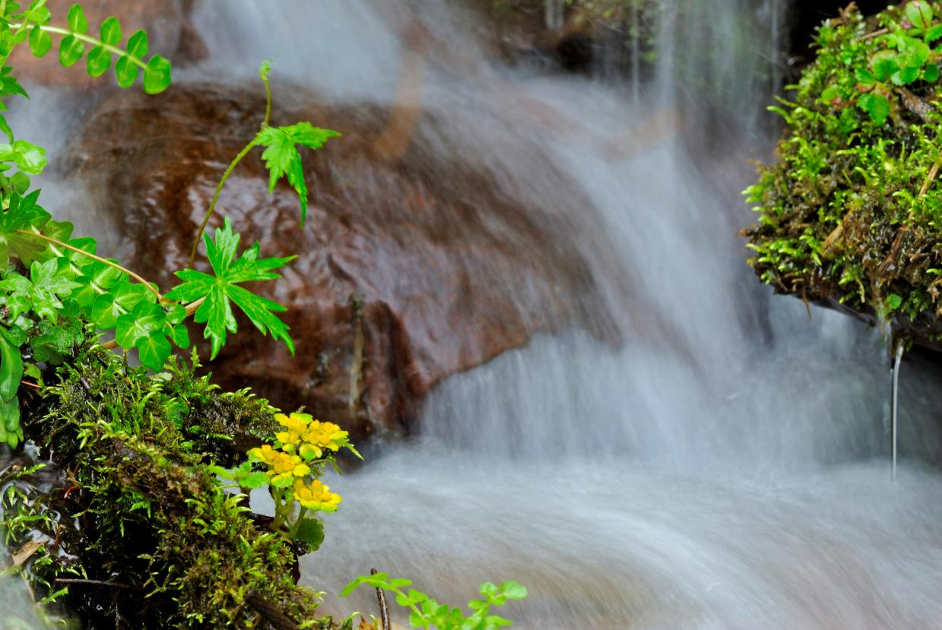
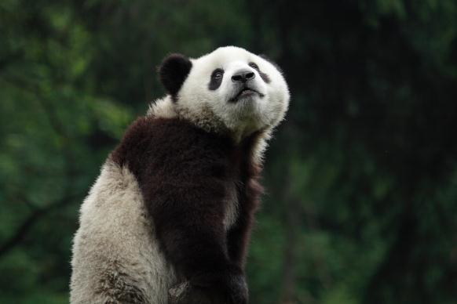
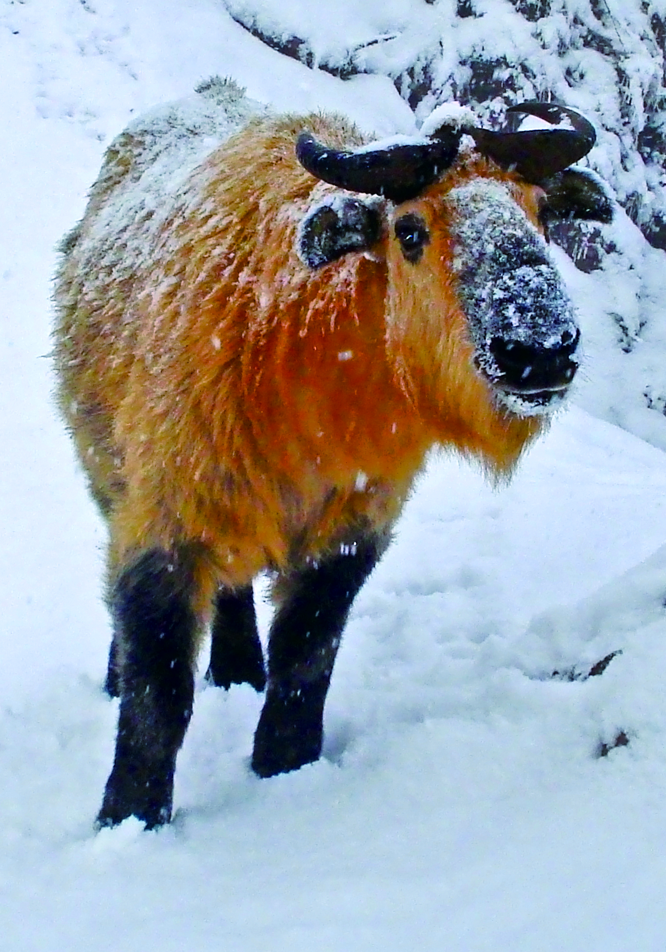

Slide 44
Yangtze basin

Slide 45
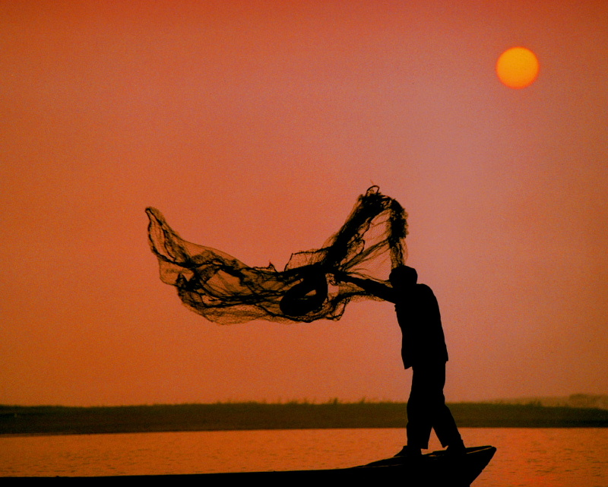
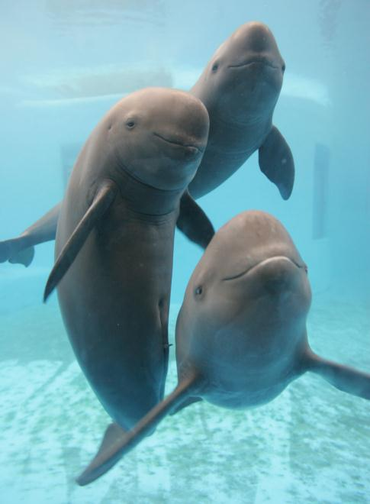
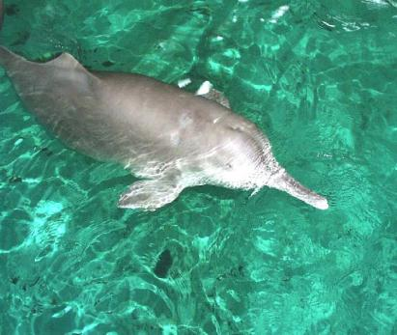

Slide 46

Siberian Crane Grus leucogeranus (CR) The Yangtze floodplain is the most important region in the world for this globally threatened species, with the vast majority occurring in Poyang lake Though the population in Poyang lake seems to have been quite stable since 2001, the lake is facing draught and Water Control , a high risk of extinction for Siberian cranes would result from loss of Poyang lake as a wintering habitat for this species.

Slide 47

In spring and autumn, coast line in Shanghai and Jiangsu is also important stopover site for migrate shorebirds, e.g. the globally Critically Endangered Spoon-billed Sandpiper Eurynorhynchus pygmeus .

Slide 48

Action Plan for a Living Yangtze
The Yangtze Eco-Region Action Plan: Past, Present and Future
2
Threats to the Yangtze
© An Junsen

Slide 49

Action Plan for a Living Yangtze
The Yangtze Eco-Region Action Plan: Past, Present and Future
Mass Tourism Development
Shipping & Navigation
Glacial Melting
Extreme Weather
Reclamation of Wetland for Farming
Sea level rise
Urban Development
Infrastructure: Dams, Mining, Roads
Pollution
Deforestation & Soil Erosion
Over-fishing
Key
Result of Climate Change
Direct Human Interference

Slide 50

Freshwater - Threats
Action Plan for a Living Yangtze
The Yangtze Eco-Region Action Plan: Past, Present and Future
Key Threats to Fresh Water Supplies in the Lower Yangtze
Three Gorges Dam
Salt water intrusion at the mouth of the Yangtze
Finless Porpoises stranded in Poyang Lake after the 2007 drought
Quantity
- Floods
- Droughts
Quality
- Pollution
- Erosion
- Biodiversity loss
Management
- Over-exploitation
- Governance

Slide 51

Tibetan Plateau

Slide 52


Yulong Copper Mine

Slide 53


Slide 54

Glacial Meltoff, Nyinchi Prefecture
1998
100m
1986

Slide 55



Slide 56


Action Plan for a Living Yangtze
The Yangtze Eco-Region Action Plan: Past, Present and Future
Laatste bevindingen monitoring: sterke achteruitgang finless porpoise
Zand- en klei
Overbevissing
Navigatie
Vervuiling
© An Junsen

Slide 57
Freshwater – Goals for 2015
Dam management ensures Environmental Flows in Central and Lower Yangtze, demonstrations carried out
Priority water ecosystems protected and rehabilitated to ensure fresh water, animal habitat, flood defense etc.
Better-coordination governance of Yangtze Basin through IRBM
Increased corporate engagement (including “water footprint” recording)

Slide 58
Climate Change Adaptation
Action Plan for a Living Yangtze
The Yangtze Eco-Region Action Plan: Past, Present and Future
To increase ecosystems’ capacity to cope with climate change
Past actions:
  Lake reconnection in Central and Lower Yangtze (over 40 reconnected since 2002)
  Carbon credit hydropower scheme in giant panda nature reserves
  Yangtze River Basin Vulnerability Assessment Report (2009)

Slide 59
Climate Change Adaptation
Action Plan for a Living Yangtze
The Yangtze Eco-Region Action Plan: Past, Present and Future
Future actions:
  Develop the tools for nature-based climate change adaptation strategies
  Four key regions:
    Yangtze Source
    Upper Yangtze Panda habitat
    Central and Lower Yangtze wetlands
    Yangtze Estuary
  Increase scale of actions and make nature-focused climate change adaptation more mainstream

Slide 60

Action Plan for a Living Yangtze
The Yangtze Eco-Region Action Plan: Past, Present and Future
© Wei Baoyu

Slide 61

Wetland Conservation
Conservation workers from 143 national reserves attended 6th Yangtze Wetland Network Annual Conference in Nov. These reserves encompass an area of 185,000km².

Slide 62
http://sites.asiasociety.org/chinagreen/four-great-rivers/

Slide 63


Contact
Vragen of ideeën?
Telefoon: 0800-1962
E-mail:
info@wwf.nl
Schriftelijk:
Postbus 7,
3700 AA in Zeist
Voor meer informatie:
www.wnf.nl
© Michel Roggo / WWF-Canon

Slide 64

WWF IN SHORT
+100
+5,000
WWF is in over
100 countries, on
5 continents
WWF has over
5,000 staff worldwide
1961
+5M
WWF was founded
In 1961
WWF has over
5 million supporters
Photo: © NASA

Slide 65


