Slide 1



Slide 3


Slide 4
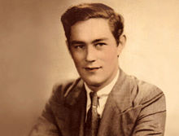

Slide 5
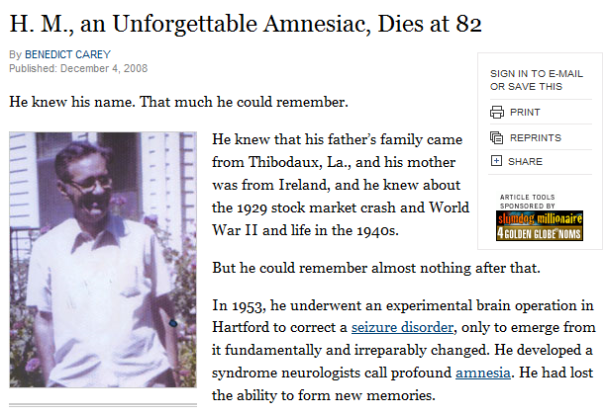
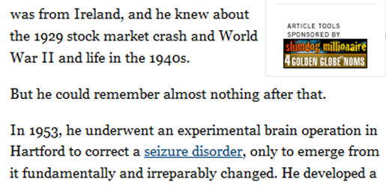
Notes:
Molaison = mO-lie-son

Slide 6
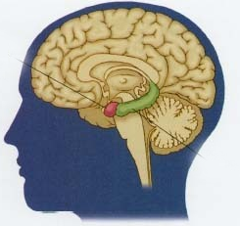
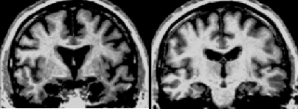

Slide 7


Slide 8
Notes:
Operated on in 1953---bilateral hippocampalectomy
Thinks Bing crosby is the best singer of all time, Has no idea who elvis is.
Thinks Eisenhower is president of the US, thinks the 1951 Desoto best car ever made.
He’s living in the past.

Slide 9
Notes:
Operated on in 1953---bilateral hippocampalectomy
Thinks Bing crosby is the best singer of all time, Has no idea who elvis is.
Thinks Eisenhower is president of the US, thinks the 1951 Desoto best car ever made.
He’s living in the past.

Slide 10
Notes:
C

Slide 11
Notes:
Has been taught to “mirror write” ----He can’t remember learning it but he can do it.
This shows Declarative and Procedural memory completely seperated.

Slide 12
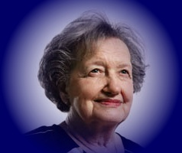
Notes:
Has been taught to “mirror write” ----He can’t remember learning it but he can do it.
This shows Declarative and Procedural memory completely seperated.

Slide 13
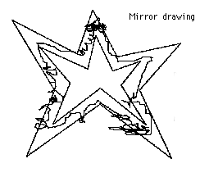
Notes:
Has been taught to “mirror write” ----He can’t remember learning it but he can do it.
This shows Declarative and Procedural memory completely seperated.

Slide 15
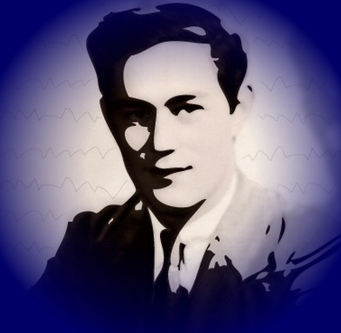

Slide 20
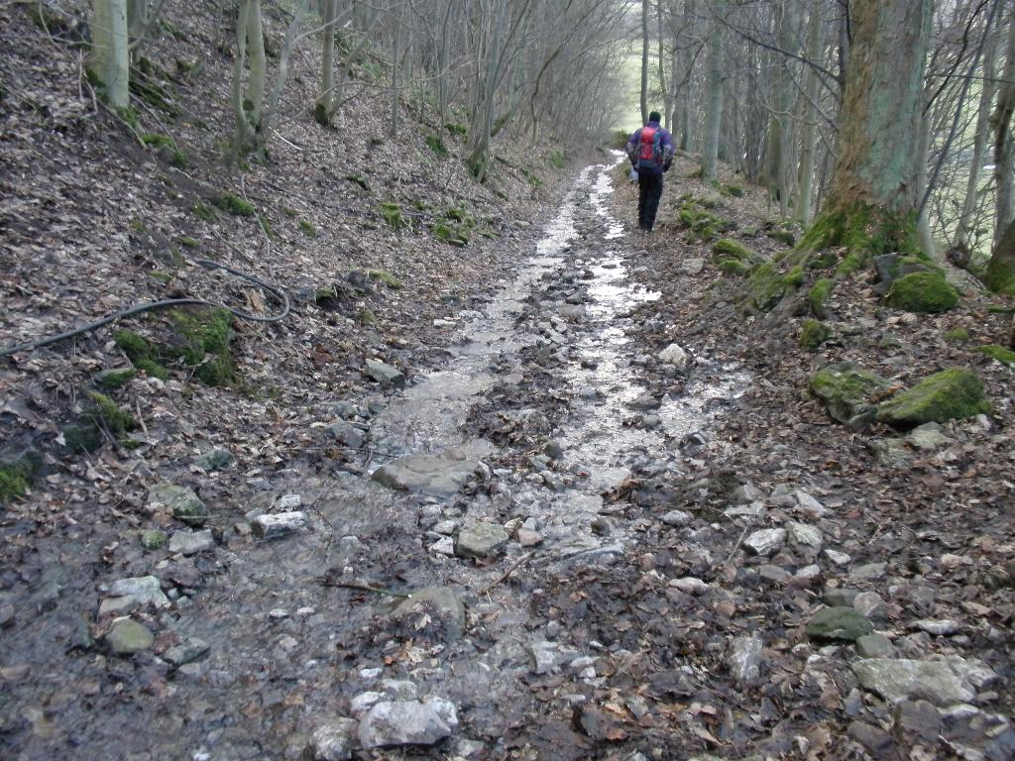

Slide 21


Slide 22


Slide 52
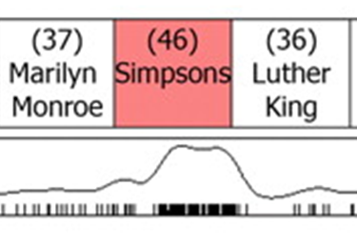

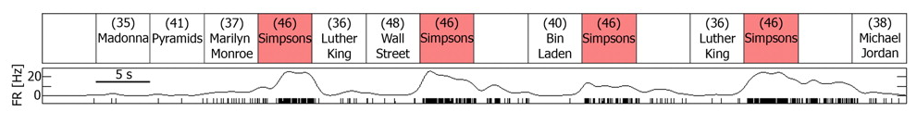

Slide 53



Slide 54


Slide 55



Slide 56


