Slide 1




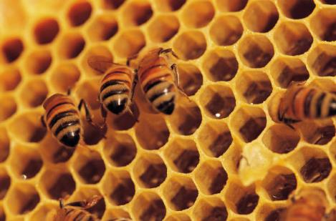
EU-project HOBeebox
29ste NIBI-onderwijsconferentie, 16 en 17 januari 2015
Bees in the classroom
Daniel Bengtsson & Peter Pany
daniel.bengtson@stockholm.se
peter.pany@schule.at

Slide 2

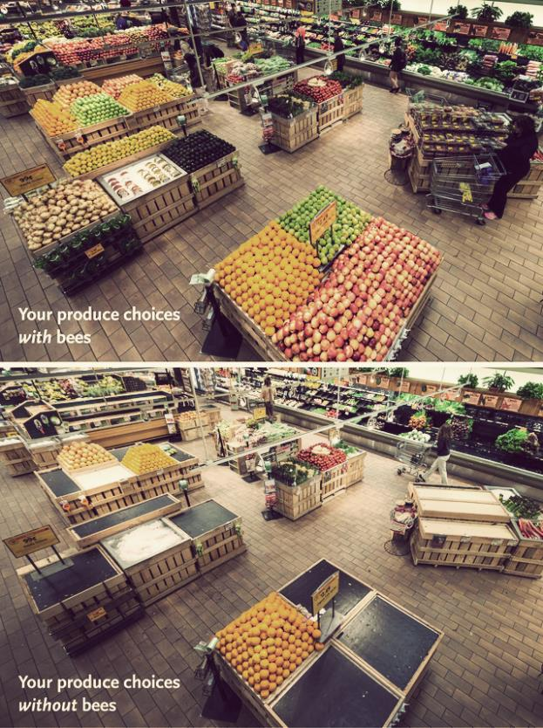

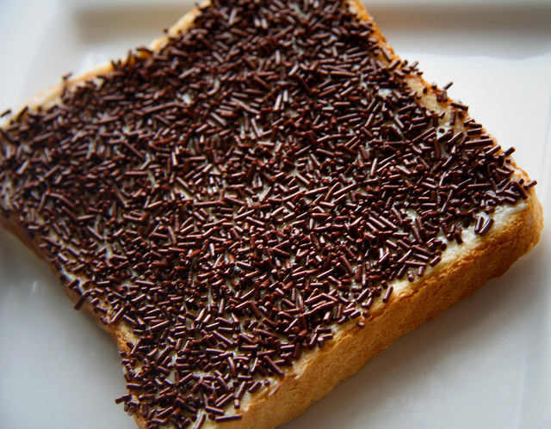




Introduction
Make a sketch of your typical breakfast
Cross out every product that depends on the activity of bees
(check the list)
How many are left?
www.hobos.de
EU-project HOBeebox

Slide 3
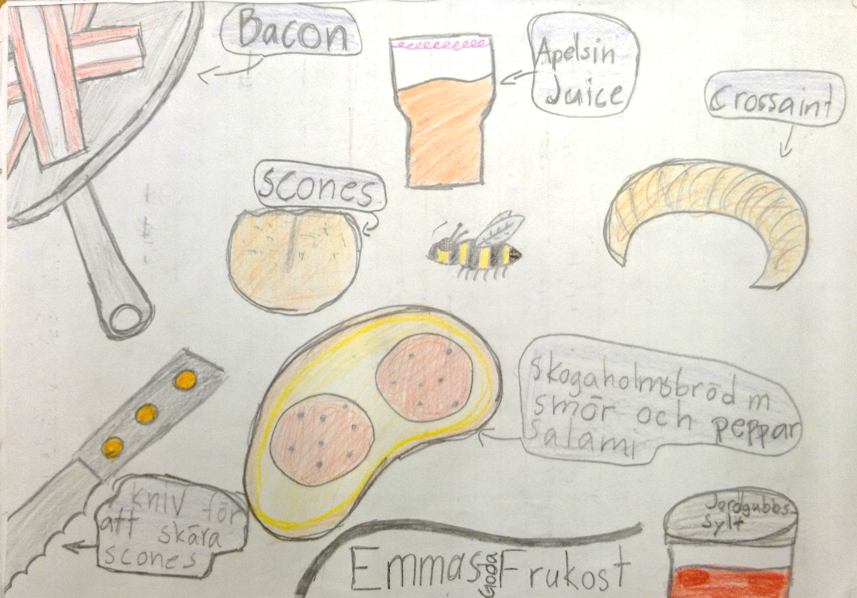
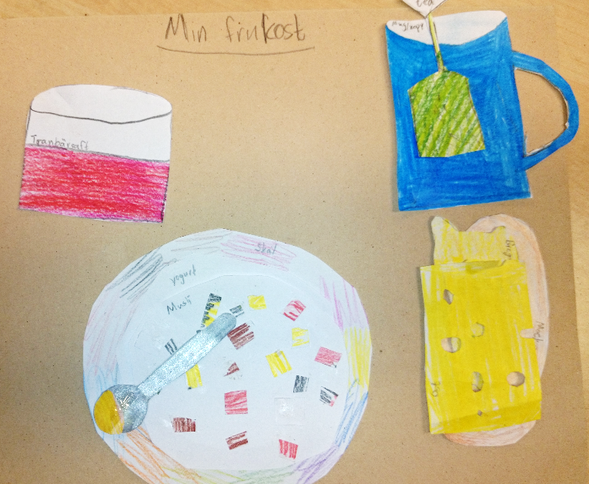
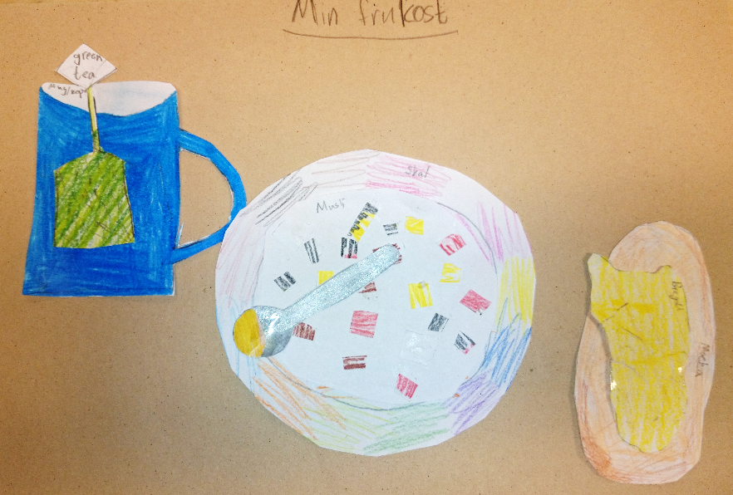
Impressions of students‘ work
www.hobos.de
EU-project HOBeebox

Slide 4


Introduction
NOT EVERYBODY CAN KEEP BEES
AND OPEN A BEEHIVE…
HOBOS 365 days/year – live and
right in the middle of the beehive
www.hobos.de
EU-project HOBeebox

Slide 5
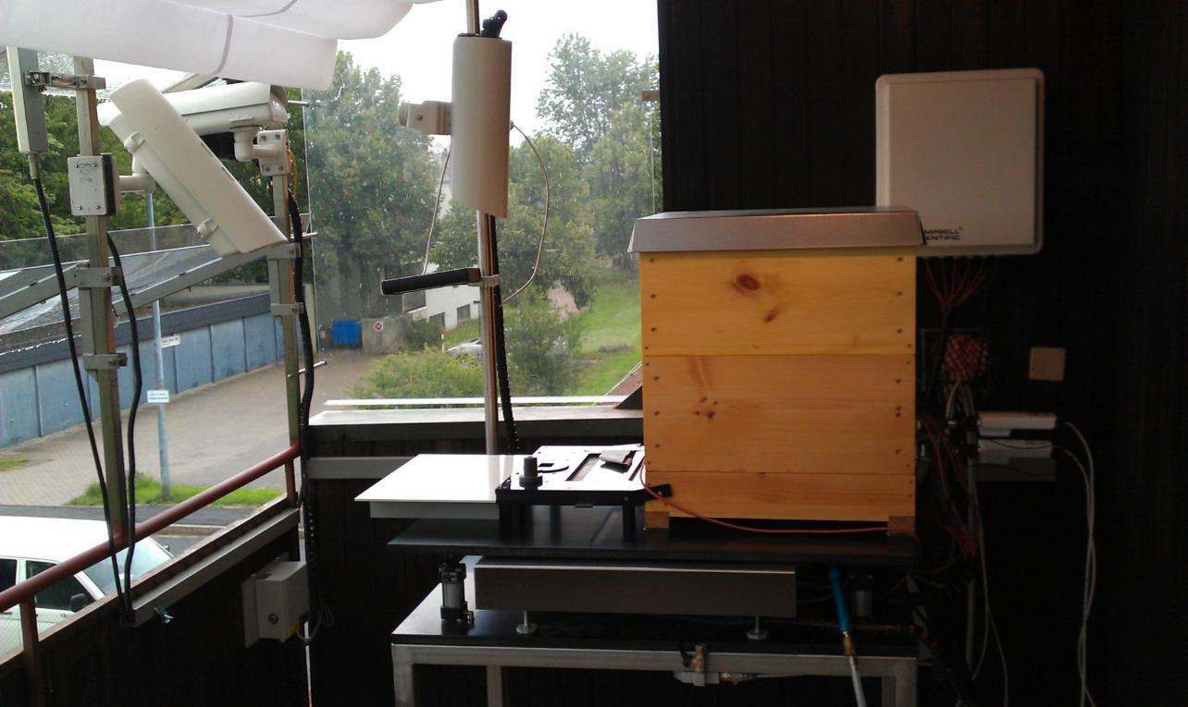
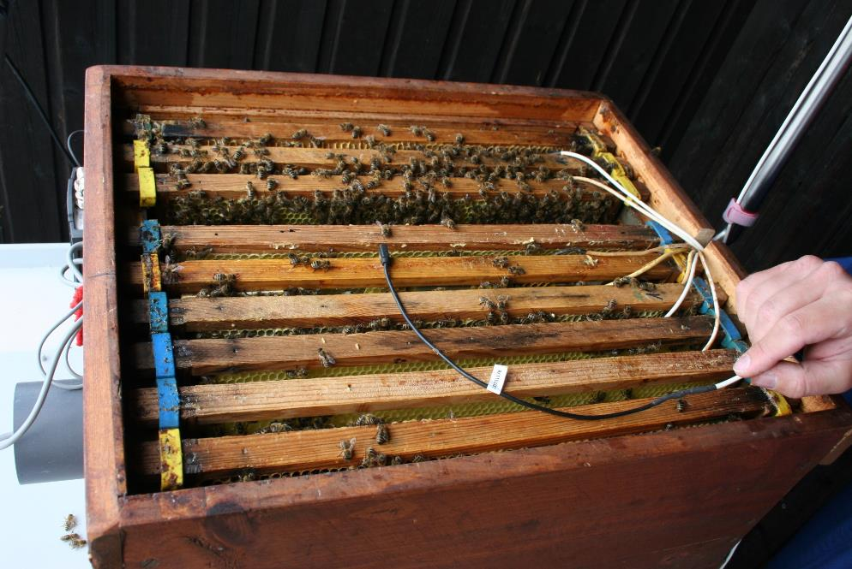
www.hobos.de
EU-project HOBeebox

Slide 6
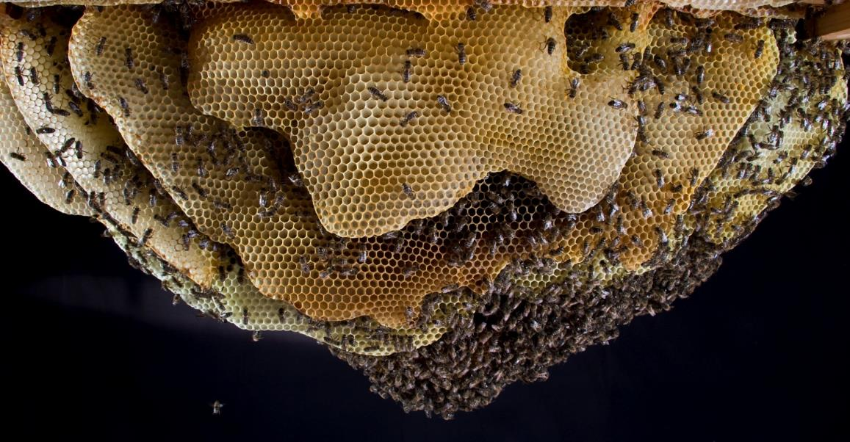

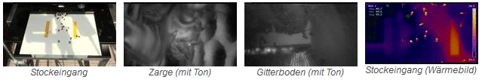
Modern online education
www.hobos.de
Sensors
Data
110 001 000 111
010 110 110 001
www.hobos.de
EU-project HOBeebox

Slide 7

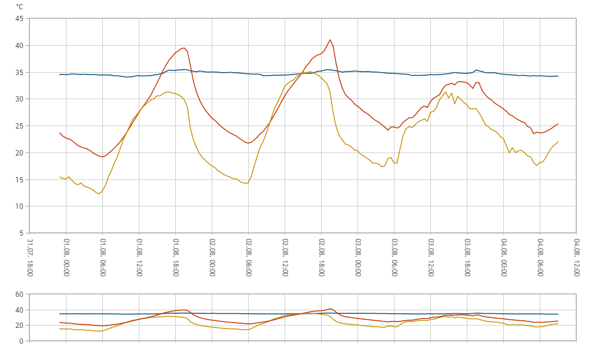
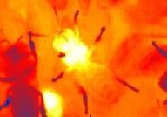
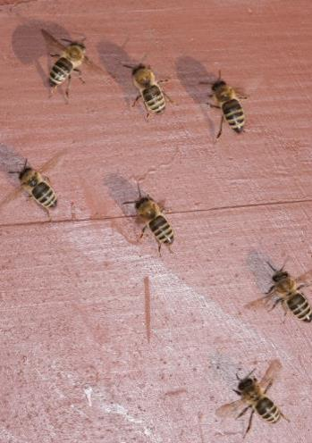

Modern Science – first Results
from the Database
Jürgen Tautz
Temperature inside the hive
Air temperature
Temperature of the hive wall (outside)
www.hobos.de
EU-project HOBeebox

Slide 8
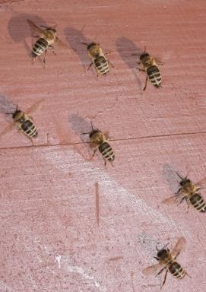
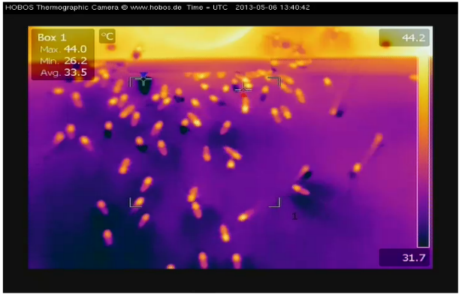
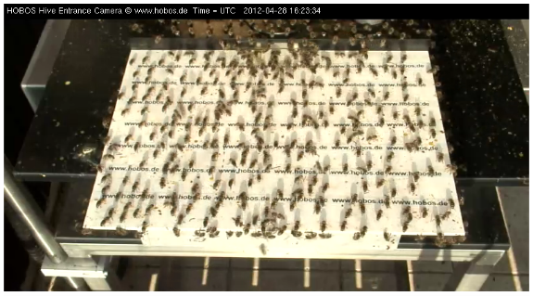
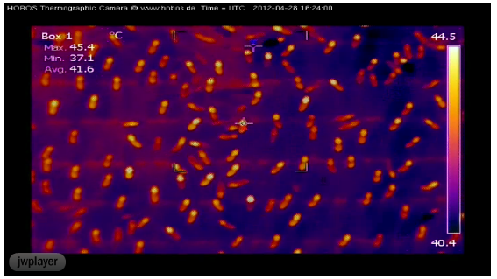
Modern Science – first Results
Jürgen Tautz
“Ventilator bees“ cool down the hive
www.hobos.de
EU-project HOBeebox

Slide 9
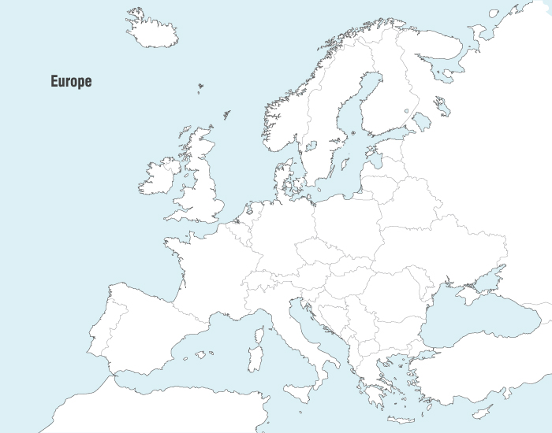

The HOBeebox spreads
the project all over Europe
Sweden
Germany
Poland
Austria
Slovenia
Italy
Croatia
Compare Data from all over Europe in the classroom
www.hobos.de
EU-project HOBeebox

Slide 10
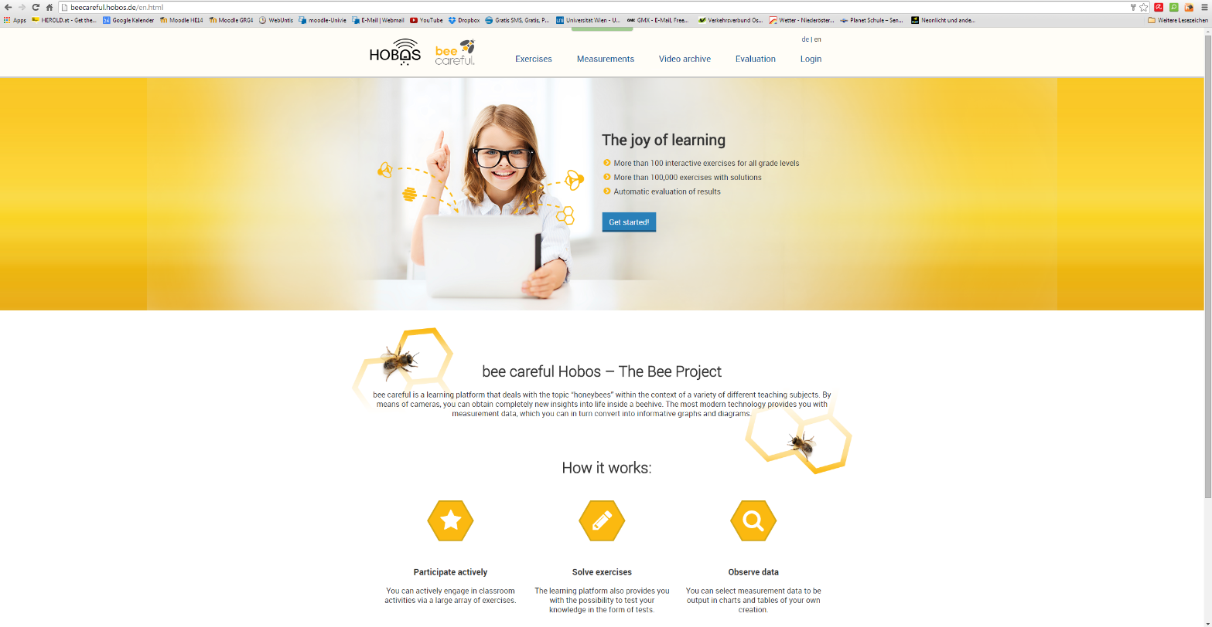
Modern education – online & offline
deal with authentic scientific data
beecareful.hobos.de
read and interpret scientific diagrams
experience to be a scientist
www.hobos.de
EU-project HOBeebox

Slide 11
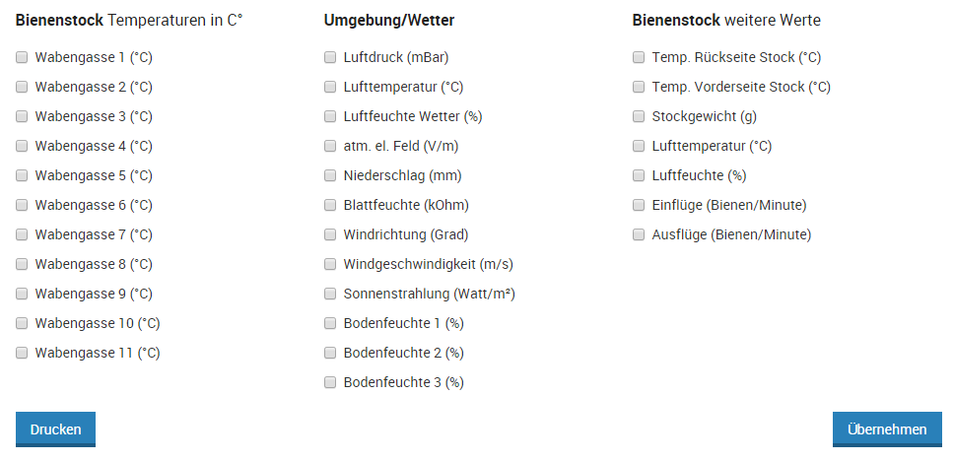
Examples for the classroom – the course of the bee year
Choose Date and time: 1.1.2012, 0:00 – 31.12.2012, 23:00
Choose Data:
air temperature
weight of the hive
temperature inside the hive
www.hobos.de
EU-project HOBeebox

Slide 12
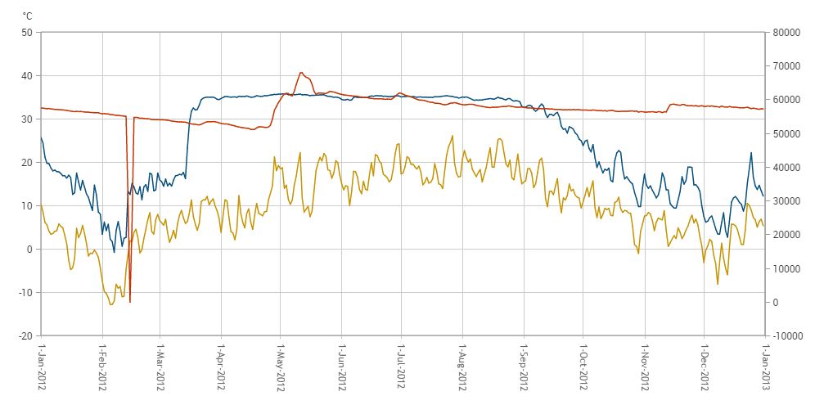

Examples for the classroom – the course of the bee year
Study the diagram and describe the graphs
form a hypothesis that may explain the course of the graphs
compare with your neighbour and discuss your ideas
Temperature inside the hive
Air temperature
weight of the hive
~5‘
www.hobos.de
EU-project HOBeebox

Slide 13
Examples for the classroom – foraging bees
Choose Date and time: 9.5.2014, 12:00 – 9.5.2014, 13:00
Choose Data:
weight of the hive
air humidity inside the hive
temperature inside the hive
bees flying out
www.hobos.de
EU-project HOBeebox

Slide 14
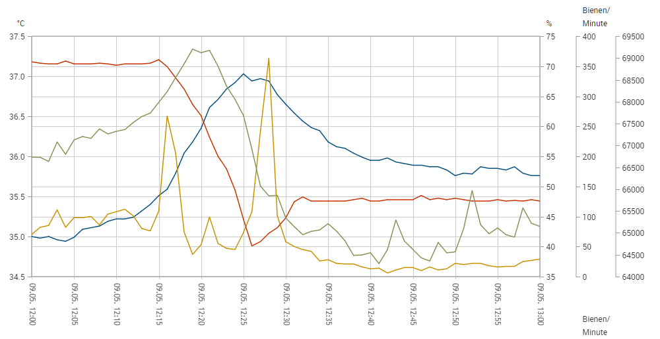
Examples for the classroom – foraging bees
Study the diagram and describe the graphs
form a hypothesis that may explain the decrease of the weight just before the main part of the bees are leaving the hive
Compare with your neighbour and discuss your ideas
Temperature inside the hive
bees flying out
weight of the hive
air humidity inside the hive
~5‘
www.hobos.de
EU-project HOBeebox

Slide 15
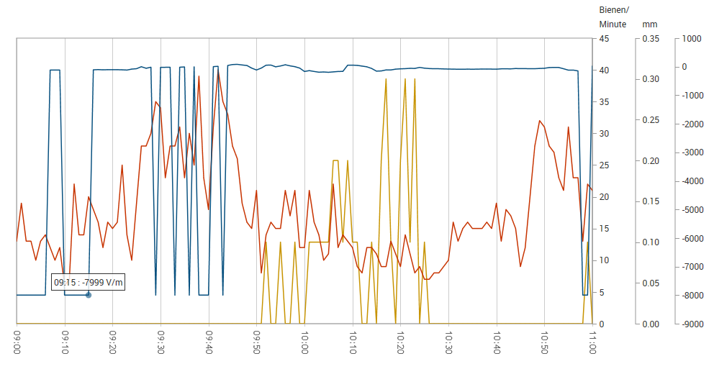
Examples for the classroom – bees and thunderstroms
Study the diagram and describe the graphs
form a hypothesis that may explain the decrease of the bees flying out just before the rain starts
Compare with your neighbour and discuss your ideas
athmospheric field
precipitation
bees flying out
www.hobos.de
EU-project HOBeebox

Slide 16
Examples for the classroom – find your own ideas
~30‘
present & discuss
www.hobos.de
EU-project HOBeebox

Slide 17
EU-project HOBeebox
Thank you for your attention!
Daniel Bengtsson & Peter Pany
daniel.bengtson@stockholm.se
peter.pany@schule.at

