Slide 1
What a plant sees
Scott Hayes

Slide 3
In the beginning, there was the heaven and the Earth.....

Slide 4
In the beginning, there was the heaven and the Earth.....

Slide 5
In the beginning, there was the heaven and the Earth.....

Slide 6
In the beginning, there was the heaven and the Earth.....

Slide 7
In the beginning, there was the heaven and the Earth.....

Slide 8
In the beginning, there was the heaven and the Earth.....

Slide 9
In the beginning, there was the heaven and the Earth.....

Slide 10
In the beginning, there was the heaven and the Earth.....

Slide 11
And then there was light!

Slide 15
Learning goals:
Explain the effect of light on plant development
Describe what kinds of light are perceived by plants and why these wavelengths are important
Describe the proteins that perceive light in plants and use this information to identify signalling mutants (Plant Detective)
Teach students about the wonders of plants!

Slide 16
Light regulates all aspect of plant development

Slide 17
Light regulates all aspect of plant development
Dark
Red light
Source: David McIntyre, https://www.macmillanhighered.com/
“Germination”

Slide 18
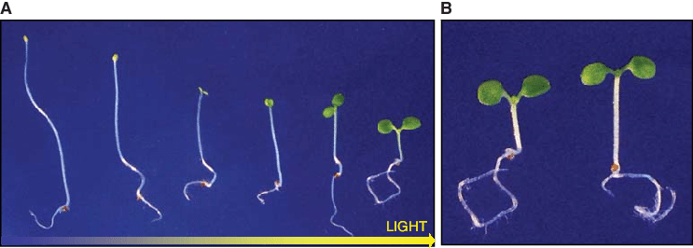
Light regulates all aspect of plant development
Source: doi.org/10.1101/cshperspect.a001586
“De-etiolation”

Slide 19
Light regulates all aspect of plant development
Source: plantmoves.nl
“Phototropism”

Slide 20
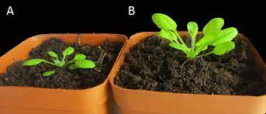
Light regulates all aspect of plant development
Light
Shade
Source: doi.org/10.3389/fpls.2020.00439
“Shade-avoidance”

Slide 21
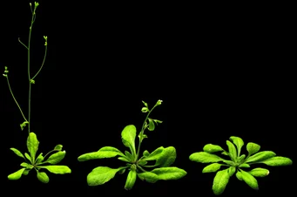
Light regulates all aspect of plant development
Short days
Long days
Source: M. Schmid- MPI for Developmental Biology Tübingen
“Flowering time”

Slide 22
Light regulates all aspect of plant development
Light
Dark
Source: doi.org/10.1186/s12870-015-0656-5
“Senescence”

Slide 23
Light regulates all aspect of plant development

Slide 24
How do plants perceive light?

Slide 25
How do plants perceive light?
Sensitivity
Wavelength

Slide 26
How do plants perceive light?
Sensitivity
Wavelength
Sensitivity
Wavelength

Slide 27
Why do plants need to sense these wavelengths?

Slide 28
Why do plants need to sense these wavelengths?
Photosynthesis!

Slide 29
Why do plants need to sense these wavelengths?
Chlorophyll absorbance
Wavelength
Plants are sensitive to blue and red light because they are needed for photosynthesis

Slide 30
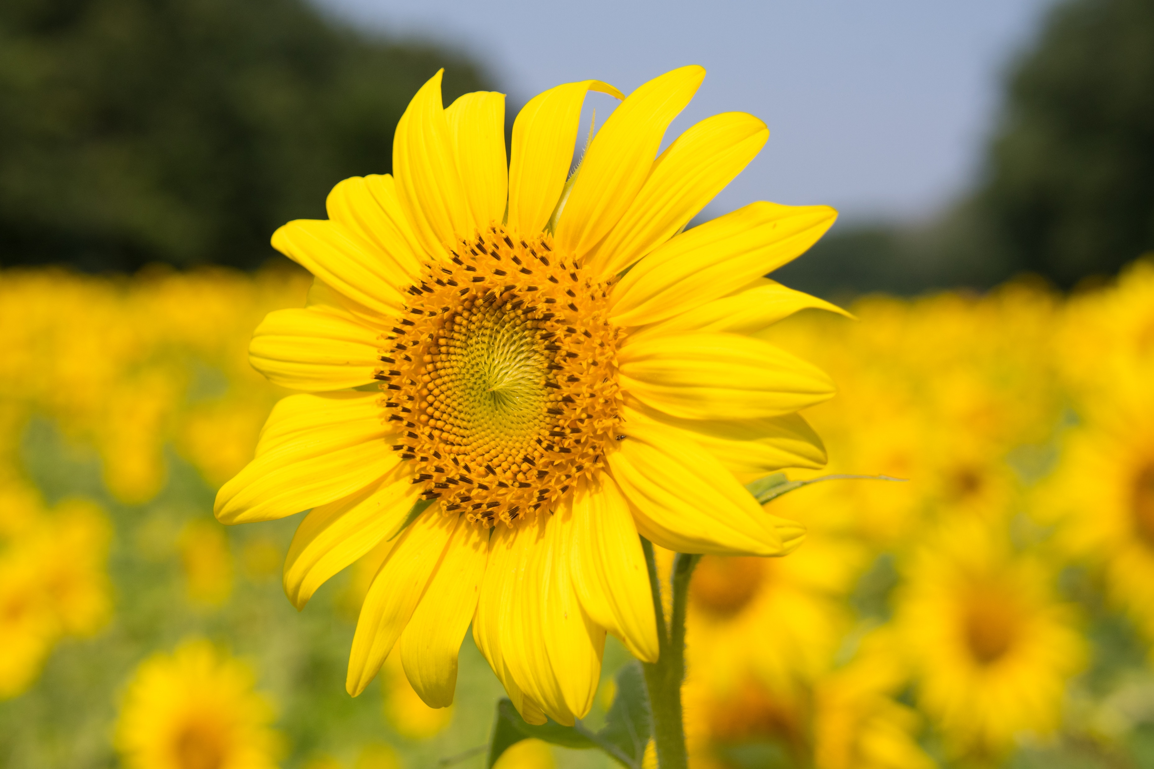
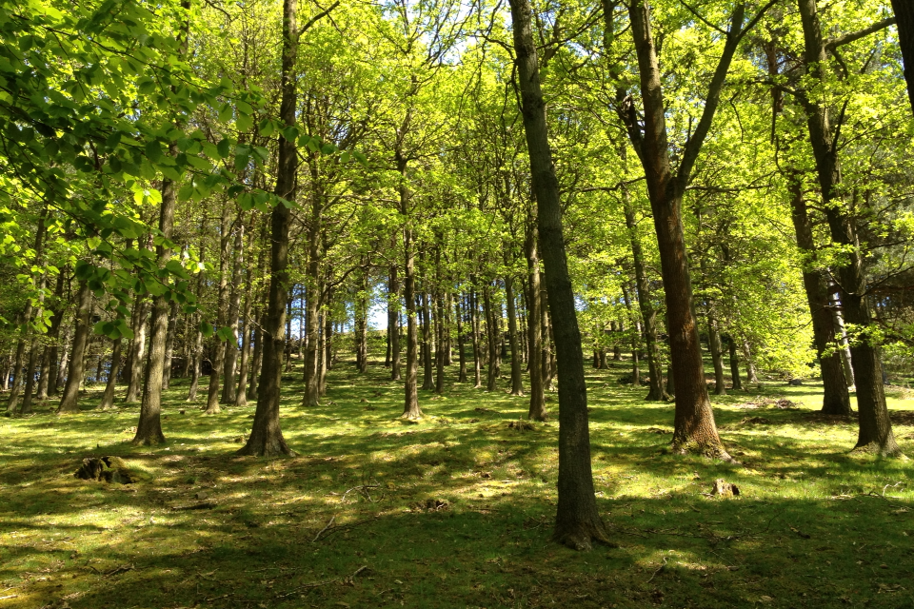
Why do plants need to sense these wavelengths?
Source: Linda Chalker-Scott, Washington State University

Slide 31
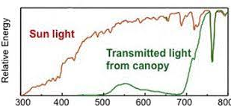
Why do plants need to sense these wavelengths?
Wavelength
Blue and red light are blocked by neighbouring plants
Source: Linda Chalker-Scott, Washington State University

Slide 32
Why do plants need to sense these wavelengths?
Wavelength
Plants increase elongation in far-red rich environments
Source: Linda Chalker-Scott, Washington State University

Slide 33
Why do plants need to sense these wavelengths?

Slide 34
Why do plants need to sense these wavelengths?
Human perspective
Source: doi.org/10.1073/pnas.1608237113

Slide 35
Why do plants need to sense these wavelengths?
Human perspective
Plant perspective
Source: doi.org/10.1073/pnas.1608237113

Slide 36
How do plants sense light?
Plant
Source: doi.org/10.1073/pnas.1608237113

Slide 37
How do plants sense light?
Plant
Source: doi.org/10.1073/pnas.1608237113

Slide 38
How do plants sense light?
Phytochrome B
Phytochrome A
Plant
Source: doi.org/10.1073/pnas.1608237113

Slide 39
How do plants sense light?
Cryptochrome 1
Phytochrome B
Phytochrome A
Plant
Source: doi.org/10.1073/pnas.1608237113

Slide 40
How do plants sense light?
UVR8
Cryptochrome 1
Phytochrome B
Phytochrome A
Plant
Source: doi.org/10.1073/pnas.1608237113

Slide 41
How do plants sense light?
UVR8
Cryptochrome 1
Phytochrome B
Phytochrome A
Zeitlupe
Plant
Source: doi.org/10.1073/pnas.1608237113

Slide 42
How do plants sense light?
UVR8
Cryptochrome 1
Phytochrome B
Phytochrome A
Zeitlupe
Phototropins
Plant
Source: doi.org/10.1073/pnas.1608237113

Slide 43
How do plants sense light?
Cryptochrome 1
Phytochrome B
Phytochrome A
Involved in de-etiolation
Plant
Source: doi.org/10.1073/pnas.1608237113

Slide 44
How do plants sense light?
Etiolated growth
Photomorphogenic growth
De-etiolation
White light
Dark
Source: doi.org/10.1101/cshperspect.a001586
Plant
Source: doi.org/10.1073/pnas.1608237113
Plant

Slide 45
How do plants sense light?
How would this plant look if it was unable to sense light?
Dark
White light
Source: doi.org/10.1101/cshperspect.a001586
Plant
Plant

Slide 46
How do plants sense light?
Cryptochrome 1
Phytochrome B
Phytochrome A
Dark
White light
Source: doi.org/10.1101/cshperspect.a001586
Plant
Plant

Slide 47
How do plants sense light?
Cryptochrome 1
Phytochrome B
Phytochrome A
How would this plant look if it was unable to sense red light?
Dark
White light
Source: doi.org/10.1101/cshperspect.a001586

Slide 48
How do plants sense light?
Cryptochrome 1
Phytochrome B
Phytochrome A
How would this plant look if it was unable to sense red light?
Dark
What if we grew it in red light?
Red light
Source: doi.org/10.1101/cshperspect.a001586

Slide 49
How do plants sense light?
Cryptochrome 1
Phytochrome B
Phytochrome A
We can use the phenotypes of mutants grown in different conditions to learn about gene function
Dark
White light
Source: doi.org/10.1101/cshperspect.a001586
Plant
Plant

Slide 50
How do plants sense light?
Cryptochrome 1
Phytochrome B
Phytochrome A
COP1
Dark
White light
Source: doi.org/10.1101/cshperspect.a001586
Plant
Plant

Slide 51
How do plants sense light?
Cryptochrome 1
Phytochrome B
Phytochrome A
COP1
Dark
White light
Growth repressing transcription factors
Source: doi.org/10.1101/cshperspect.a001586
Plant
Plant

Slide 52
How do plants sense light?
How would this plant look if it lacked COP1?
Cryptochrome 1
Phytochrome B
Phytochrome A
COP1
Dark
White light
Growth repressing transcription factors
Source: doi.org/10.1101/cshperspect.a001586
Plant
Plant

Slide 53
Mutant Detective Game
Work in teams of 3 or 4
Work-out which genes may be missing in each plant
Hint: try to find the wild type plant first!
Plant
Plant

Slide 54
Mutant Detective Game
Cryptochrome 1
Phytochrome B
Phytochrome A
COP1
Dark
White light
Growth repressing transcription factors
Source: doi.org/10.1101/cshperspect.a001586
Plant
Plant

Slide 55
Mutant Detective Game
Plant
Plant

Slide 56
Mutant Detective Game
Missing gene:
Missing gene:
COP1
Phytochrome A
Phytochrome B
A
D
Cryptochrome 1
E
Phytochrome A
B
C
F
Phytochrome B
None!

Slide 57
Summary
Light shapes the entire life cycle of plants
Plants ‘see’ light very differently to us
Phytochromes, cryptochromes are light receptors
Light acts to inhibit COP1
Plants are not passive!
Plant
Plant

Slide 58
Resources
www.plantmoves.nl
-Beautiful movies of dynamic plants
Mutant detective game and seeds
- Contact: scott.hayes@wur.nl
Plant
Plant

