Slide 1
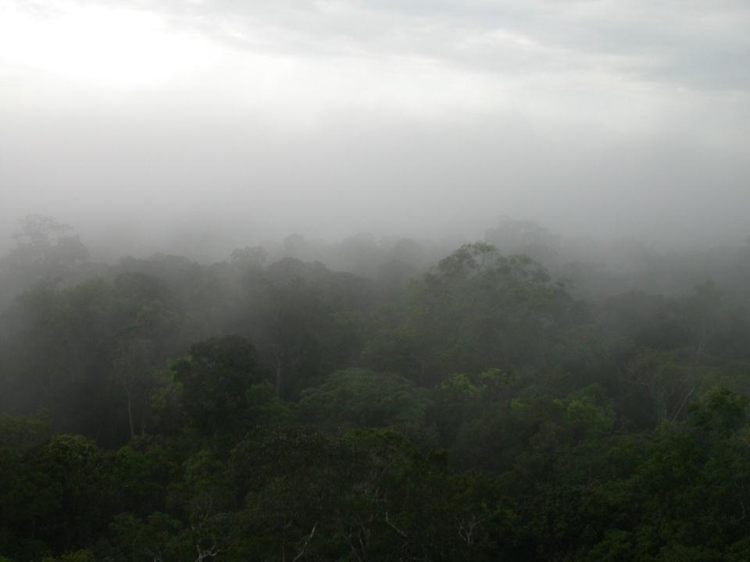
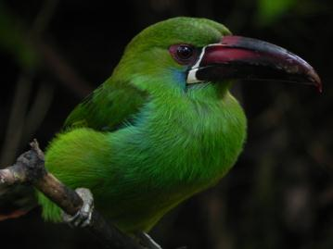
Het onstaan van de Amazone en haar diversiteit

Slide 2
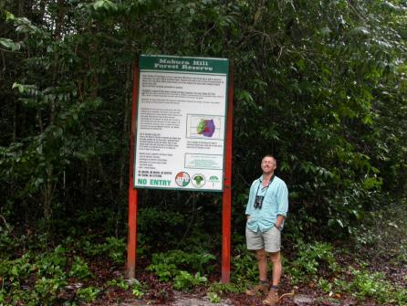
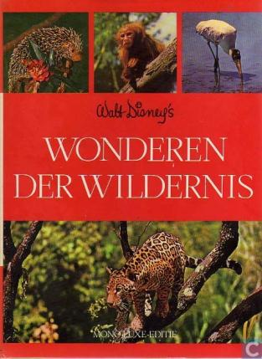
Gefascineerd door biodiversiteit
Met dank aan Walt Disney ;-)

Slide 3

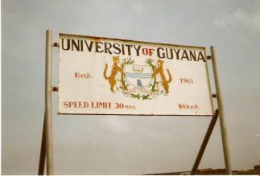
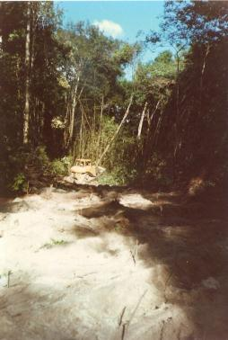
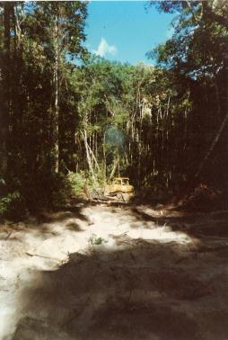
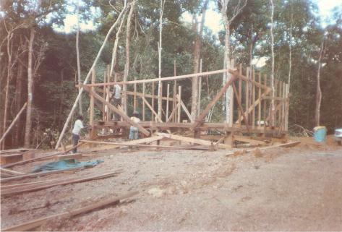
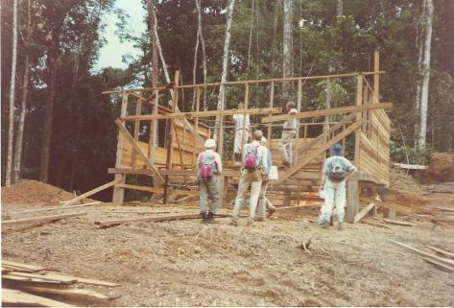
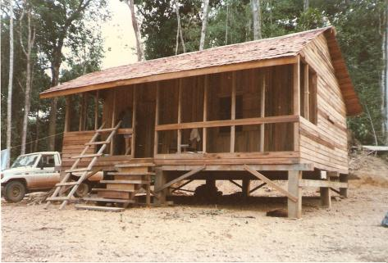

Forest Project Mabura Hill

Slide 4

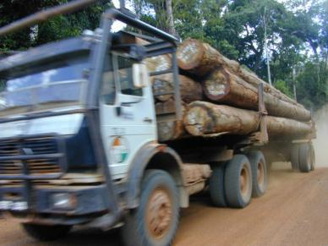
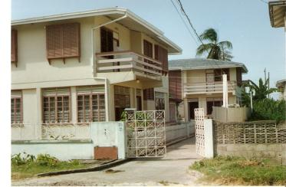
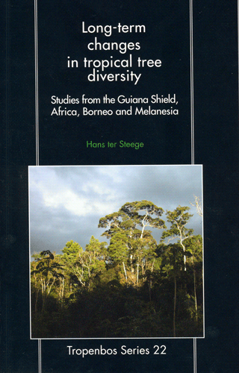
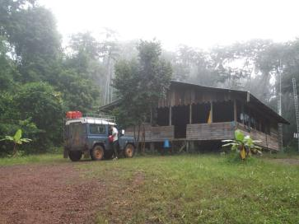
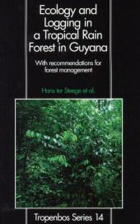
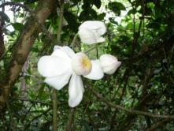
Tropenbos-Guyana Programma
Sustainable use and conservation of tropical forests

Slide 5
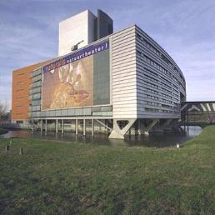
Naturalis Biodiversity Center
39 miljoen collecties
Gedeeltelijk gedigitaliseerd
Een schatkist aan diversiteit
Met nog veel onbeschreven soorten

Slide 6
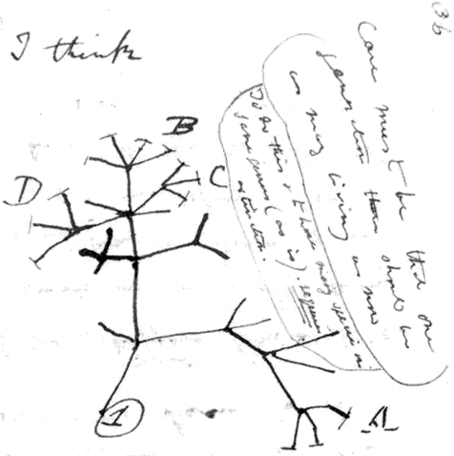
Ontdekken en begrijpen van de
‘Tree of Life’
We zijn een open archief van de diversiteit van deze ‘boom’ om
De boom van het leven te ontrafelen en begrijpen
mensen te onderwijzen over de natuur,
Mensen bewust te maken van het belang van duurzaam gebruik van onze natuurlijke hulpbronnen
Darwin's eerste boom
Notes:
As you already know from the first SAB meeting, the reconstruction and understanding of selected branches of the ToL is the ultimate aim of the Sector Research and Education within NCB Naturalis.

Slide 7
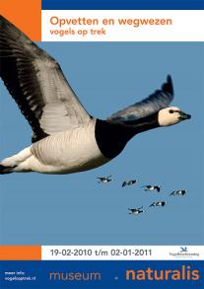
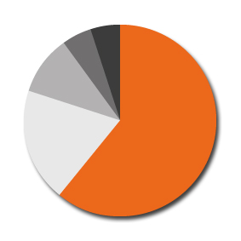


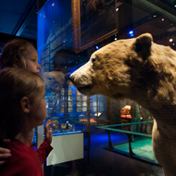
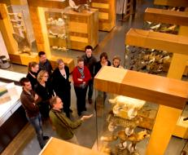
Museum Naturalis: 265.000 annual visitors
5%: Speciale
gelegenheden
5%: cultuurliefh.
10%: Natuurliefh.
61%: Families
(meest met
kinderen <12)
19%: Scholieren
en Studenten
Notes:
7

Slide 8
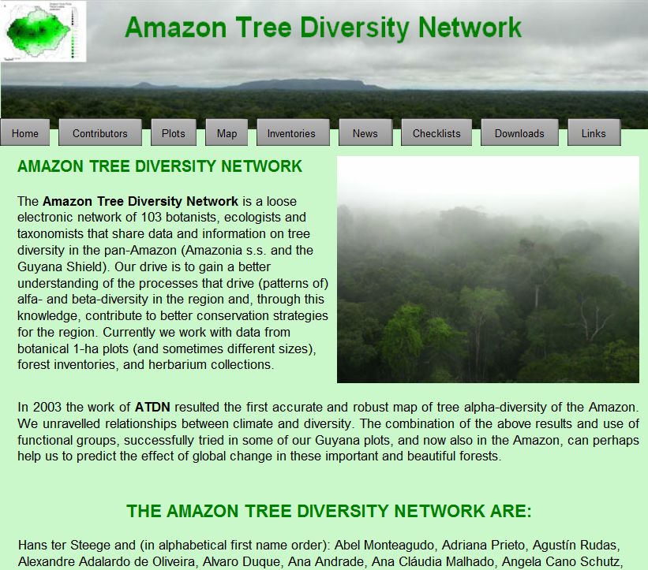
Amazon Tree Diversity Network
http://web.science.uu.nl/Amazon/ATDN/

Slide 9
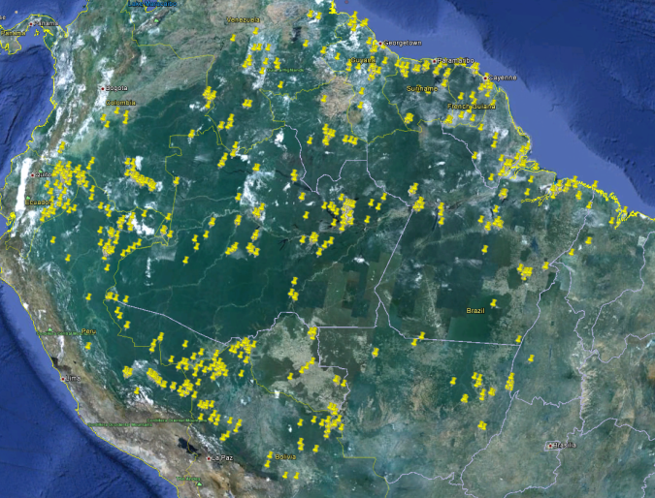
Waar zijn onze plots?
http://web.science.uu.nl/Amazon/ATDN/

Slide 10
Steeds een up to date kaart
http://web.science.uu.nl/Amazon/ATDN/

Slide 11











Een trip plannen?
http://web.science.uu.nl/Amazon/ATDN/

Slide 12
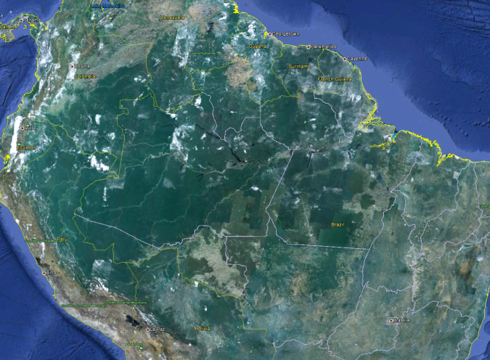
Langs de rand - een smalle strip
Source: Google earth

Slide 13
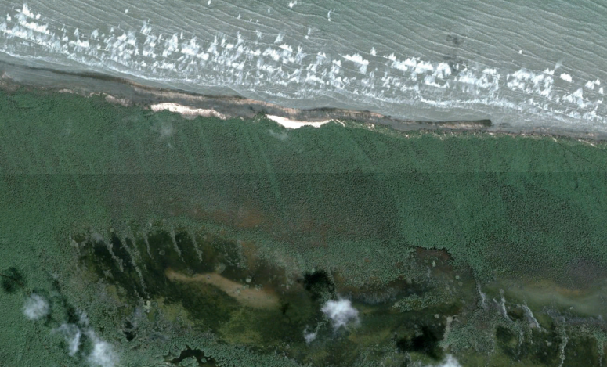
een smalle strip mangrove
Mangroves, Suriname
Source: Google earth

Slide 14
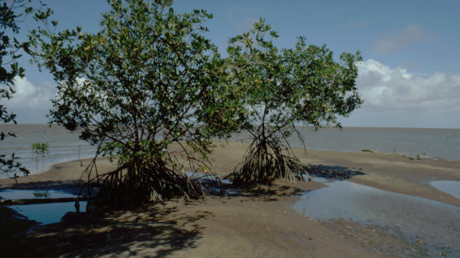
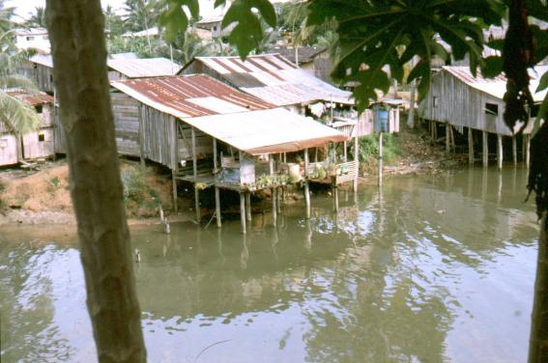
Rhizophora mangle, Fr. Guiana
San Lorenzo, Ecuador

Slide 15
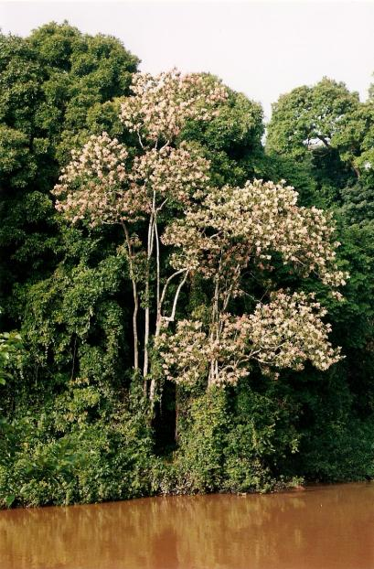
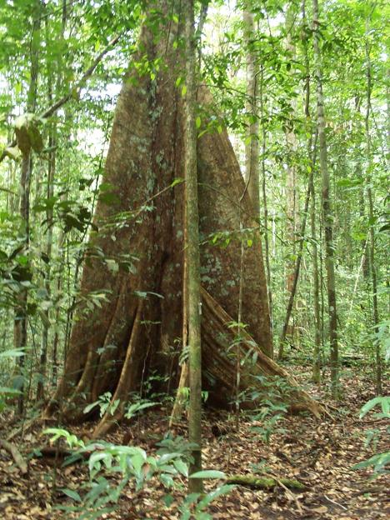
Triplaris weigeltiana
Mora excelsa

Slide 16
De “Guayana Highlands”
Source: Google earth

Slide 17
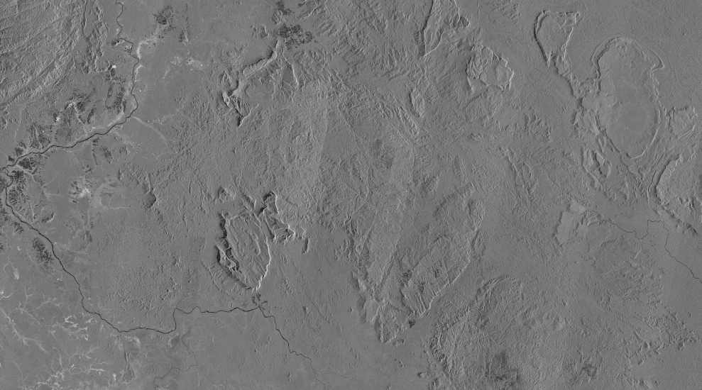
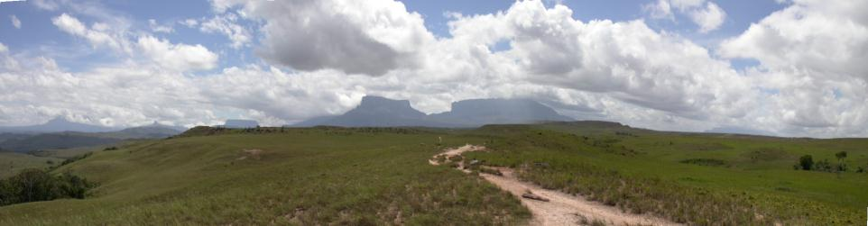
Sir Conan Doyle’s “Lost World”
Gran Sabana, Venezuala

Slide 18
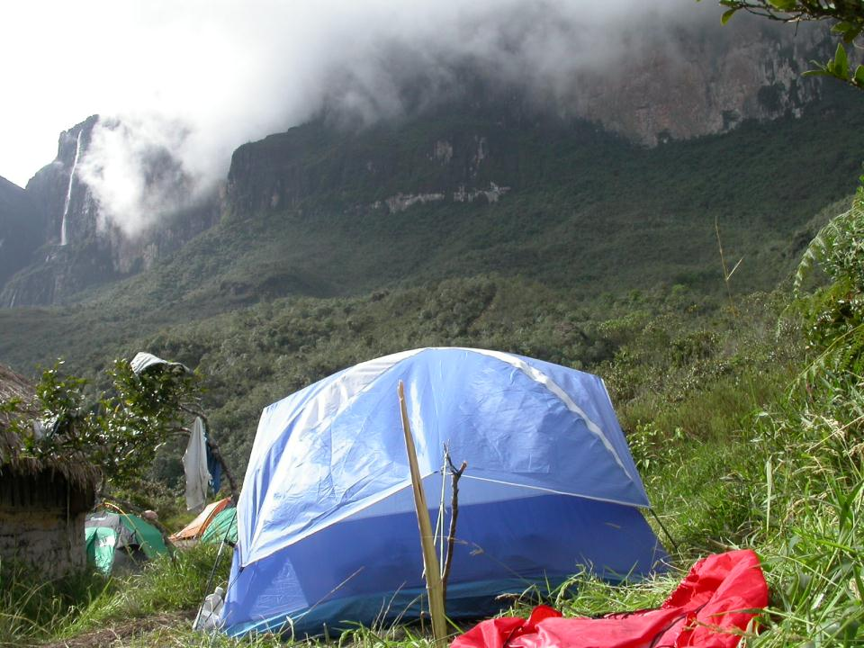
Mt. Roraima, Venezuala

Slide 19
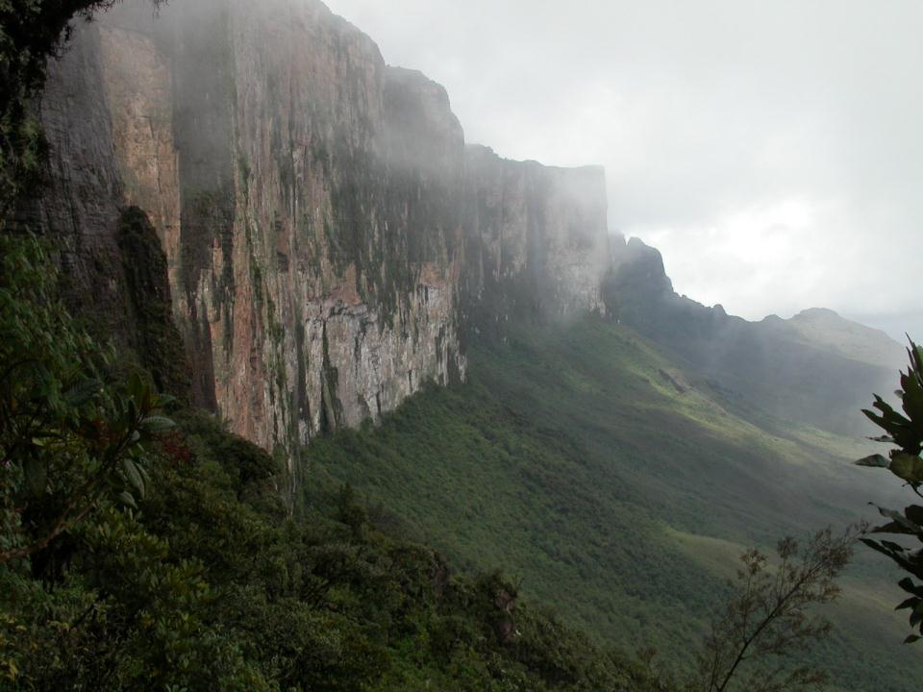
Mt. Roraima, Venezuala

Slide 20
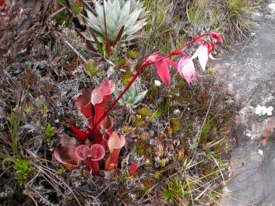
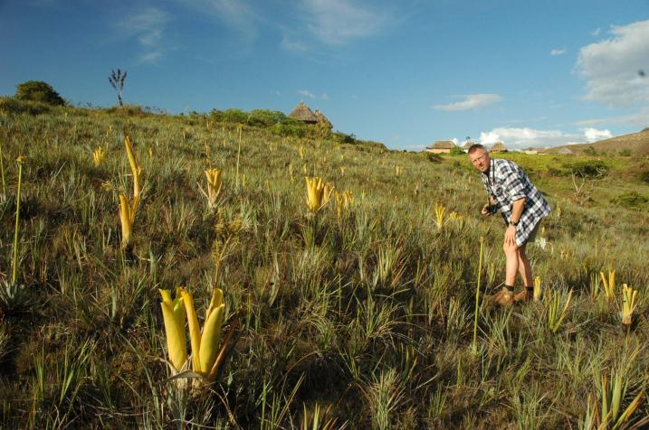
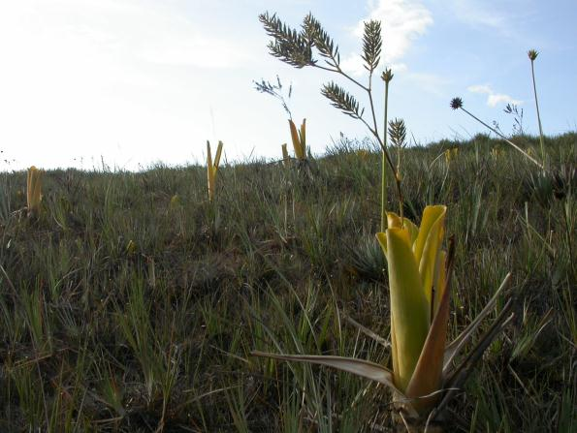
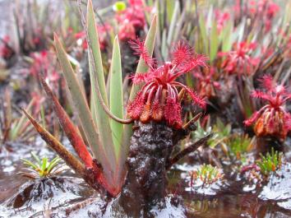
Carnivoren
Heliamphora nutans
Drosera cf. roraimae
Brocchinia reducta

Slide 21
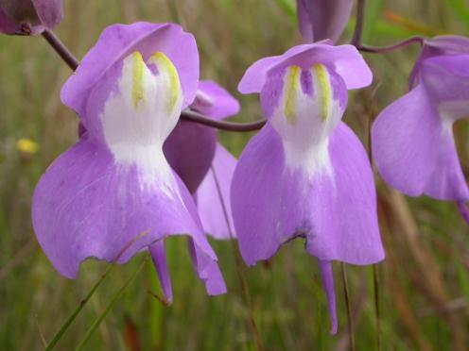
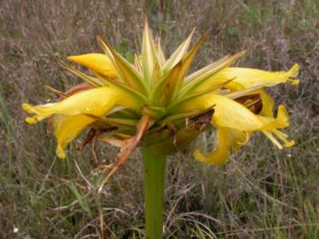
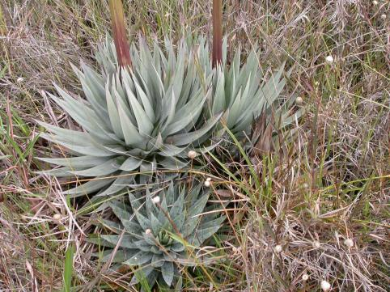
And…
Utricularia humboldtii
Orectanthe sceptrum

Slide 22
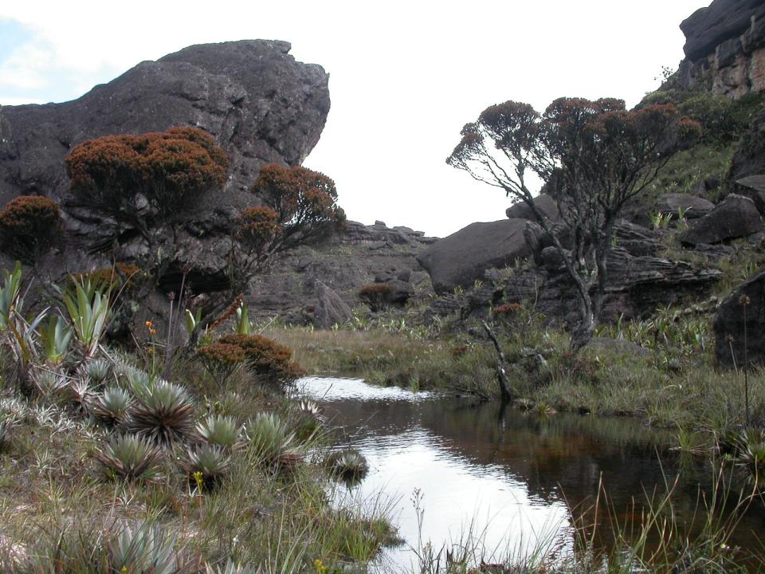
Mt. Roraima
Bonnettia

Slide 23
De Witte Zanden
Source: Google earth

Slide 24
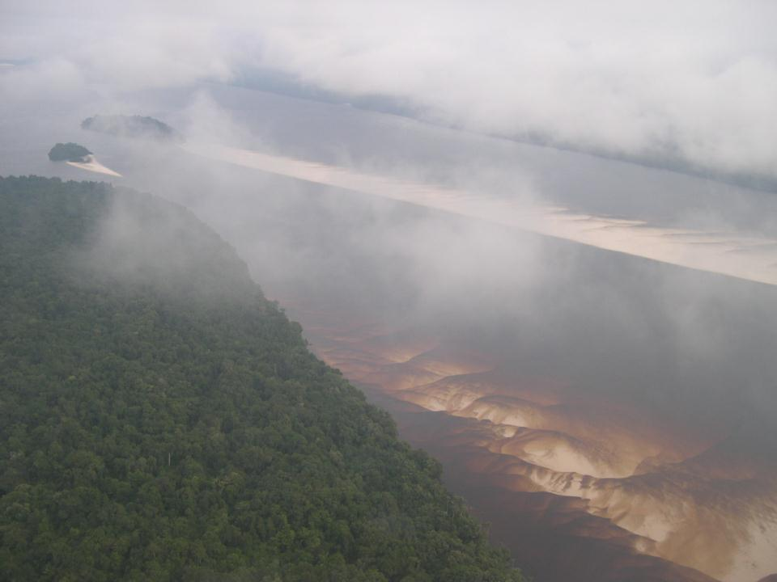
Rio Negro, Brazilie

Slide 25
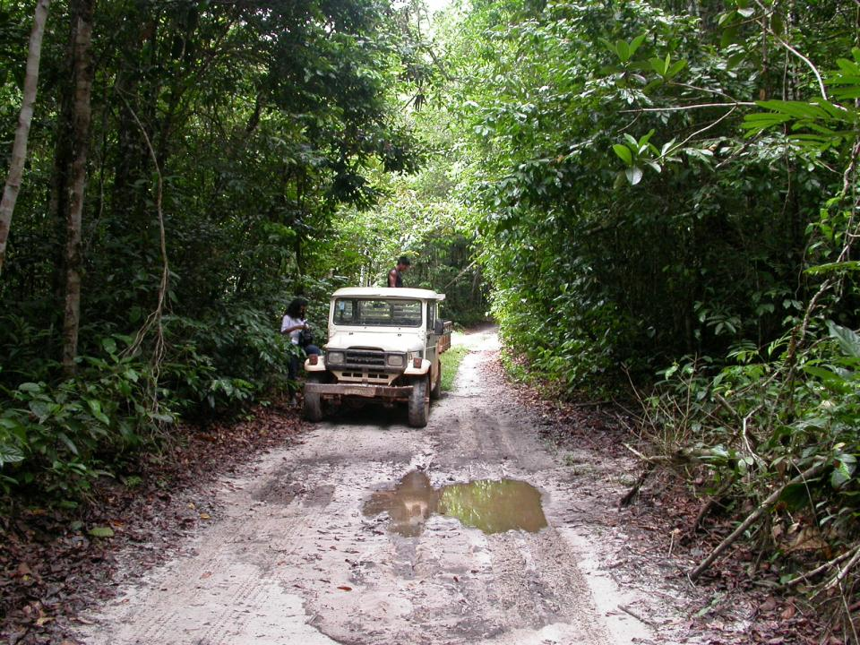
Rio Negro, Brazilie

Slide 26
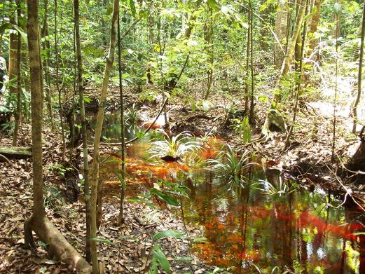
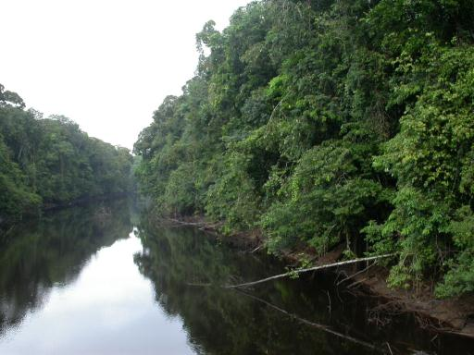
Mabura Hill, C. Guyana

Slide 27
De Andes
Source: Google earth

Slide 28
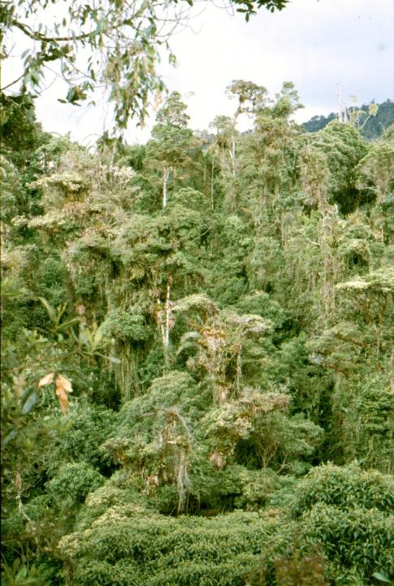
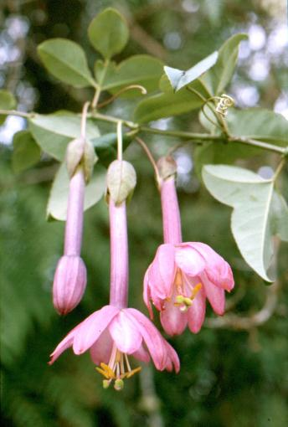
Bergbossen
Centrale Andes, Colombia

Slide 29
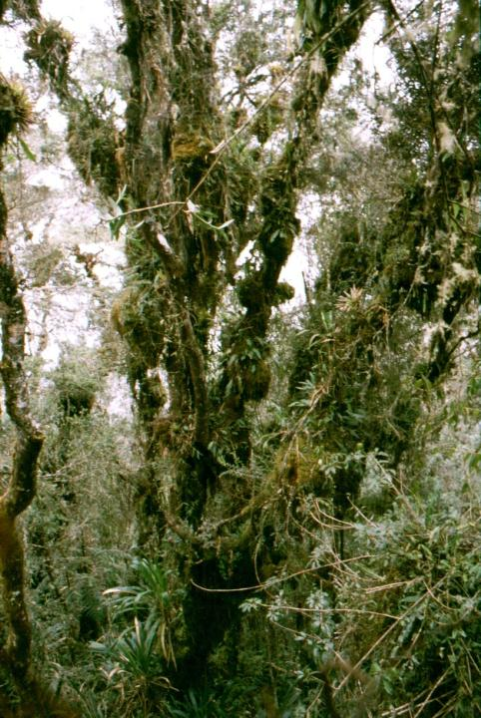
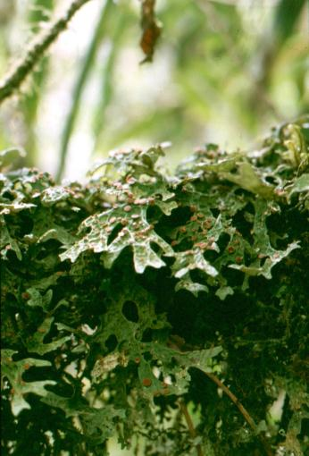
Mosbossen
Centrale Andes, Colombia

Slide 30

Paramos
Paramo de las pappas, Colombia

Slide 31
Noord en zuid rand - savannes
Source: Google earth

Slide 32

Droge savannes
Rupununi savanne, Guyana
Source: Google earth

Slide 33

Byrsonima verbascifolia, Rupununi savanne, Guyana

Slide 34

Mauritia flexuosa, Rupununi savanne, Guyana

Slide 35


Miereneter, Jaguar, Guyana (Foto Duane de Freitas)

Slide 36

Het Amazonebos

Slide 37

Centraal Amazone, Br.
Source: Google earth

Slide 38

Enorme hoeveelheden water

Slide 39

Centraal Suriname
Source: Google earth

Slide 40

Centraal Suriname
Nassau Mts. Centraal Suriname

Slide 41


Woudreus 1
Virola kwattae

Slide 42


Woudreus 2
Chimarrhis turbinata

Slide 43

Woudreus 3
Parkia nitida

Slide 44

De grootste rijkdom in het grootste bos

Slide 45

een Amazone met >15000 boomsoorten
ter Steege et al, unpublished data

Slide 46

De Rijkdom is Overweldigend
Urucu, 1 ha
N=872, S=365
Urucu, 5 ha
N=3946, S=937
Yasuni, 25 ha
N=17224, S=846
Ecuador, 72 ha
N=17224, S=3393
Sucusari A, 1 ha
N=647, S=313
Pando, 30 ha
N=18074, S=658

Slide 47

Waar komen al die soorten vandaan?

Slide 48

De Amazone 65 – 33 Ma bp
Hoorn et al. Science 2010
Notes:
The area presently known as Amazonia used to be part of a much larger “pan-Amazonian” region which, before the late Miocene (until 10 Ma), included the area of the present Amazon, Orinoco, and Magdalena drainage basins (Fig. 1A). At times this region extended to the South, into the northern Paraná region (21). We call this vast area “pan-Amazonia” because we know from the fossil record that a diverse fauna existed, elements of which are now restricted to Amazonia.
Most of Amazonia’s geologic history was centered on the Amazon Craton, the hard rock core in the eastern part of South America, but this situation changed in the course of the Cenozoic. Following continental break-up (135-100 Ma), both the growing Atlantic Ocean and plate tectonic adjustments along the Pacific margin (22) caused deformation within the Amazon Craton, and later the formation of the Andes (SOM, Fig. S1-4 and ‘Methodology’ and ‘References’). Archives of this regional history are stored within a series of north-south trending foreland basins along the Andes, the east-west trending intracratonic basins, and in the Amazon submarine fan in the Atlantic (23-25).
Testimony to the post break-up changes on the craton are alluvial and braided river deposits of Cretaceous age that accumulated in the E-W stretching sedimentary basins. These drainage systems were captured in a ‘reversed’ trunk river with westward flow (26), quite dissimilar from the present Amazon River. The drainage divide was initially situated in eastern Amazonia, but during Paleogene times (c. 65 - 23 Ma) it migrated westward (24, 27) giving way to the precursor of the modern lower Amazon River (Fig. 1 A-B). Towards the end of the Paleogene the continental divide was located in Central Amazonia and separated east and west flowing Amazonian rivers (23).

Slide 49


Cerrejon Flora (Paleoceen – 58 Ma)
onstaan moderne regenwouden
Wing et al. PNAS 2009

Slide 50

jason bourque/ nature
Geen goede plek om de hond uit te laten
Slide courtesy Frank Wesselingh 2010

Slide 51



Paleocene Cerrejon rainforest snakes: Titanoboa
jason bourque/ nature
Ray carson/ hmnh.org
Ray carson/ hmnh.org
www.vivariumsbydesign.co.uk
Slide courtesy Frank Wesselingh 2010

Slide 52

O. Grillo
Titanoboa
Slide courtesy Frank Wesselingh 2010

Slide 53










The Amazon 23 – 10 Ma bp
Hoorn et al. Science 2010
Notes:
Parallel to intensified uplift in the Andes a large wetland of shallow lakes and swamps developed in Western Amazonia (Fig. 1C; (36)). These new aquatic environments of the “Pebas” system were colonized by rapidly radiating endemic invertebrate faunas composed of mollusks and ostracods (37). It was also the stage for a diverse reptile fauna including gharials, caimans, and turtles (Fig. 2A). One of the most remarkable representatives of this now extinct fauna was Purussaurus, the largest known caiman, that reached c. 12 m in length (38).
The wetland fragmented pre-existing rainforests, yet a diverse forest that already bore resemblance to the modern forest (in terms of plant family composition) remained at the margins of this new aquatic system (15, 39). Although lower than in the Paleogene, plant diversity (as indicated by pollen types) peaked at 13 Ma, near the end of the mid-Miocene Climatic Optimum (Fig. 2A). Geochemical evidence from mollusk shells further indicates that a modern type of monsoonal climates was already present and provided a seasonal water influx into the wetland system (40). Terrestrial taxa such as xenarthrans, Gonatodes geckos and leaf beetles, as well as cichlid fish in the aquatic environments, lived and diversified in the wetlands (Fig. 2B and SOM, Table S1).
Taxa of marine ancestry in the Miocene (41) or earlier (42), such as potamotrygonid stingrays, thrived in the Amazonian freshwater wetlands. Periods with somewhat elevated salinities are also indicated by benthic foraminifera, barnacles, (marginal) marine mollusks and the geochemical signature in the mollusk shells (43). These marine invertebrates, however, were Neogene arrivals and disappeared with the withdrawal of marginal marine conditions. Other indicators of marine influence in the wetland were dinoflagellates, pollen from mangrove trees, and marine ichnofossils. Biogeographic reconstructions based on phylogenies also fit this scenario (8, 20, 41). In spite of such evidence, the extent of marine influence in Amazonia is still debated (44).

Slide 54


Orlando Grillo
Stupendemys
Slide courtesy Frank Wesselingh 2010

Slide 55



www.g1.globo.com/Divulgação
Douglas Riff
Purussaurus
Slide courtesy Frank Wesselingh 2010

Slide 56

The Amazon 10 – 7 Ma bp
De geboorte van de Amazone rivier
Hoorn et al. Science 2010
Notes:
By the end of the middle Miocene (c. 12 Ma) faster and more widespread Andean mountain building prompted peak topographic growth. This created deep canyon incision and erosion in the Central and Northern Andes, especially in the Eastern Cordilleras and in the Venezuelan Andes (SOM, Fig. S1-4) (16, 45), where alluvial megafans developed (46, 47). It also coincided with raised sedimentation rates in the Andean foreland basins that eventually became overfilled. At c. 10 Ma, coinciding with global sea level drop and climate cooling, Andean sediments reached the Atlantic coast through the Amazon drainage system, and the Amazon River became fully established at c. 7 Ma (23, 48).
Meanwhile the Western Amazonian wetland changed from a lacustrine to a fluvial or fluvio-tidal system (Fig. 1D; (36, 44, 49)), which resembled the present-day Pantanal in southern Amazonia (44). This so-called “Acre” system harbored a very rich aquatic vertebrate fauna that included mega-sized gharials, caimanines and side-neck turtles (38), which eventually declined with the disappearance of megawetlands in Western Amazonia at c. 7 Ma (Fig. 2A; (21, 37, 38). Most of the endemic mollusk fauna was unable to adapt to the initial fluvial conditions and was strongly reduced around 10 Ma (37). The floodplains of this system were dominated by grasses (50) and inhabited by a more diverse xenarthran fauna than at present (51).
Western Amazonia from then on bore the key geographic features of the landscape as we know it today (Fig. 1 E-F). It had changed from a drowning, negative relief into a positive relief incised by an increasingly entrenched river system with high sediment load. By the late Miocene, good swimmers such as proboscideans had crossed the relatively small seaway that remained between Central and South America and were at the forefront of a major immigration wave (55, 56).

Slide 57

De nieuwe Andes zorgde ervoor dat regen verder zuidwaarts werd gestuwd
IAmazon
Hydrological
Cycle
Slide courtesy Frank Wesselingh 2010

Slide 58

IAmazon
Hydrological
Cycle
Snelle stijging van de Andes (10 Ma bp) zorgde voor grote sediment instroom in de Amazone
Slide courtesy Frank Wesselingh 2010

Slide 59

The Amazon 7 – 2.5 Ma bp
Hoorn et al. Science 2010
Notes:
Preliminary palynological evidence indicates a ~10-15% increase of plant diversity between c. 7 and 5 Ma, shortly after the wetlands were replaced by forested habitats (Fig. 2A). Molecular studies of tree genera such as Guatteria (Annonaceae, c. 250 species) and Inga (Fabaceae, c. 300 species) show a similar trend of rapid diversification following the demise of Amazonian wetlands (52, 53). This suggests that the establishment of terrestrial conditions in western Amazonia may have been an important pre-requisite for the diversification of the current biota of this region. However, the actual triggers of speciation in these and other cases may have be much more complex and involve factors such as soil adaptation and plant-herbivore interactions (54).

Slide 60

The Amazon 2.5 - 0 Ma bp
Hoorn et al. Science 2010
Notes:
The final scenes of this history are characterized by further Andean uplift (Fig. 1F), closure of the Panama Isthmus (c. 3.5 Ma), Quaternary ice ages (2.5 Ma – 0.01 Ma) and restriction of megafans in the foreland basin zone. This, together with neotectonic processes in Amazonian lowlands (27), caused uplift of the Neogene deposits, development of widespread river terrace systems, and readjustments of river patterns, and led to the mosaic-type landscape of the present (57). The accelerated uplift phases in the last 10 Ma fostered spectacular radiations of highland plants such as lupines (58), as well as tanagers, bumblebees, and some rodents (Fig. 2B and SOM, Table S1). This was also a time of extensive migration, when both Amazonia and the new montane habitats in the Andes were colonized by taxa of North American descent during the ‘Great American Biotic Interchange’ (GABI) (55).
The GABI caused decline in the number of endemic South American mammal families during the Pliocene and especially the Quaternary. However, overall generic diversity of South American mammal taxa remained stable and the total number of genera increased by the strong diversification of taxa derived from North American immigrants (55) (Fig 2A). Molecular studies suggest that many bird lineages also took part in the GABI (59, 60). By contrast, plants have been more capable of overseas dispersal and many lineages crossed the Panama Isthmus before its final closure (61), while others probably reached South America directly from Africa (62). These results, based on molecular and fossil studies, suggest that immigrants from other landmasses have played an important role in the historic assembly of the Amazonian biota (63).

Slide 61








The West is the best…
The Doors, 1967
Notes:
A comparison of present biodiversity patterns with geologic and edaphic units shows that the highest concentrations of terrestrial mammal and amphibian richness peak on Western Amazonian soils that developed on the Neogene (Andean) sediments (Fig. 3A; SOM, Fig. S6-7). These soils show much higher variation in levels of nutrients and are in stark contrast to generally nutrient-poor soils on the craton in Eastern Amazonia (64). Forest productivity and forest dynamics are also higher on these soils (SOM Fig. S8), suggesting a link between bedrock composition, diversity, and ecosystem productivity (65).
Water geochemistry, sediment composition and fertility of floodplains further confirm the disproportionate richness in nutrients of the Andean system versus that of relative nutrient poverty in the ‘cratonic’ aquatic system (66). It seems paradoxical that the old Amazon Craton, that had the opportunity to accumulate taxa for a much longer period than the young areas in western Amazonia, has fewer species, genera, and families.
Nutrients and habitat heterogeneity are paramount in Amazonian diversity, but they are not the only ingredient. Tree alpha-diversity (i.e. the diversity measured on 1-ha plots) peaks in the wetter, less seasonal part of western Amazonia (Fig. 3B), suggesting a role for climate in sustaining (and perhaps also driving) diversity (65). By contrast, highest levels of mammal diversity appear little affected by rainfall seasonality, from a-seasonal Ecuador down to highly seasonal Bolivia (Fig. 3A; SOM Fig. 6D), suggesting that additional factors – such as productivity –need also be considered.

Slide 62
Allopatrische soortvorming
In allopatrische soortvorming beperkt geographische isolatie gen uitwisseling tussen populaties
Reproductieve isolatie kan dan onstaan door natuurlijke selectie, genetische drift, of sexuele selectie in de twee geisoleerde populaties
Campbell & Reece, 2008

Slide 63

Bewijs allopatrische soortvorming
Gebieden met veel geographische barrieres hebben vaak meer soorten dan gebieden zonder.
Schipper et al. Science 2008

Slide 64

De Refugium theory van Haffer 1969
Prance, 1982

Slide 65

De Refugium theory van Haffer 1969
Terborgh, 1992

Slide 66

De meeste speciatie is te vroeg
Hoorn et al. Science 2010

Slide 67


Soortvorming vogels vooral in de Andes
NatureServe 2010

Slide 68

Rivieren als barrieres
Ayres, Am Nat 1992

Slide 69


Rivieren als barrieres
Ribas et al, Proc. R. Soc. B 2012

Slide 70
Sympatrische soortvorming
In sympatrische soortvorming isoleert een reproductieve barriere een deel van een populatie zonder geographische isolatie
Sympatrische soortvorming kan het gevolg zijn van polyploidy, zeer strerke natuurlijke selectie, of sexuele selectie
Campbell & Reece, 2008

Slide 71




Ecologische soortvorming
Fine et al., Science 2004, Evolution 2005

Slide 72

Neutrale
Soortvorming als afstand and reproductieve isolatie limiteren
Aguiar et al, Nature 2009

Slide 73





Kan bodemvruchtbaarheid bijdragen?
Vruchtbaarheid drijft productiviteit
Productiviteit drijft dynamiek
Dynamiek beinvloedt de regeneratie tijd
Taxa met korte RT hebben hogere speciatiesnelheden (Verdu, Evolution 2002)

Slide 74
Dus…?
De hoge soortenrijkdom in het westen van de Amazone zou verklaard kunnen worden door
Soorten uit de Andes
Korte generatietijd van de soorten = snellere evolutie
Sympatrische soortvorming beinvloed door bodemverschillen

Slide 75
Zijn oerwouden groene longen?
Nee – een bos in evenwicht produceert evenveel zuustof bij opbouw als het gebruikt bij afbraak.
Ja – op dit moment (met verhoogde CO₂) neemt het bos meer op dan het afgeeft.

Slide 76




Maar…het klimaat veranderd
Vooral droogtes die potentieel meer gaan optreden zijn een probleem
Dit kan van Amazone bos een CO₂ producent maken in plaats van een opslag

Slide 77

De droogte van 2005
Phillips et al 2009, Science

Slide 78
Maar…het klimaat veranderd
Vooral droogtes die potentieel meer gaan optreden zijn een probleem
Dit kan van Amazone bos een CO₂ producent maken in plaats van een opslag
Maar ‘Global Change’ is meer
dan klimaatverandering

Slide 79


Wegen doorkruisen de Amazone
Roraima, Br. Source: Google earth
De situatie in 2020.
Boven optimistisch
Beneden pessimistisch
Laurance et al 2001

Slide 80



Global Change is meer dan klimaat
Roraima, Br. Source: Google earth
Rondonia, Br
Source: Google earth
Centraal Guyana

Slide 81



The Hamburger connection

Slide 82




Soja
8 miljoen ha

Slide 83



Biofuel: oplossing of bedreiging?

Slide 84


Biofuel: oplossing of bedreiging?

Slide 85


Witte energie - niet CO₂ neutraal
Brokopondo stuwmeer, Suriname. Source: Google earth

Slide 86



Flooding the land, warming the earth
“Some tropical reservoirs have an impact many times greater than even the dirtiest fossil fuel equivalent”

Slide 87



Alluminium/IJzer
Guymine, C. Guyana. Source: Google earth
Trombetas, Br. Source: Google earth

Slide 88


Goud - legaal
Omai, C. Guyana. Source: Google earth

Slide 89


Goud - illegaal
Central Suriname. Source: Google earth

Slide 90



Bosbouw – Duurzaam of niet?
Demerara Timbers Ltd. C. Guyana

Slide 91




Urucu, Br.
Source: Google earth

Slide 92




Waar is de fragmentatie het grootst
World Fire Atlas hot pixels from 1996-2006

Slide 93



REDD++
Reduction in Emissions from Deforestation and Degradation
Koolstofmarkt

Slide 94


Heeft het effect?

Slide 95


Tot slot: er ook beschermd
http://ecosynapsis.net/RANPA_EN/indexEN.htm

