Slide 1
Energy and matter at the origin of life
Nick Lane
Professor of Evolutionary Biochemistry
University College London

Slide 2
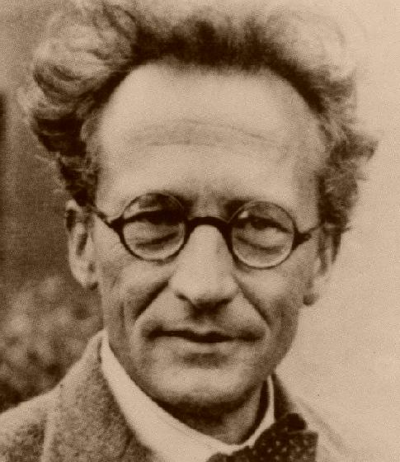
What is life?
Genes
“Chromosomes … contain in some kind of code-script the entire pattern of the individual's future development and of its functioning in the mature state”
Entropy
“Life feeds on negative entropy…The device by which an organism maintains itself stationary at a fairly high level of orderliness really consists in continually sucking orderliness from its environment”
Erwin Schrödinger
Notes:
2

Slide 3
What is living?
Genes
“Chromosomes … contain in some kind of code-script the entire pattern of the individual's future development and of its functioning in the mature state”
Energy
“If I had been catering for physicists alone I should have let the discussion turn on free energy instead.”
Erwin Schrödinger
Notes:
3

Slide 4

What is free energy?
Free energy is the energy available to power work e.g. muscle contraction
All our energy comes from burning
food in oxygen – cell respiration
Respiration generates heat – entropy! –
but free energy is conserved as ATP
Humans turn over our own
bodyweight in ATP every day
ADP + Pi ATP
Rich P. Nature 421: 583 (2003).
Notes:
4

Slide 5
Is there a universal form of free energy conservation across all living things?
Yes:
Proton gradients across membranes
are as universal as the genetic code
But:
The machinery of membrane bioenergetics is extremely complex…

Slide 6
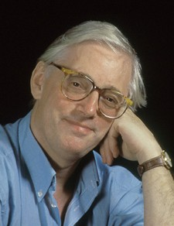
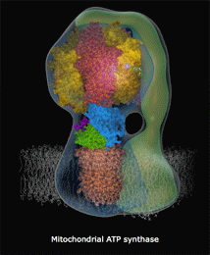

Astonishing molecular machines…
ATP synthase is an amazing rotary motor set in the membrane –
a turbine
Sir John Walker

Slide 7
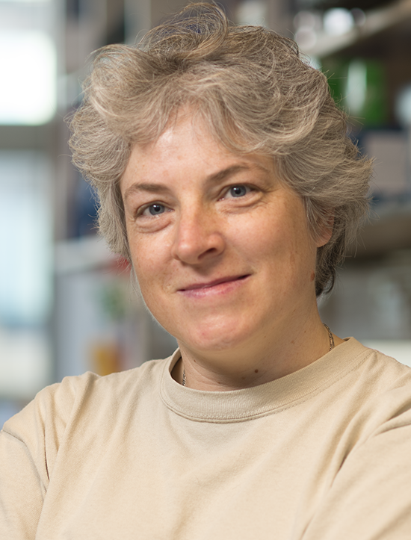
…. are clearly not prebiotic
Judy Hirst
Zhu J, Vinothkumar KR, Hirst J. Nature 536: 354-3588 (2016).

Slide 8
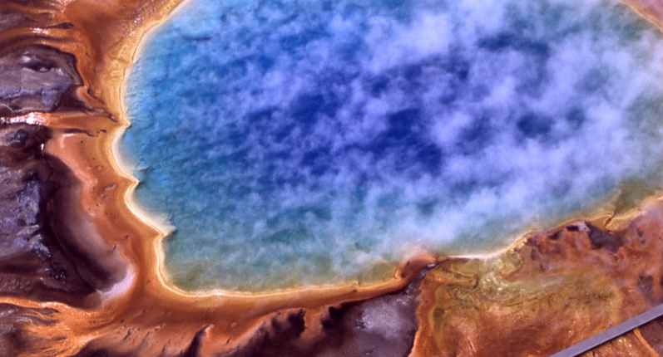
More believable sources of primal energy?
Cyanide
Cyanoacetylene
Formamide
UV radiation
Lightning
Zn sulphide
Wet-dry cycles
Jim Peaco, National Park Service via Wikimedia

Slide 9

Frankenstein chemistry
The unnatural origin of life
No resemblance between prebiotic chemistry and biochemistry
Substrates – cyanide, cyanamide, formamide, PAHs (buckyballs from outer space!)
Solvents – formamide, silicate gels, supercritical water, wet-dry cycles
Catalysts – iron pyrites, borate, ZnS
Reaction pathways – cyanosulfidic protometabolism
Energy coupling – pyrites pulling, UV, heat, lightning, ZnS photosynthesis, radioactivity, proton radiation

Slide 10
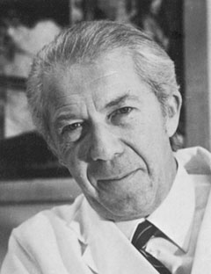
Can life give insight into its own origins?
How did protometabolism come to be replaced by metabolism? The obvious answer to this question is that the appearance of catalysts, whether ribozymes, protein enzymes, or both, was responsible for the transition...
We have to ask how catalysts with appropriate properties came to appear...
The only scientifically plausible explanation is that the catalysts arose through selection...
Enzymes are selected only if they fit into protometabolism
Christian de Duve

Slide 11
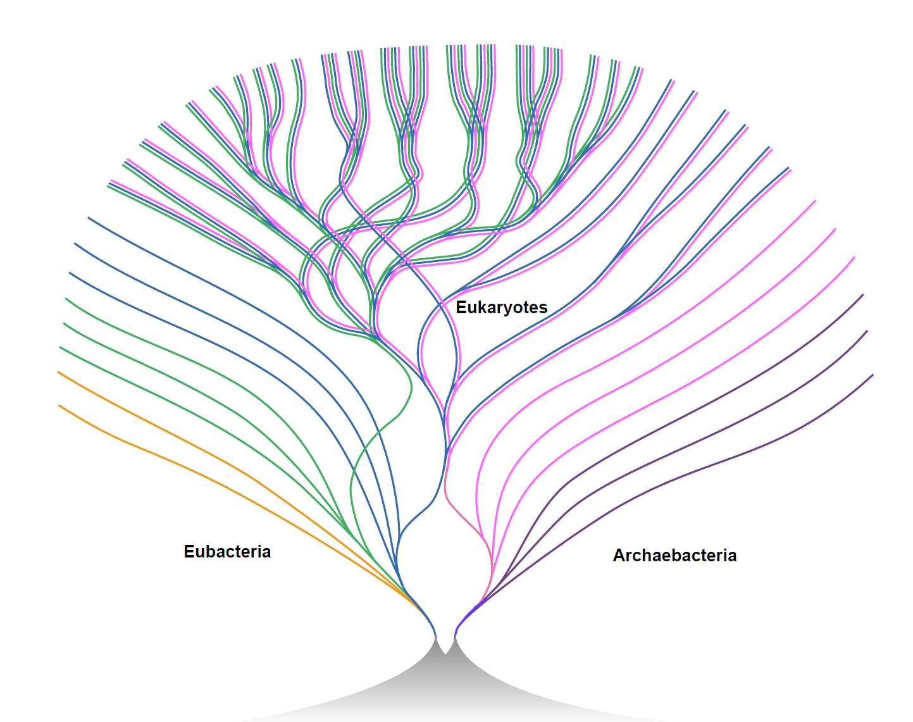
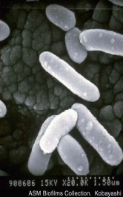
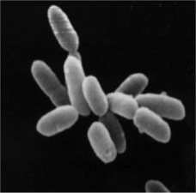
What were the earliest cells like?
LUCA was the ancestor of bacteria and archaea
Bill Martin
Bacteria
Archaea
Martin W. Mosaic bacterial chromosomes: a challenge en route to a tree of genomes. BioEssays 21: 99–104 (1999).
LUCA

Slide 12
Paradoxical traits of bacteria and archaea
Same | Different
Universal genetic code | Cell membrane
Ribosomes | Lipid synthesis enzymes
Transcription | Cell wall
Translation | Glycolysis
Krebs cycle (in part) | DNA replication
Membrane bioenergetics | Respiratory chains
What kind of cell was LUCA?

Slide 13
The paradox of membrane bioenergetics
Membrane bioenergetics are universal
but membranes are not
Niels Bohr: “How wonderful that we have met with a paradox. Now we have some hope of making progress”
Paradox could be resolved if life originated in an environment with geological proton gradients
Is there such a place?

Slide 14
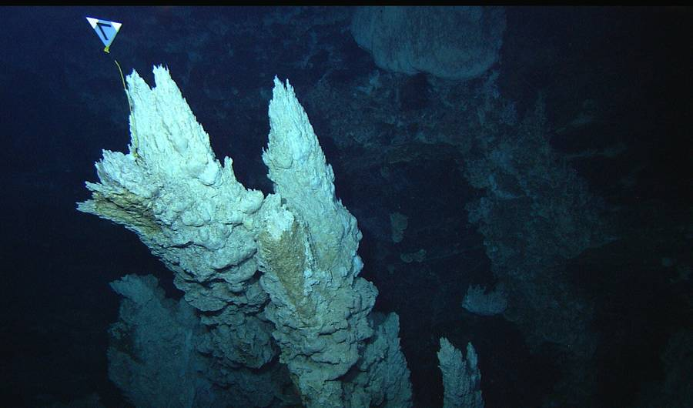
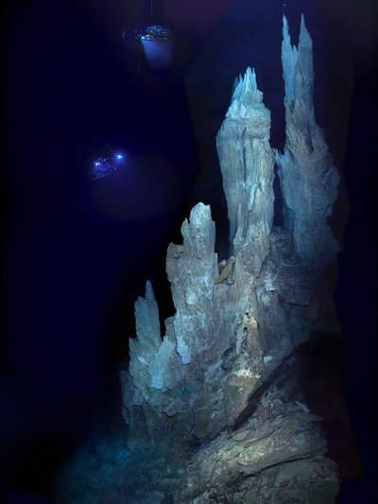
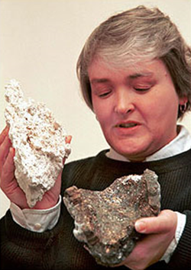
Alkaline hydrothermal vents
Deborah Kelley
Lost City vent field
Notes:
14

Slide 15
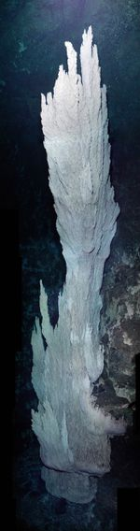
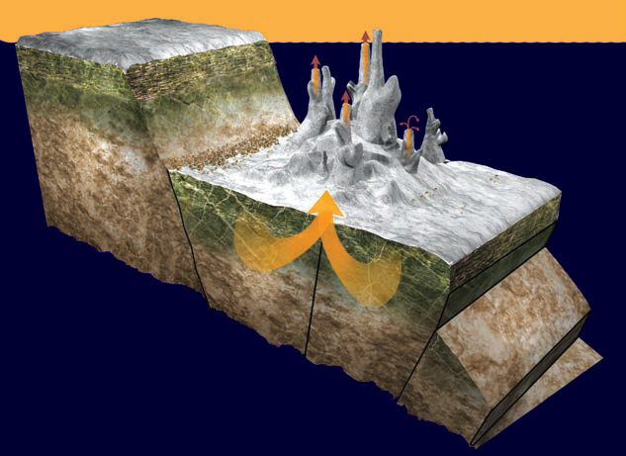
Serpentinization and Lost City
Alkaline vents are formed by the exothermic oxidation of Fe²⁺ in olivine by water to form serpentinite
They should form on any wet rocky planet or moon
Scientific American

Slide 16
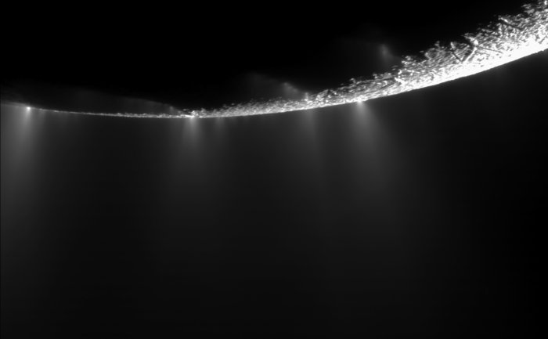
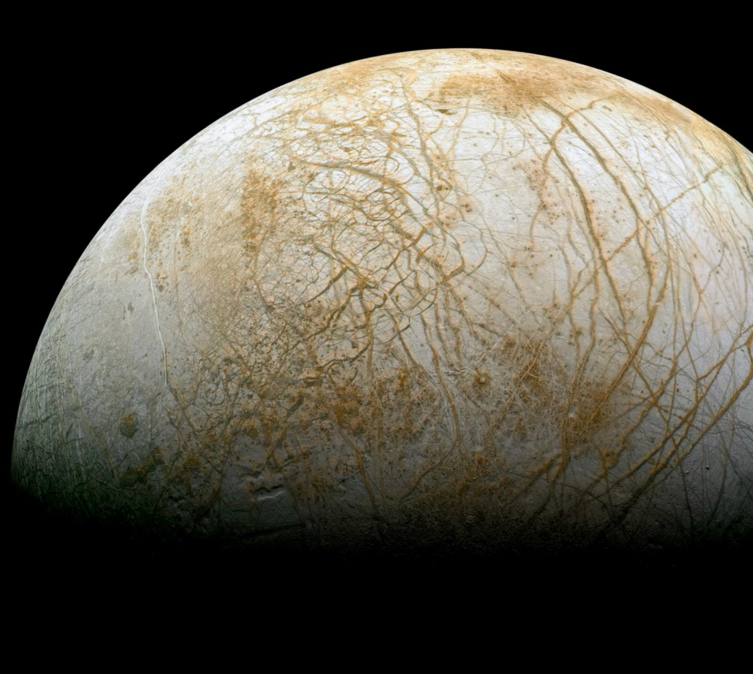
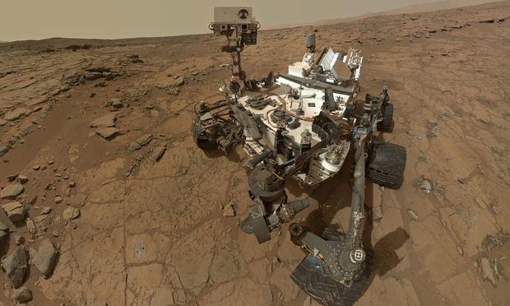
NASA are now interested in alkaline vents
Enceladus – alkaline ocean, pH 10 plumes
Methane on Mars? (Curiosity Rover)
Europa’s oceans may be larger than Earth’s

Slide 17
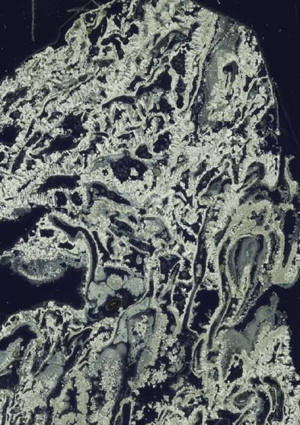
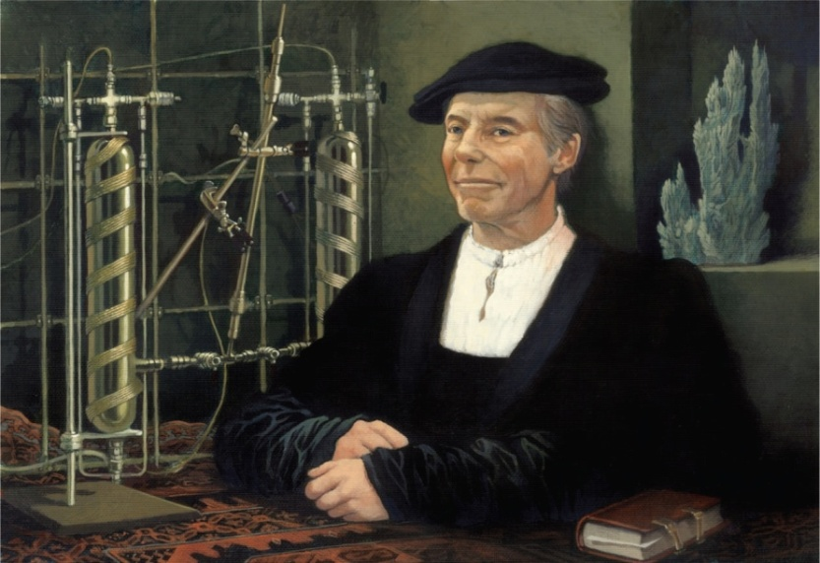
Electrochemical flow reactors
Mike Russell, Nascence Man
High concentrations of H₂ and CO₂
Proton gradients across catalytic FeS walls
0.5 mm

Slide 18
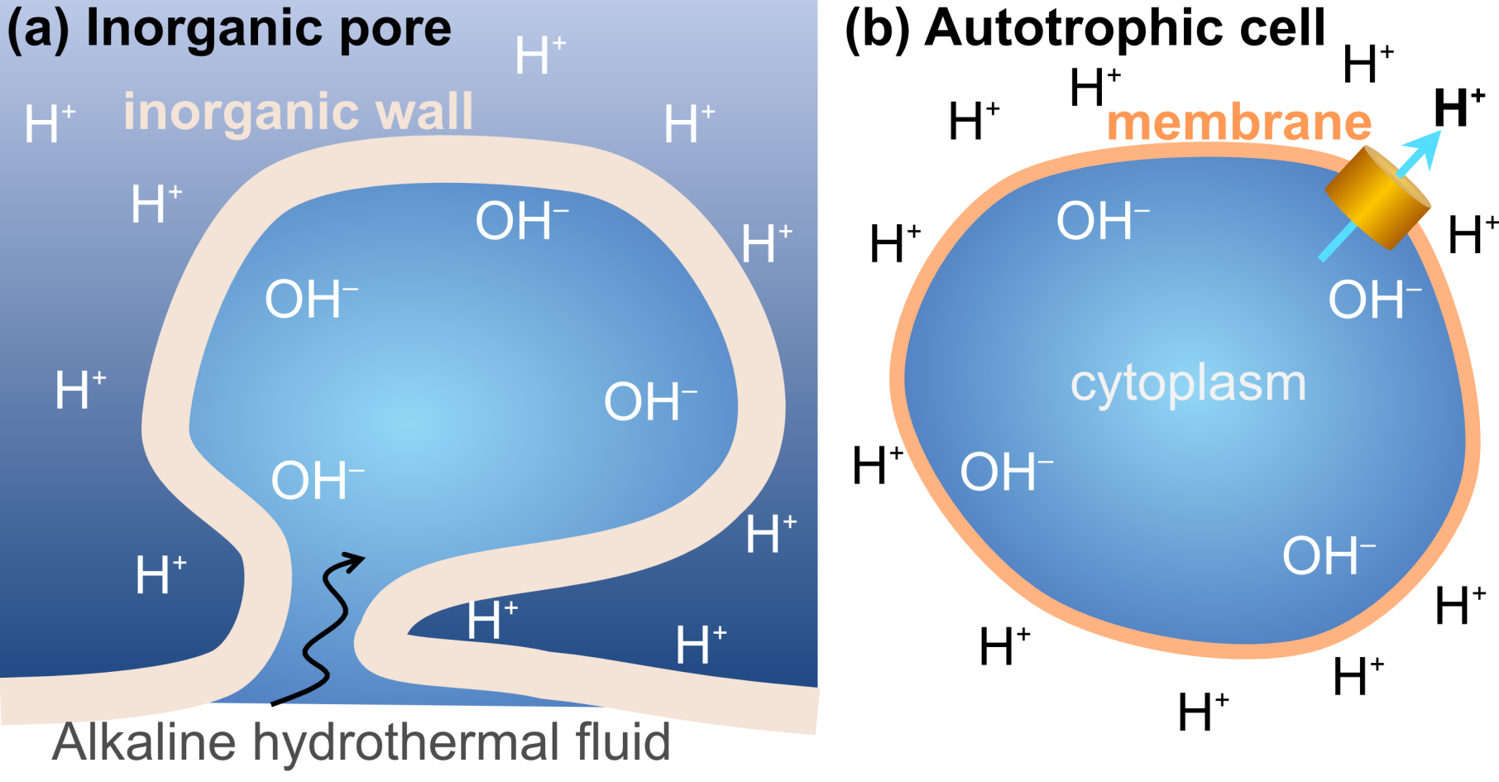
Vents pores are analogous to cells
Sojo V, Herschy B, Whicher A, Camprubi E, Lane N. The origin of life in alkaline hydrothermal vents. Astrobiology 16(2): 181-197; 2016.

Slide 19
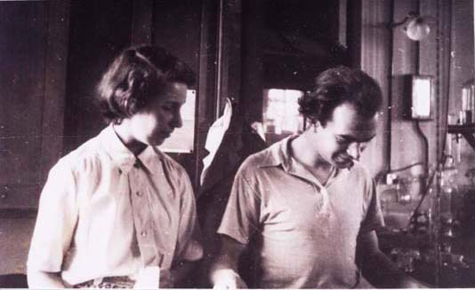
Proton gradients are fundamental
“Not since Darwin has biology come up with an idea as counterintuitive as those of, say, Einstein, Heisenberg or Schrödinger…” Leslie Orgel
“I cannot consider the organism without its environment… from a formal point of view the two may be regarded as equivalent phases between which dynamic contact is maintained by the membranes that separate and link them.”
Peter Mitchell, 1957
Jennifer Moyle and Peter Mitchell
Notes:
19

Slide 20
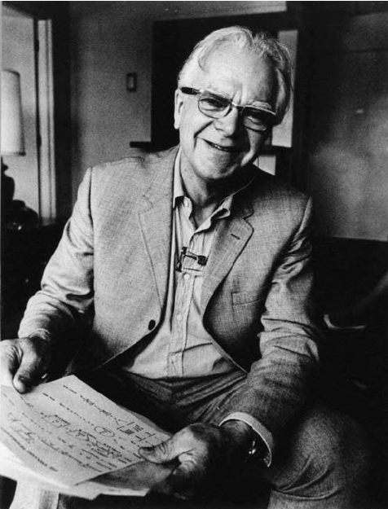
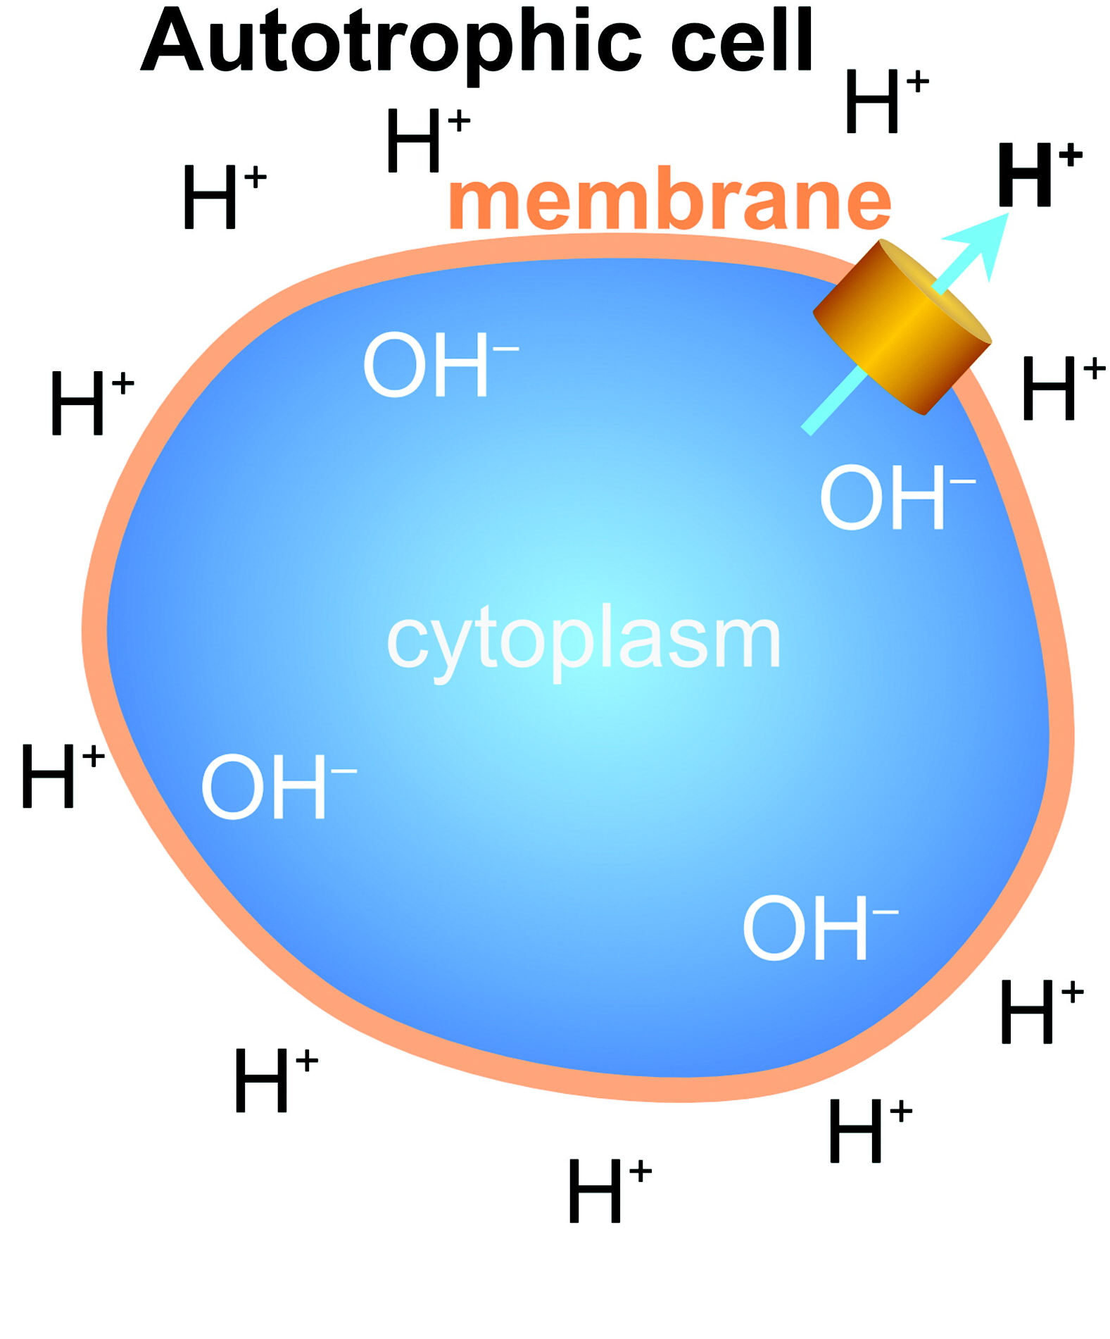
How do bacteria keep the outside out?
It costs energy to keep the outside out
Peter Mitchell

Slide 21
How do bacteria keep the outside out?
Influx of protons can power work
- ATP synthesis or CO₂ fixation
Peter Mitchell

Slide 22
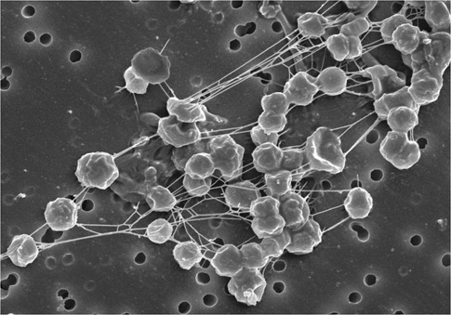
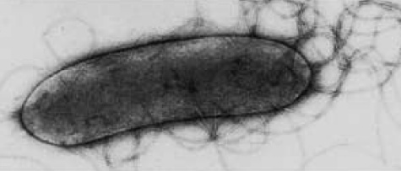
Most ancient cells grew from H₂ and CO₂
Methanogens (archaea)
Acetogens (bacteria)
Everett Shock
CO₂ + 4H₂
CH₄ + 2H₂O ΔGº′ = −131 kJ mol⁻¹
2CO₂ + 4H₂
CH₃COOH + 2H₂O ΔGº′ = −104 kJ mol⁻¹
The acetyl CoA pathway is the only CO₂-fixation pathway found in both bacteria and archaea
Notes:
22

Slide 23
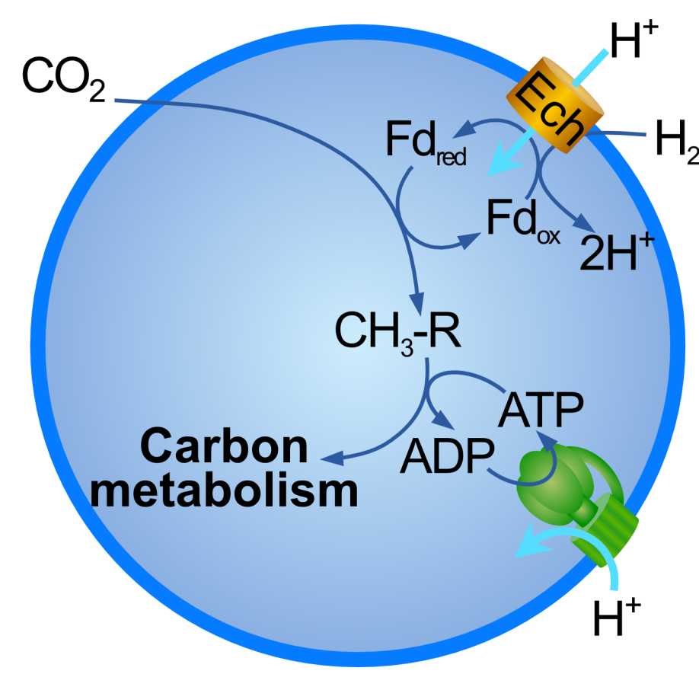
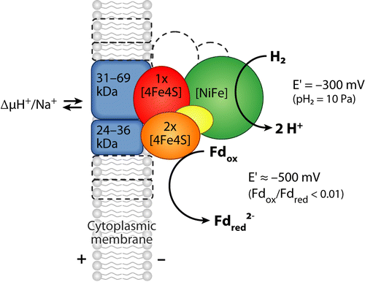
Proton gradients drive growth in methanogens
Ech contains FeS clusters that have crystal structures similar to greigite.
Could a prebiotic version use amino acids or peptides to do the same job?
Sojo V, Herschy B, Whicher A, Camprubi E, Lane, N. The origin of life in alkaline hydrothermal vents. Astrobiology 16: 181-197 (2016)

Slide 24
Origins of biochemistry from H₂ and CO₂?
Sequential reactions of H₂ with CO₂ in biology gives rise to acetyl CoA and Krebs cycle intermediates
Amino acids, fatty acids and sugars all derive from Krebs cycle intermediates
Nucleotides derive from precursors shown in red boxes
Harrison S & Lane N. Life as a guide to prebiotic nucleotide synthesis.
Nat Commun 9, 5176 (2018)

Slide 25

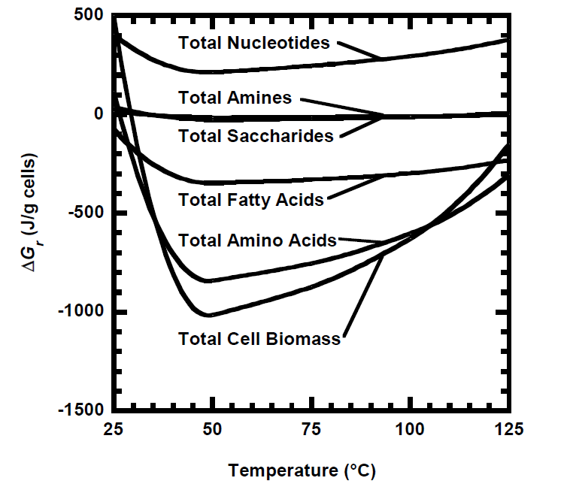
Abiotic organic synthesis from H₂ + CO₂
Jan Amend
Synthesising cell biomass from H₂ and CO₂ is
exergonic under alkaline hydrothermal conditions
Amend JP, McCollom TM. (2009) In Zaikowski L et al. eds. Chemical Evolution II: From the Origins of Life to Modern Society. American Chemical Society. p 63–94.

Slide 26
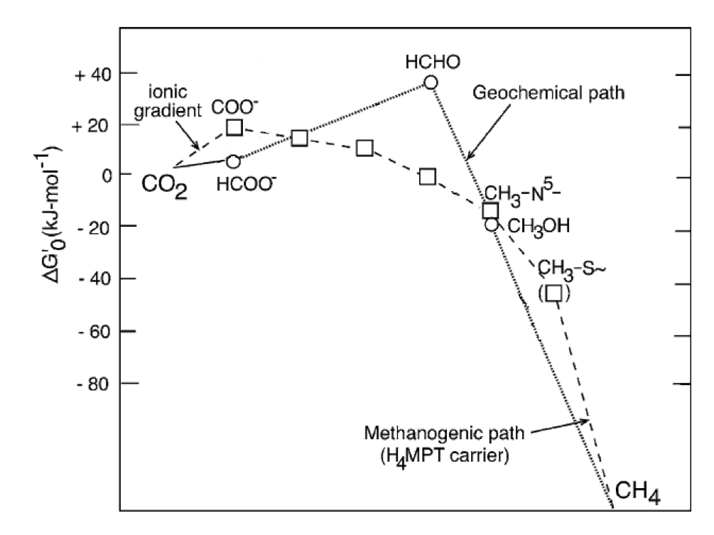
Proton gradients drive reaction of H₂ + CO₂
Proton gradient
Methanogens
use proton gradients to lower energy barrier to reaction
Could some geological environment do the same thing?
The first steps of this reaction are difficult – CO₂ is stable
Recast from Maden BE. Biochem J 350: 609–629 (2000)

Slide 27
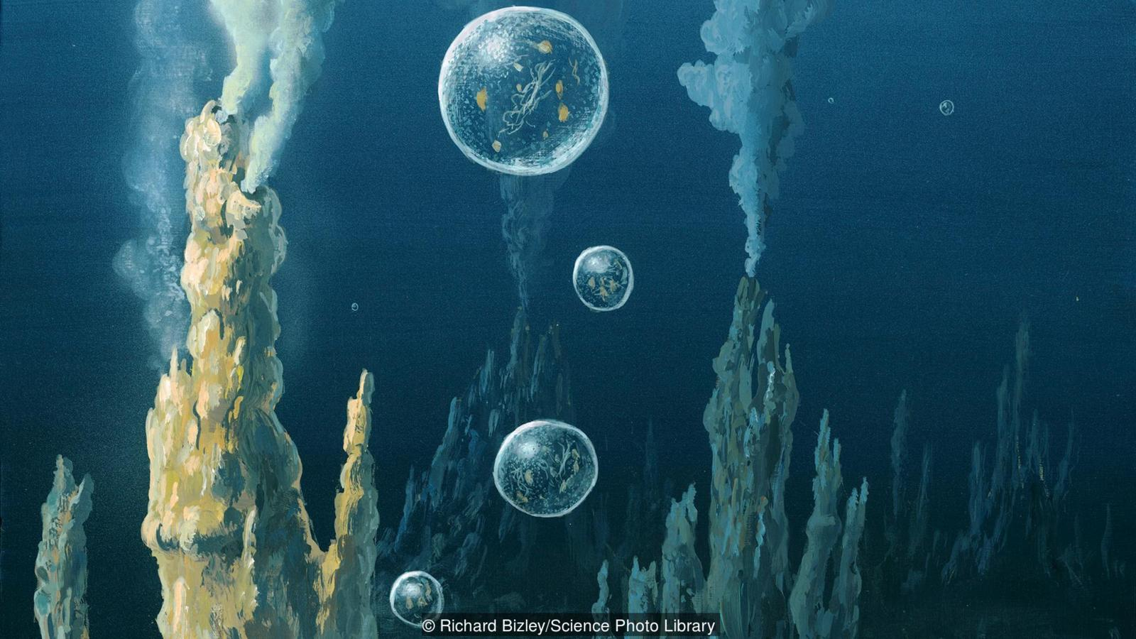
Redox potential of H₂ and CO₂ depends on pH
H₂ ➔ H⁺
CO₂ ➔ CH₂O
CO₂ ➔ CH₂O
H₂ ➔ H⁺
pH 7
pH 7
pH 11
pH 6
Herschy B, Whicher A, Camprubi E, Evans J, Lane N. An origin-of-life reactor to simulate alkaline hydrothermal vents. J. Mol. Evol. 79: 213-227 (2014)

Slide 28
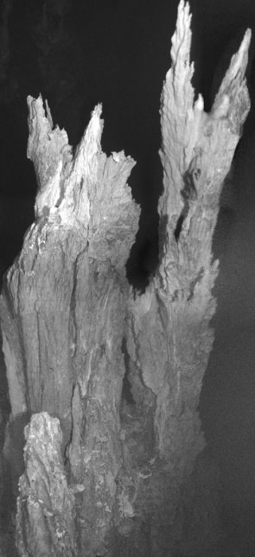
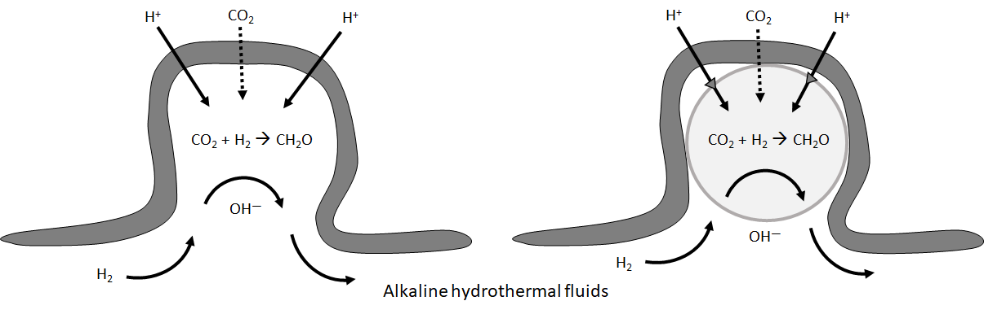
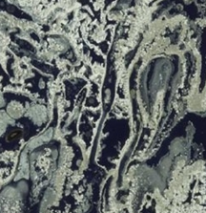

Could a proton gradient drive CO₂ fixation?
Proton gradients should drive CO₂ reduction by H₂ to form organics

Slide 29
Could a proton gradient drive CO₂ fixation?
Protocells should form within alkaline pores with CO₂ fixation inside

Slide 30
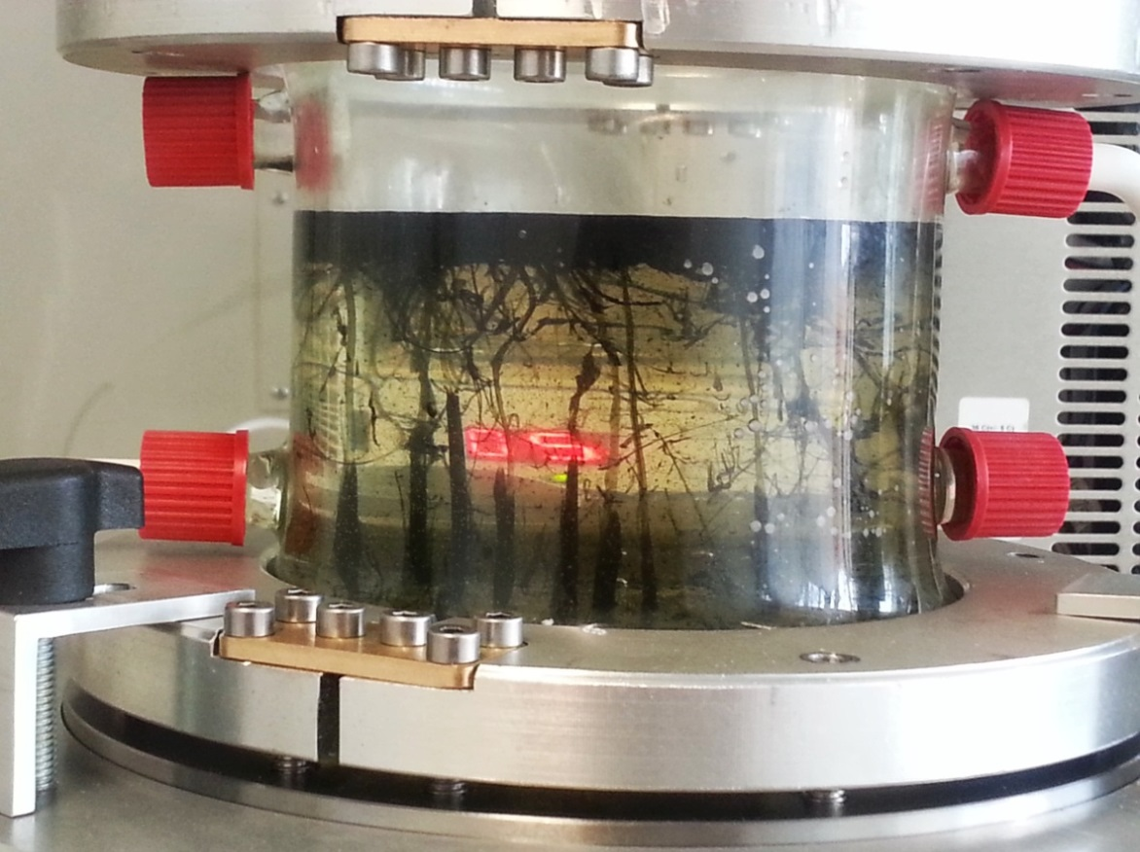
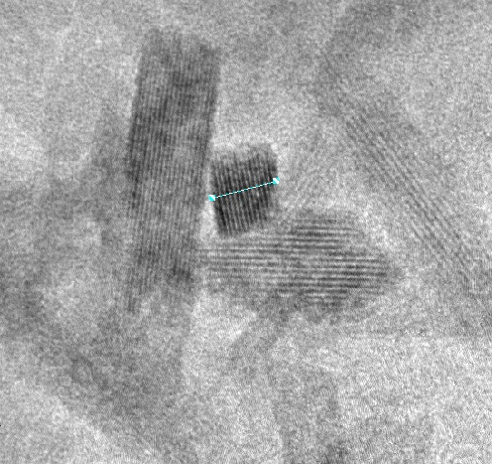
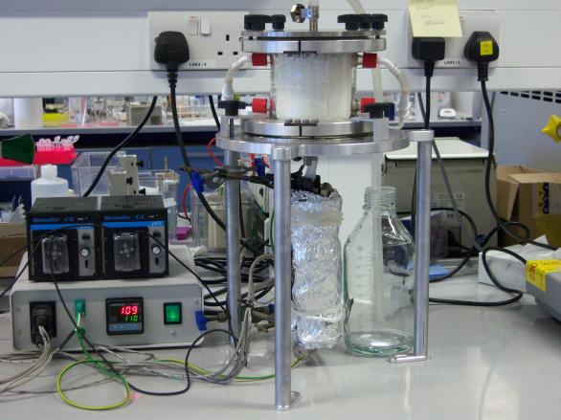
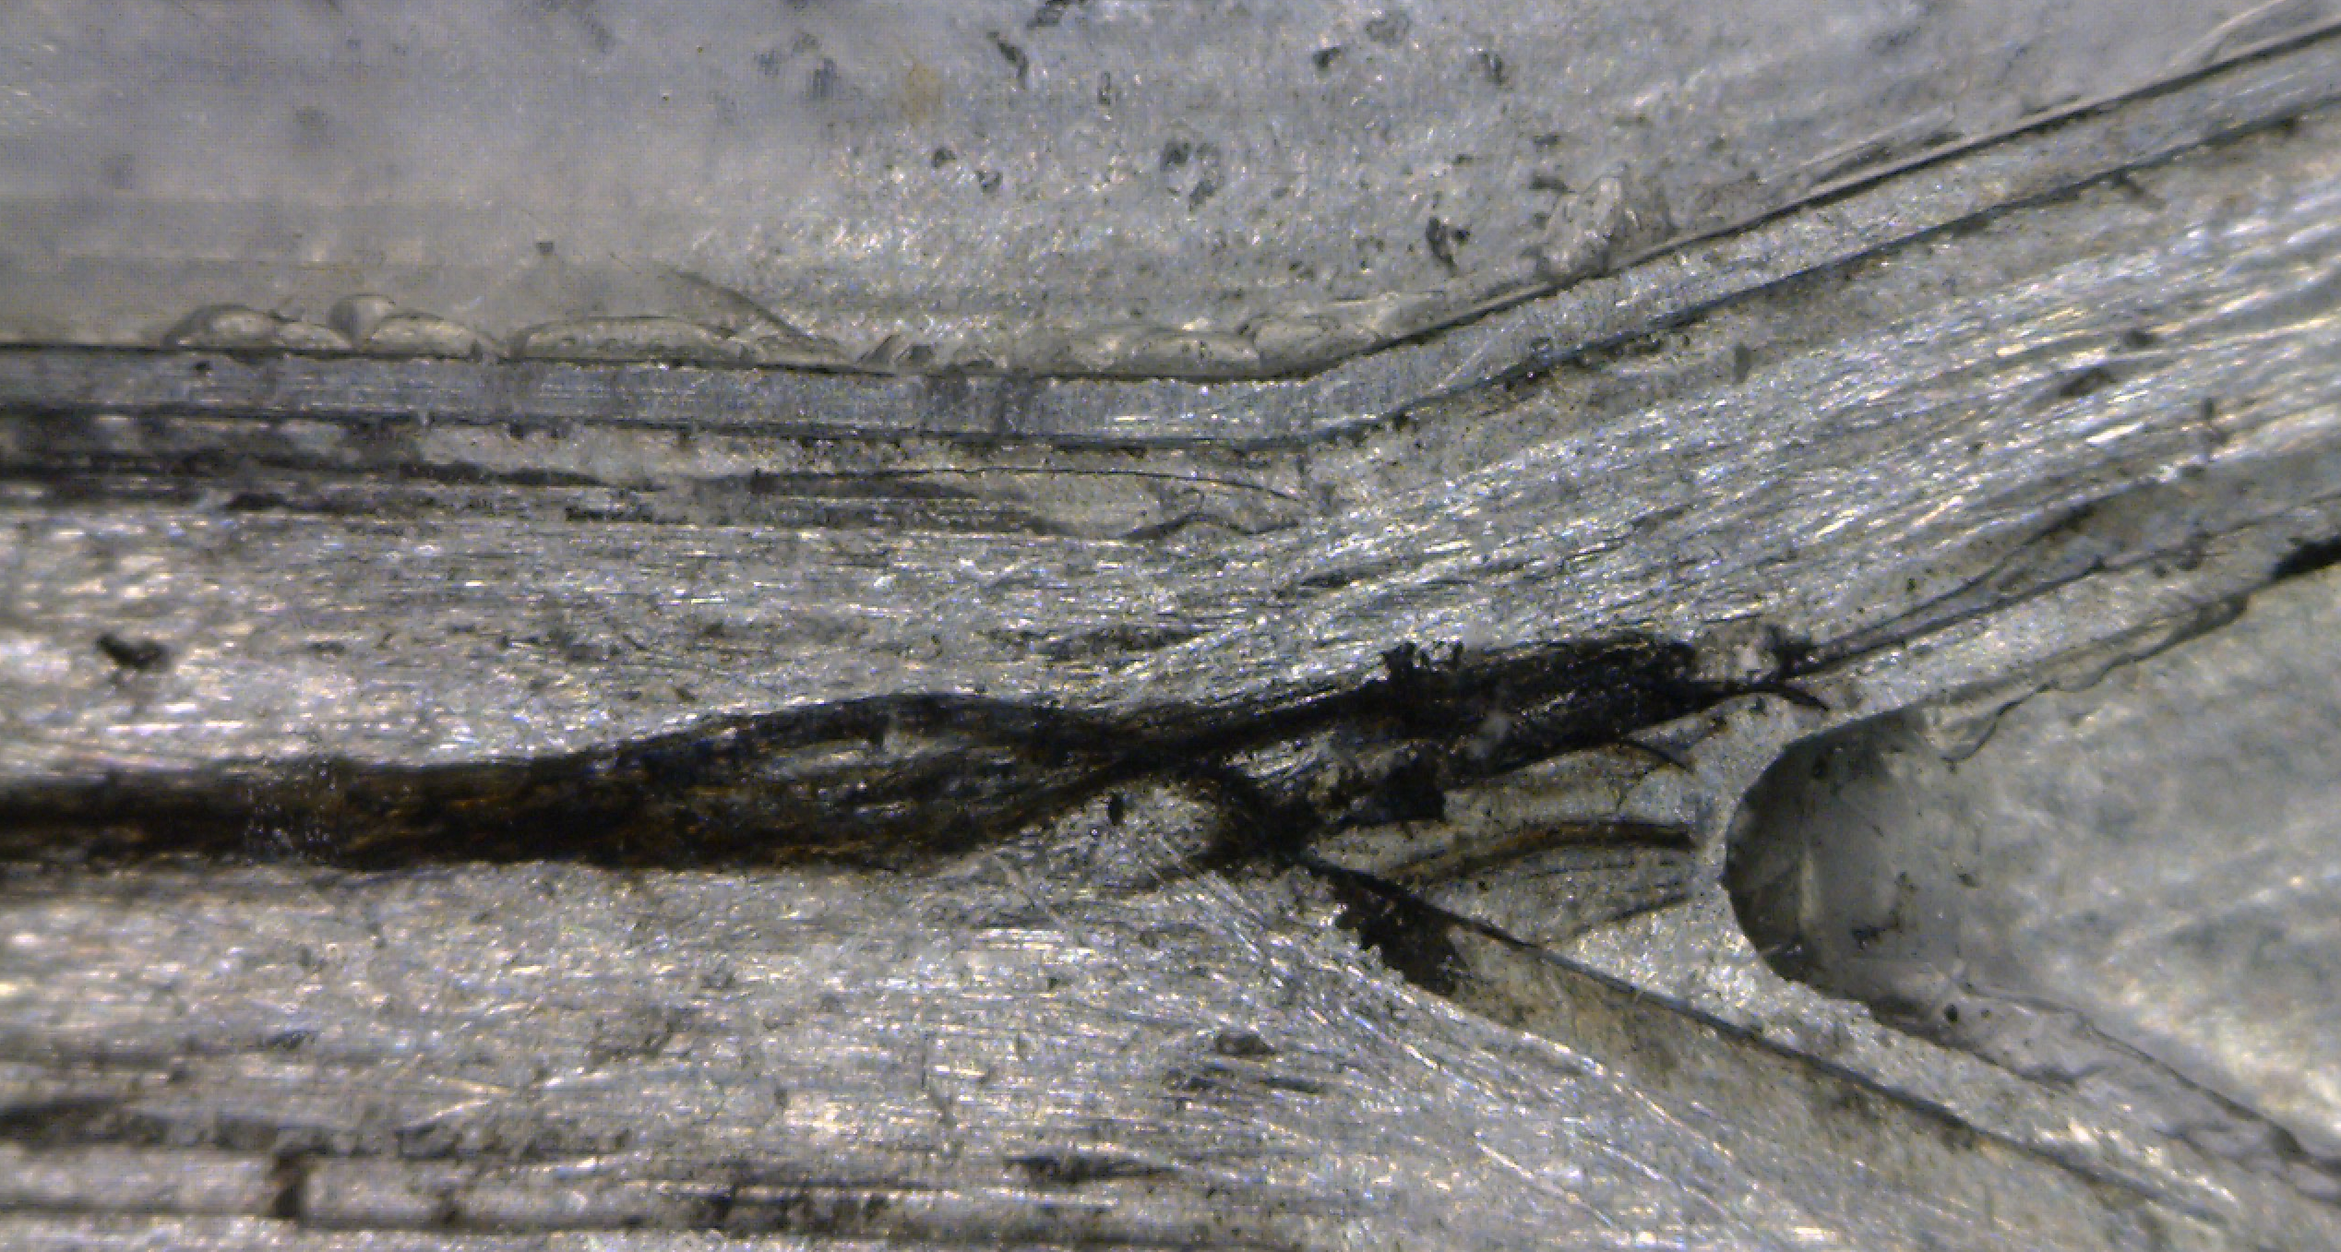
An origin-of-life reactor to simulate vents
Herschy B, Whicher A, Camprubi E, Evans J, Lane N. An origin-of-life reactor to simulate alkaline hydrothermal vents. J. Mol. Evol. 79: 213-227 (2014).

Slide 31
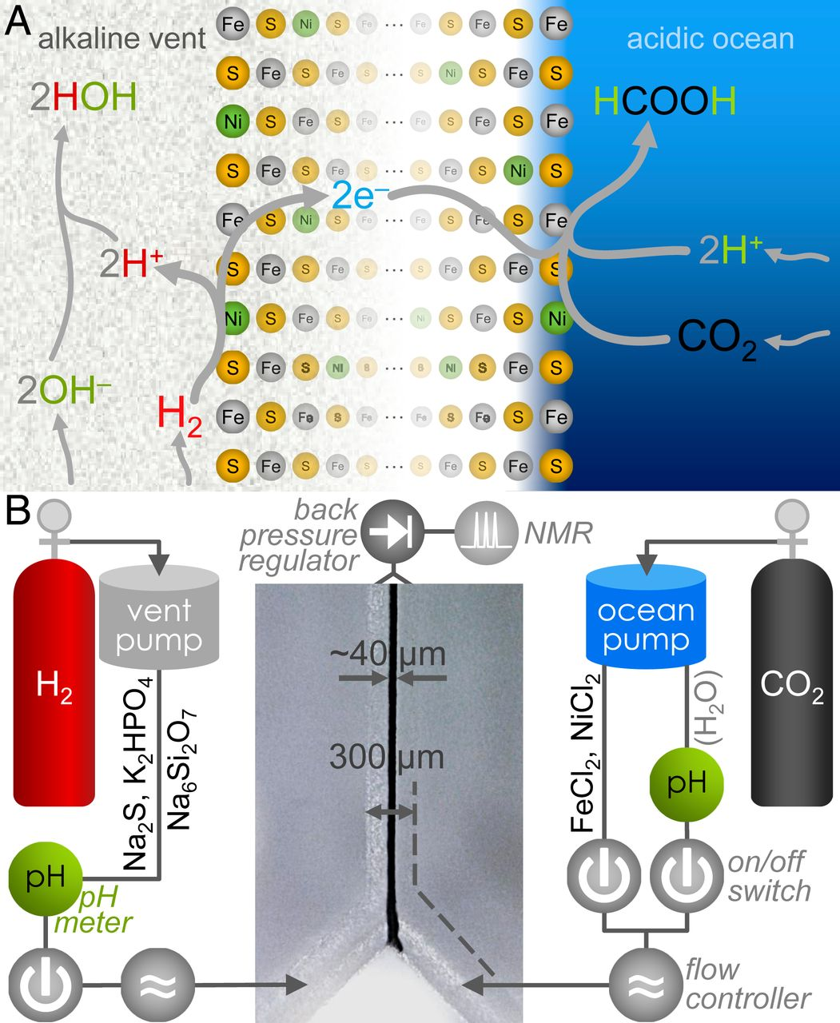
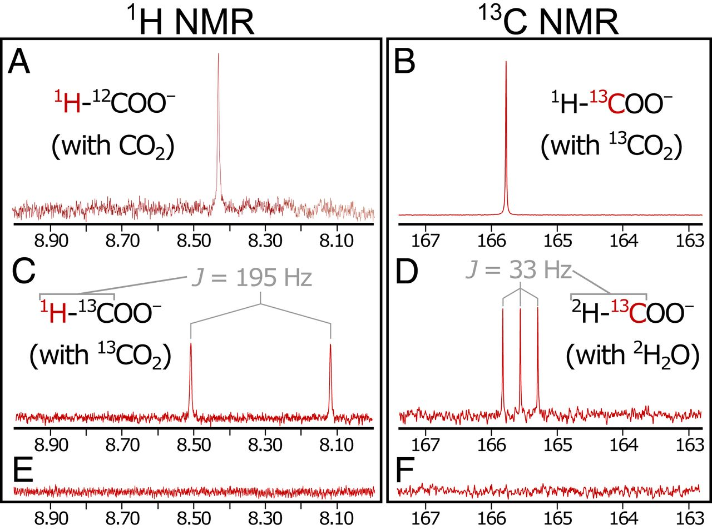
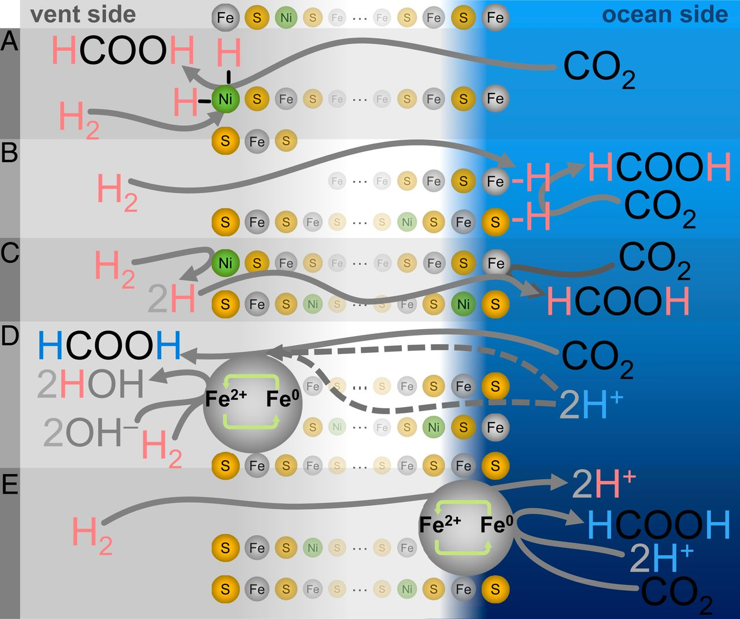
CO₂ reduction driven by a pH gradient
But what is crossing the barrier – electrons or protons?
Hudson R, de Graaf R, Rodin MS, Ohno A, Lane N, McGlynn SE, Yamada YMA, Nakamura R, Barge LM, Braun D, Sojo V.
CO₂ reduction driven by a pH gradient. Proc Natl Acad Sci USA 117: 22873-79 (2020)

Slide 32
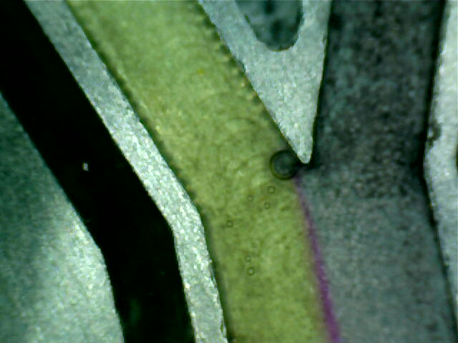
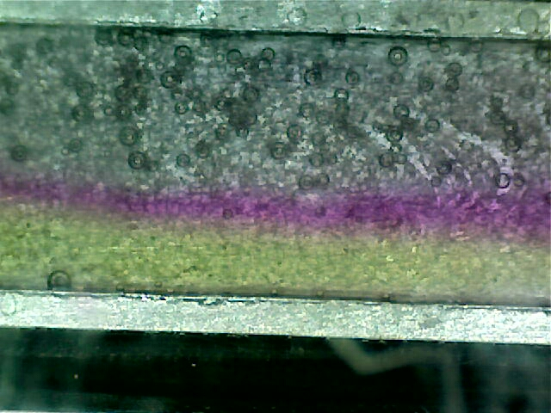
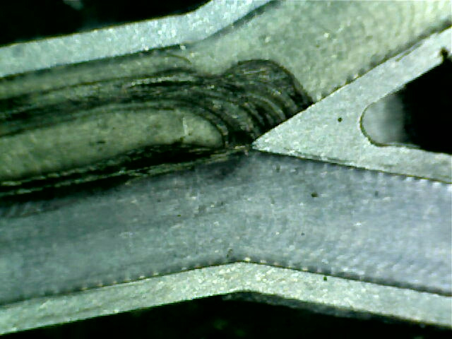
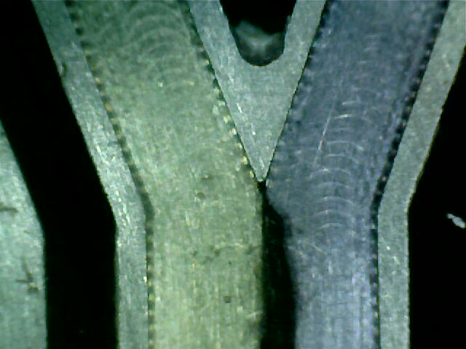
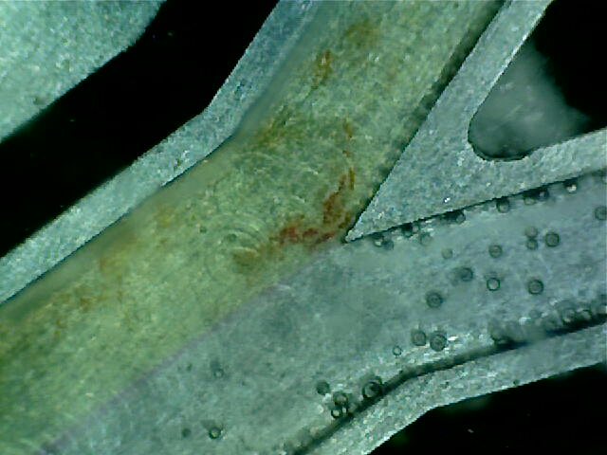
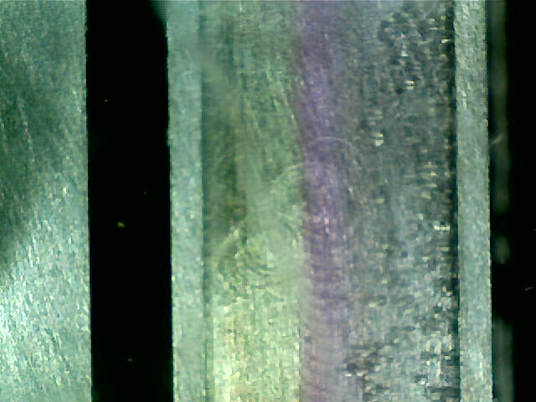
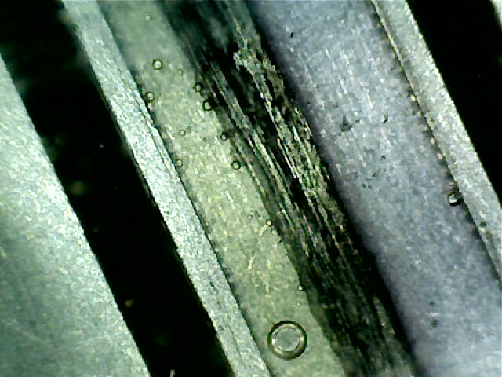
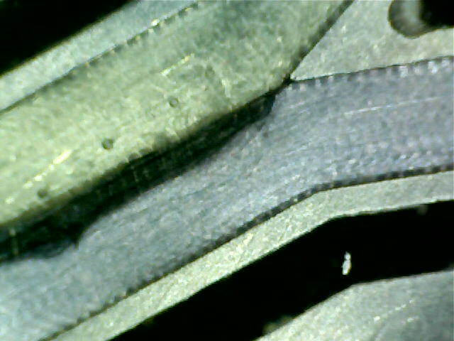
Microfluidic chip – pH gradients and Fe(Ni)S barriers
Laminar flow can sustain steep pH gradients (6 pH units across tens of µm) in absence of barriers.
Fe(Ni)S barriers formed over 20 min and can retain stable structure over hours to days of flow.
H⁺ ions cross the barrier much more readily than OH– (acid inside barrier): CO₂ reduction on alkaline face?

Slide 33
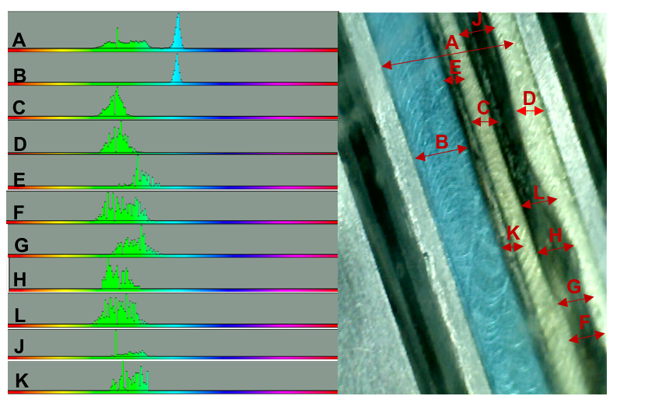
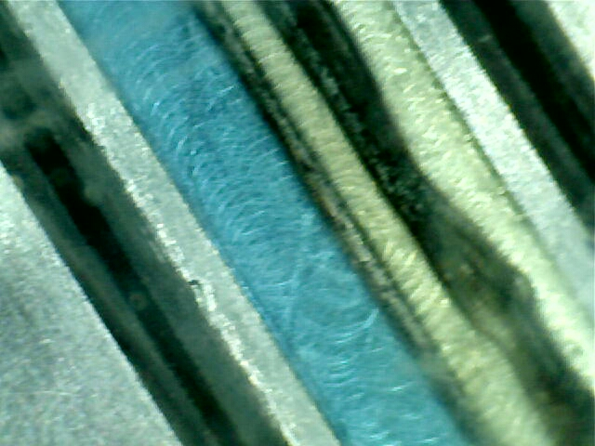
Steep pH gradients across inorganic barriers
551
79
414
420
654
70
753
5 pH units over ~70 µm, H⁺ flux 2 million-fold faster than OH– = 3 pH units over ~25 nm
Vasiliadou R, Dimov N, Szita N, Jordan S, Lane N. Possible mechanisms of CO₂ reduction by H₂ via prebiotic vectorial electrochemistry. Interface Focus 9, 20190073 (2019).

Slide 34
So this arrangement is at least feasible…
Protocells should form within alkaline pores with CO₂ fixation inside

Slide 35

Are vents too harsh for fatty acid vesicles?
pH - 5 -12
Temperature - 50 to 100 °C
Salinity - NaCl (600 mM)
Divalent cations – Mg²⁺ (50 mM), Ca²⁺ (10 mM)

Slide 36
Hydrothermal FTT synthesis of amphiphiles
Starting from H₂ and CO₂, chain lengths are similar to modern membrane lipids
McCollom TM, Ritter G, Simoneit BRT. Lipid synthesis under hydrothermal conditions by Fischer- Tropsch-Type reactions. Orig Life Evol Biosph 29, 153–166 (1999).

Slide 37




Promotion of protocell self-assembly
pH 12, 70⁰C, 600 mM NaCl, 50 mM MgCl_{2,}
10 mM CaCl₂
pH 7.09
1:1 Fatty acid/alcohol C10 - C15 (5 mM) pH 12.13
Decanoic acid alone
6 FA mix, 5 mM
1:1 FA:FOH mix
5:1 FA:FOH mix
Protocells with bilayer membranes form spontaneously from mixed amphiphiles under alkaline hydrothermal conditions
Jordan S, Rammu H, Zheludev IN, Hartley AM, Marechal A, Lane N. Promotion of protocell self-assembly from mixed amphiphiles at the origin of life. Nature Ecology & Evolution 3, 1705 (2019)

Slide 38




Formation of biological FeS clusters
UV-Vis spectroscopy [4Fe-4S] clusters
Mössbauer spectroscopy
Cyclic voltammetry
[4Fe4S] clusters form spontaneously from cysteine, Fe³⁺ & S²⁻ under alkaline conditions
Jordan SF, Ioannou I, Rammu H, Halpern A, Bogart LK, Ahn M, Vasiliadou R, Christodoulou J, Maréchal A, Lane N. Spontaneous assembly of redox-active iron-sulfur clusters at low concentrations of cysteine. Nat Comms 12: 5925 (2021)

Slide 39




Synthesis of uracil using life as a guide
Can form nucleobase uracil, following biochemical pathway with metal ion catalysts
Last steps of uracil synthesis greatly enhanced by alkaline hydrothermal conditions
Harrison SA, Harries T, Pinna S, Lane N, Prebiotically plausible, non-enzymatic synthesis of pyrimidine nucleobases. MS in prep (2021)

Slide 40


Why ATP is the universal energy currency
Acetyl phosphate is unique in phosphorylating ADP to ATP in water
Only adenosine among nucleobases is phosphorylated in this way
ATP emerged as universal energy currency due to prebiotic chemistry
Pinna S, Kunz C, Harrison S, Jordan SF, Ward J, Werner F, Lane N. A prebiotic basis for ATP as the universal energy currency. In review PLOS Biol. (2021); available https://www.biorxiv.org/content/10.1101/2021.10.06.463298v1?rss=1

Slide 41





Metabolic heredity promotes protocell growth
Catalytic feedbacks from nucleotides on CO₂ fixation and autocatalysis drive cell growth
Catalysis has to be balanced – strong catalysis of specific pathways collapses growth
Nunes Palmeira R, Colnaghi M, Harrison S, Pomiankowski A, Lane N. The limits of metabolic heredity in protocells. Submitted to Proc. Phil. Trans. R. Soc. B. (2021).

Slide 42



Genetic code: the code within the codons
First letter of codon corresponds to distance from CO₂ fixation – purines early
Second letter of anticodon corresponds to hydrophobicity – especially for purines
Code expanded over time; direct biophysical interactions between bases and AAs
Harrison S, Nunes Palmeira R, Halpern A, Lane N. A solution to the emergence of the genetic code. MS in prep (2021).

Slide 43


Origins of the genetic code – the third base
Redundancy at third position is not random
If there is a purine at second position, the amino acid encoded depends on whether a purine or a pyrimidine is at third position
Harrison SA, Nunes Palmeira R, Halpern A, Lane N. A solution to the emergence of the genetic code. MS in prep (2021).

Slide 44
The origin of information in biology
Far-from-equilibrium environment drives protocell growth; protometabolism follows favoured thermodynamic pathways including nucleotide synthesis
Positive feedbacks from nucleotides on CO₂ fixation (as naked cofactors) promote robust synthesis of nucleotides and faster growth
Metabolic heredity is not evolvable, but gains in complexity by lowering kinetic barriers
ATP synthesis introduces short, random RNA polymers into protocells – no information
Biophysical interactions between amino acids and RNA sequences generates non-random peptides through templating
Peptides gain function in context of growing protocells: hydrophobic peptides partition to membrane & promote CO₂ fixation, hydrophilic peptides promote RNA replication
Sequences evolve to optimise protocell growth from the outset: information has meaning
Harrison SA, Nunes Palmeira R, Halpern A, Lane N. A solution to the emergence of the genetic code. MS in prep (2021).

Slide 45



Thank you!
Joana Xavier
Feixue Liu
Stuart Harrison
Aaron Halpern
Hanadi Rammu
Thanks to the BBSRC, EPSRC, NERC, Leverhulme Trust, and Gates Ventures for funding
Sean Jordan
Silvana Pinna
Enrique Rodriguez
Flo Camus
Raquel Nunes Palmeira
Marco Colnaghi

