Slide 1
Voeding op scholen: transitie naar een gezonder en duurzamer voedingspatroon.
Jaap Seidell
Dienst Marketing & Communicatie

Slide 2
Overgewicht en obesitas bij kinderen van 12-16 jaar in Nederland

Slide 3
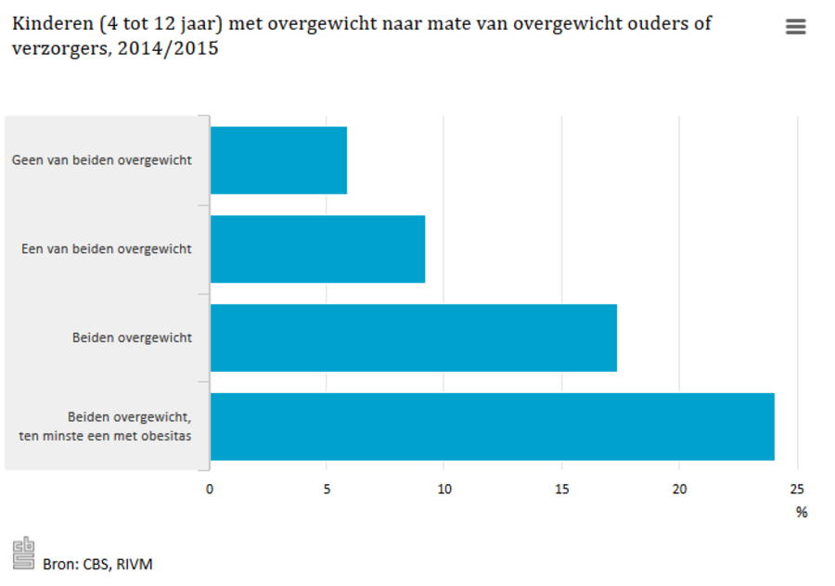

Slide 5
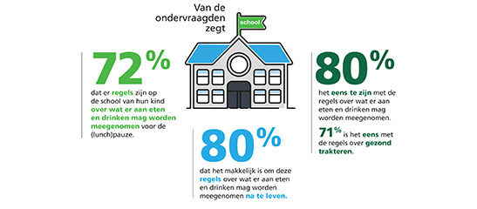

Slide 6
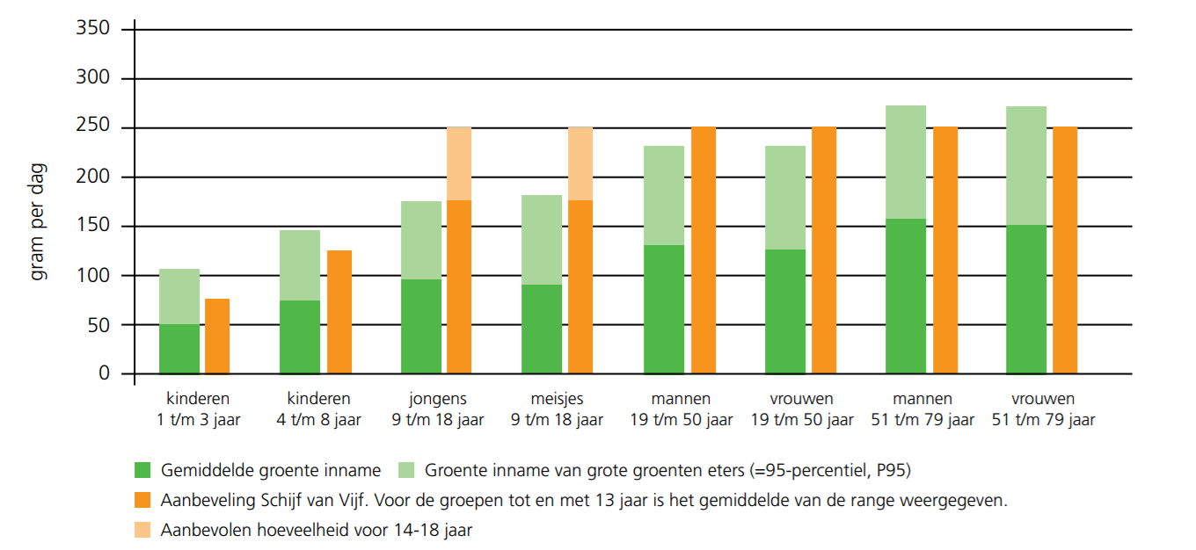

Slide 7
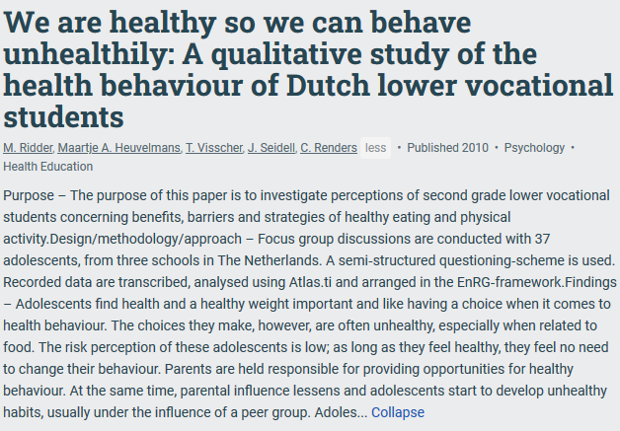

Slide 8
Platform Healthy food environment amsterdam
Aim: healthier food environment for children in Amsterdam
Effects of supermarket interventions:
Healthy checkout counter
Healthy Supermarket coach

Slide 9
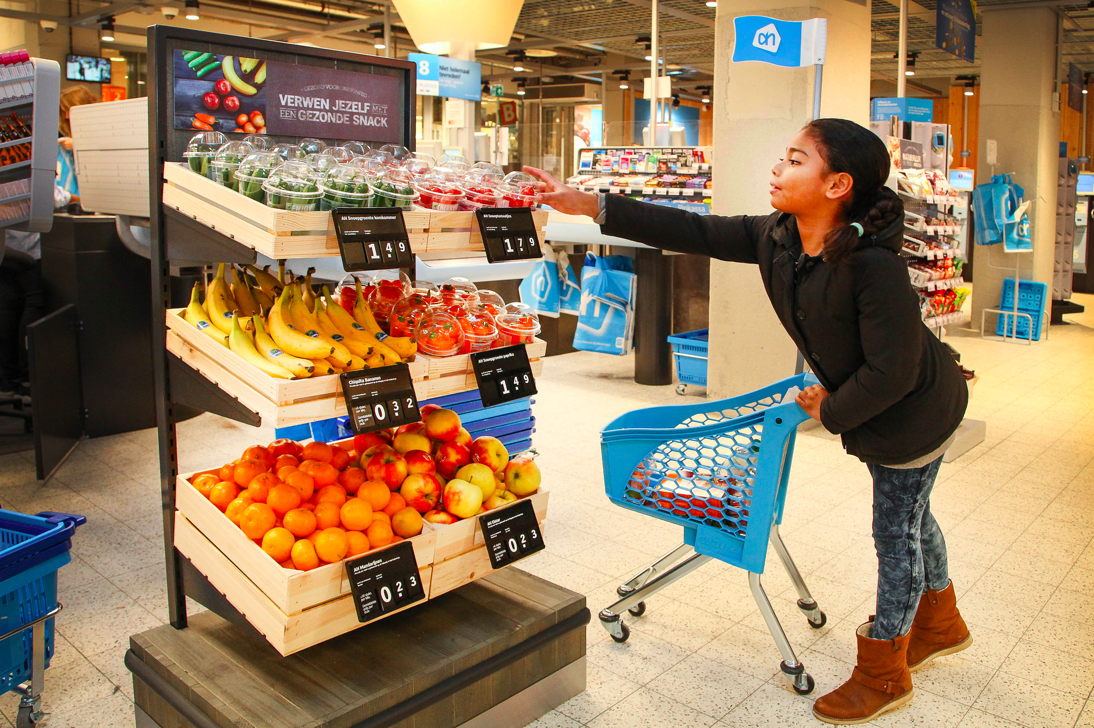
Healthy checkout counter

Slide 10
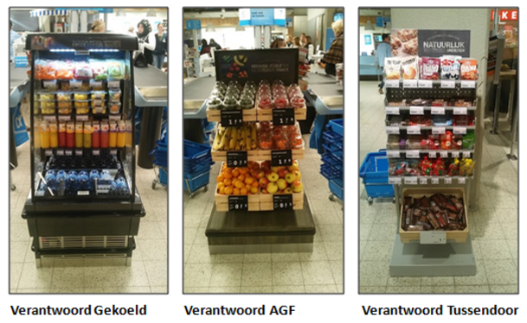
Healthy checkout counter

Slide 11
Peer education workshop: The healthy supermarket coach
Notes:
The healthy supermarket coach is a peer education workshop, which means that the workshop was given by peers of the students, in this case young, popular and good looking supermarket employees. Previous research showed that especially this peer education is an important and successful part of health promotion. The intervention consisted of a 45 minute workshop in the supermarket were the students learned about healthy eating. There was a quiz, a guided tour, students had to select a healthy and affordable lunch. The were also asked to participate in a 2 week healthy challenge to eat and buy healthily. Students created action plans and signed a contract.

Slide 12
Baseline characteristics of the students (n=432).
 | Total | Comparison school | Intervention schools
Total population | 432 | 81 | 351
Gender (N, %)
Boys | 209 (48.8) | 35 (43.2) | 174 (49.6)
Girls | 223 (51.6) | 46 (56.9) | 177 (50.4)
Age (years) (M, SD) | 13 (0.94) | 13 (0.60) | 13 (0.99)
School year (N, %)
First | 376 (87.0) | 81 (100) | 295 (84.0)
Second | 56 (13.0) |  | 56 (16.0)
n=number, M=mean, SD=standard deviation

Slide 13
Frequency of purchases around school during school hours at baseline (n=432).
Do you purchase food in retail food outlets (e.g. supermarket, fast-food restaurant) close to your school during school hours? | N (%)
No | 119 (27.5)
Yes | 307 (71.1)
If so, where do you usually purchase food during school hours?
Supermarket | 272 (88.6)
Fast-food restaurant | 22 (7.2)
Somewhere else | 13 (4.2)
Notes:
Most of the adolescents who purchased foods in food outlets around school (71.1%) did this in the supermarket (88.6%).

Slide 14
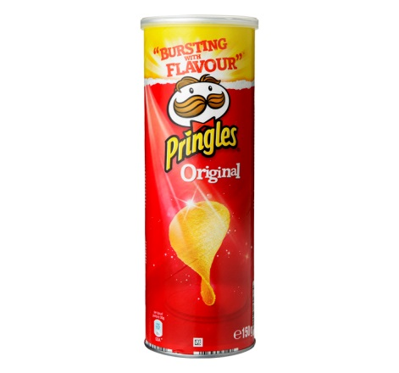
Top 3 – most purchased foods in the supermarket
Notes:
The most frequently foods purchased within the supermarket were potato chips (36%), croissants (34%) and other savory snacks (23%). The most frequently purchased drinks in the supermarket were energy drinks (56%) and sugary drinks (31%).

Slide 15
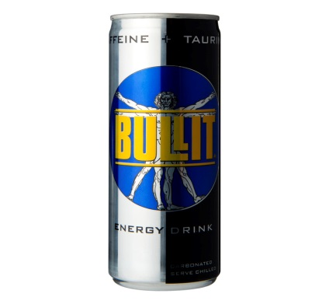
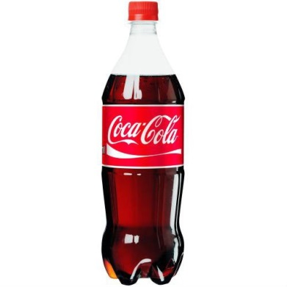
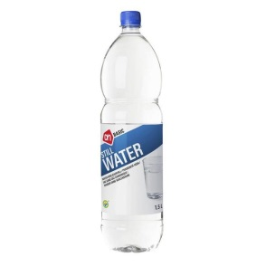
Top 3 – most purchased drinks in the supermarket
Notes:
Energy- and sportdrinks
Sugared drinks
Water

Slide 16
Intervention effect on nutritional knowledge and attitudes towards healthy eating (n=370).
 | Nutritional knowledge β (95%CI) | Attitudes toward healthy eating β (95%CI)
Crude model | 0.68 (0.23-1.13)* | 0.14 (0.02-0.26)*
Adjusted model¹ | 0.69 (0.23-1.15)* | 0.17 (0.04-0.29)*
n= number, ¹ Adjusted for gender, school year and age, *P<0.05, B: regression coefficient, CI: confidence interval
Notes:
After the HSC workshop nutritional knowledge scores of adolescents from intervention schools were statistically significant higher compared to the comparison school (B: +0.69, 95% CI: 0.23-1.15) as well as their attitudes toward healthy eating scores (B: +0.17, 95% CI: 0.04-0.29).
Adjusted linear regression analyses indicated that the HSC intervention generated a statistically significant improvement in both nutritional knowledge (β =0.69, 95%CI: 0.23–1.15, p=0.003) and attitudes towards healthy eating (β =0.17, 95%CI: 0.04–0.29, p=0.009, Table 3).

Slide 17
7.4
Notes:
The adolescents evaluated the HSC intervention positively (Table 4). For example, they rated the workshop with an average of 7.43 points (on a scale from 0 to 10),

Slide 18
conclusions
Nutrition peer education in supermarkets can improve nutritional knowledge and attitudes toward healthy eating among adolescents from lower vocational schools.
Notes:
Future research on the short- and long-term effects of nutrition peer education on actual food purchases and dietary intake among adolescents is needed.

Slide 19
Why a healthy school canteen?
Unhealthy offerings stimulate unhealthy eating behavior (Kocken et al., 2012)
Peer influence (Bevelander et al., 2014)
Negative relationship between overweight and learning results (Caird et al., 2011)
Responsibility parents, schools or children? (Ridder et al., 2014)
Notes:
Peer influence influences youth in their choices. – social proof – if other people choose this option, then you are more willing to choose this as well. -> Hotel reservations ‘2 other people are watching this’ 1 people did just booked this.

Slide 20
Government: 100% healthy school canteens in 2017
75% basic foods and 25% non-basic foods
Notes:
Since 2001 attention for the healthy school canteen.
From the government: Motie Vendrik –100% healthy school canteen in 2015, Later, Motie Wolbrink changed to 2017.
When is a canteen healthy? It just to be: 75-25%. In new guidelines: Volume and presentation, appearance as well taken into account.

Slide 21
Government: 100% healthy school canteens in 2017
75% basic foods and 25% non-basic foods
HEALTHY??
Notes:
Since 2001 attention for the healthy school canteen.
From the government: Motie Vendrik –100% healthy school canteen in 2015, Later, Motie Wolbrink changed to 2017.
When is a canteen healthy? It just to be: 75-25%. In new guidelines: Volume and presentation, appearance as well taken into account.
What do you think – healthy or not?
Bread – was healthy.
Now unhealthy. Fat.

Slide 22
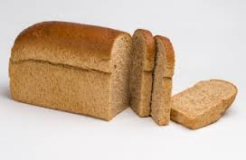
Guidelines for Healthier Canteens
Better Choice | Occasional
Better choice within each product group
Basic healthy accessibility
Written policy
Stimulate drinking water
Not sufficient for schools
Product offer: 60% Better choice / 40% Occasional
Vegetables OR Fruit
Display layout: 60% healthy
Product offer: 80% Better choice / 20% Occasional
Vegetables AND Fruit
Display layout: 80% healthy
Veldhuis, 2017. http://www.voedingscentrum.nl/Assets/Uploads/voedingscentrum/Documents/Professionals/Pers/Factsheets/English/Fact%20sheet%20Guidelines%20for%20Healthier%20Canteens.pdf
Notes:
In the new guidelines, there is made a distinction between the kind of products in a certain productgroup. The more preference/second choice product you have, the healthier the canteen is.

Slide 23
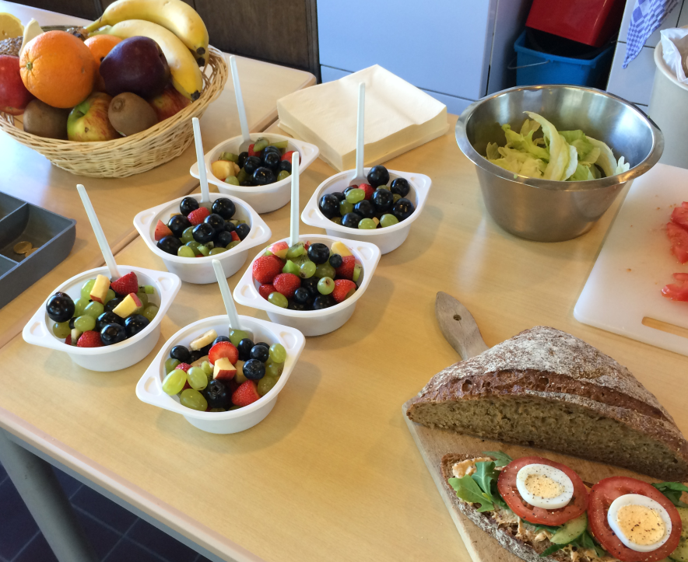
Veldhuis, 2017
http://www.voedingscentrum.nl/Assets/Uploads/voedingscentrum/Documents/Professionals/Pers/Factsheets/English/Fact%20sheet%20Guidelines%20for%20Healthier%20Canteens.pdf
Notes:
So we have guidelines, but how do we reach healthy canteens? What support does organizations, people in the field need? How can we translate them into practice?

Slide 24
Guidelines Healthier Canteens
Measurement tool
Canteen Scan
Nick Wezenbeek
Irma Evenhuis
Schools
Sport clubs
Worksites
School canteens
Healthy worksite cafeteria
Irma Evenhuis
Youth on a Healthy Weight
(JOGG)
Liesbeth Velema
Notes:
24
24

Slide 25
Notes:
We need to collaborate. Multi stakeholder public private collaboration
A lot of partners are involved: Caterers, suppliers, commercial and non-commercial organisations.
Not always easy, but necessary to collaborate. The government can not do it by their own – commercial parties have a big influence and more financial opportunities, more money for advertisement and nutrition labeling development.
. You have to involve all parties in the field. To reach big improvements
Example: “Agreement-parties” Dutch caterers, drink-companies like coca-cola, Spa, watercompany are collaborating with support of Youht on a Healthy Weight to increase a healthy food environment on schools and sport canteens. All have the intention and will follow the guidelines for Healthier canteens. The are monitored by the Dutch Nutrition centre if their canteens are in line with the guidelines. So not only intention, they has to perform as well. Not conform appointments? Improve it, or leave the agreement-parties.

Slide 26
Implementation of Guidelines for Healthier Canteens in schools
Aim
How can schools be supported in implementing the Guidelines for Healtier Canteens
How
Interviews, expertmeeting
6-month, quasi experimental study in 20 schools for process and effect evaluation
Results
Insight in barriers and facilitators
Development of implementation activities
Process and effect evaluation
Notes:
Hoe: Interviews met stakeholders, expert meeting, onderzoek op 20 scholen.
Wat levert het op: Implementatie strategieën en optimalisatie proces van implementatie.
Liefst zelf doelgroep betrekken
Anecdote: gezonde prullenbak

Slide 27
Implementation of Guidelines Healthier Canteens in schools
Notes:
Ask the field what they need!

Slide 28
Implementation and effect study
What is the effect of the Guidelines for Healthier Canteen on:
changes in the school canteen (amount, quality, placing)?
Canteen Scan
(determinants of) purchase behavior of students (13-14 year)?
Questionnaire to (determinants of) purchase behavior
How do stakeholders evaluate the implementation of the Guidelines for Healthier Canteen in secondary school?
Questionnaire with process evaluation concepts
Notes:
Leerlingen: Ervaringen: aanbod, uitstraling, gebruik, tevredenheid
Stakeholders: Proces mate van implementatie, Haalbaarheid, toepasbaarheid, helderheid Richtlijnen
Doel:
Ontwikkeling implementatiestrategie Richtlijnen Gezondere Kantines.
Evaluatie proces van implementatie en inzicht aankoopgedrag.

Slide 29
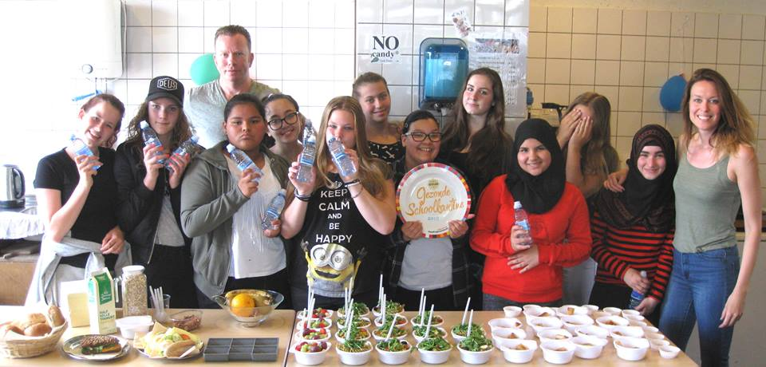
Notes:
Met als uiteindelijke doel: gezondere schoolkantines.
Mogelijk ook translatie naar sportkantines?

Slide 30
Conclusions
Veel leerlingen in het voortgezet onderwijs hebben een ongezonde leefstijl.
Dat komt deels door overwegend ongezond voedselaanbod in en rond de school én de intensieve marketing van ongezond voedsel gericht op tieners.
Voedseleducatie (bv. In de biologieles en mede door mede-leerlingen/vakkenvullers), een gezonde kantine en afspraken met aanbieders rond de school kunnen helpen kinderen gezonder te laten eten en drinken.
Betrokkenheid ouders is ook belangrijk.

Slide 31
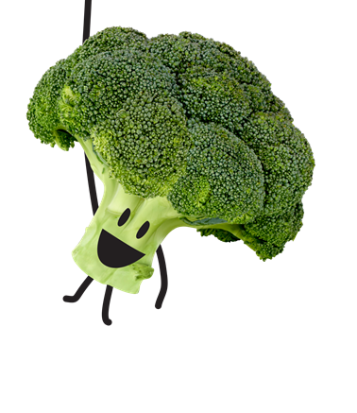
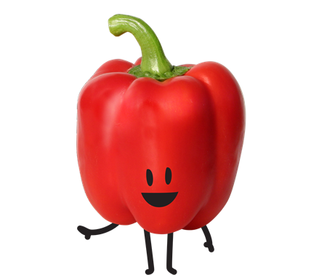
questions?
j.c.seidell@vu.nl
Notes:
Questions?

