Slide 1
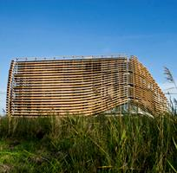
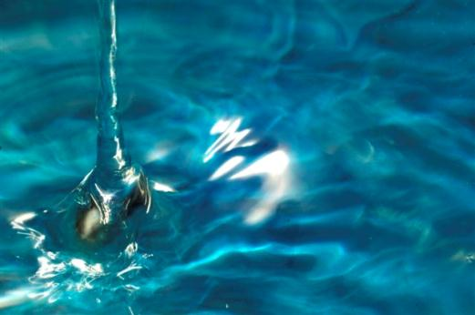
Marco de Graaff
sustainable
water technology

Slide 2
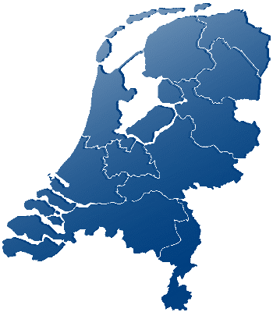

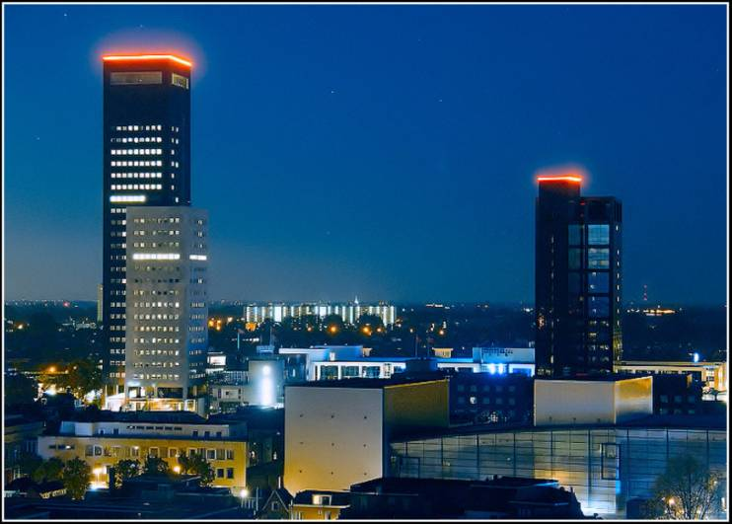
Technological Top Institute Water
2

Slide 3
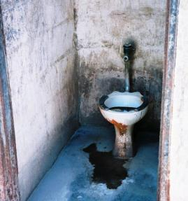
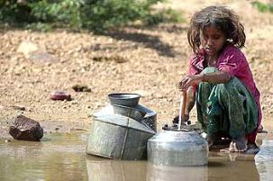
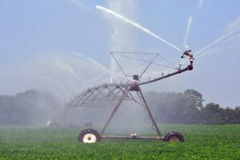
World Water Stress
1.1 billion people without
clean drinking water
2.5 billion people without
safe sanitation
shortage of irrigation
water
3

Slide 4
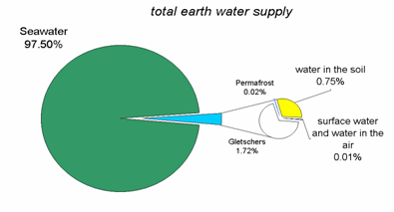
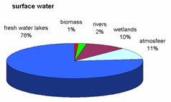
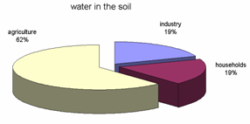
Earth water supply

Slide 5
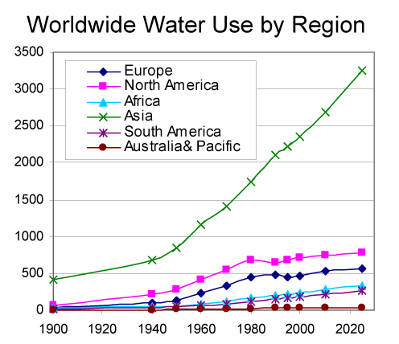
Water use

Slide 6
Price of water (€/m³)

Slide 7
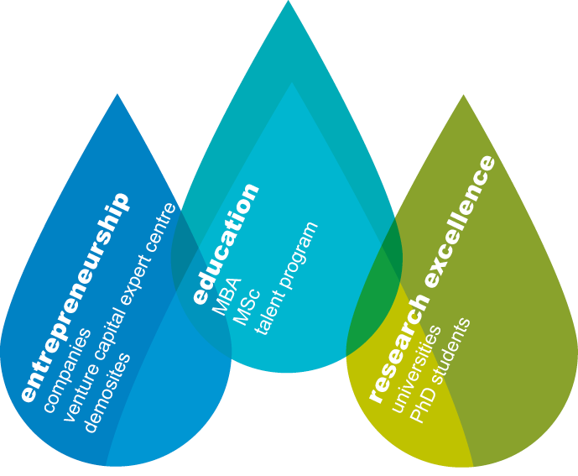
Wetsus Vision
Wetsus is a research institute for water technology:
Research: develop new sustainable technologies
Education: educate students for their future career
Entrepreneurship: bring technology to the market, earn money
7

Slide 8






Cooperation
Companies and Universities
90 Companies
16 Universities
Financing
Companies | 25%
Universitities | 25%
Government | 50%
8

Slide 10
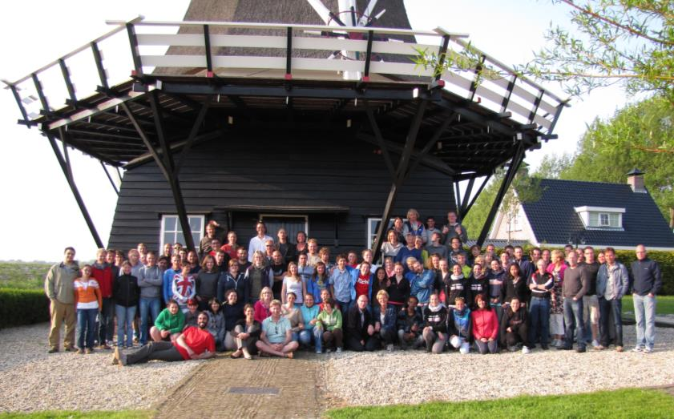
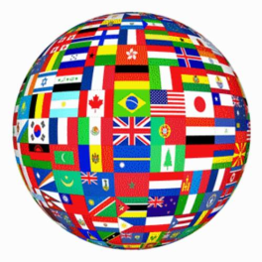
Wetsus - 2015
120 Employees
- 70 PhD Researchers
- 35 Internship students
60% of our employees is foreign:
- 23 nationalities
- English communication

Slide 11
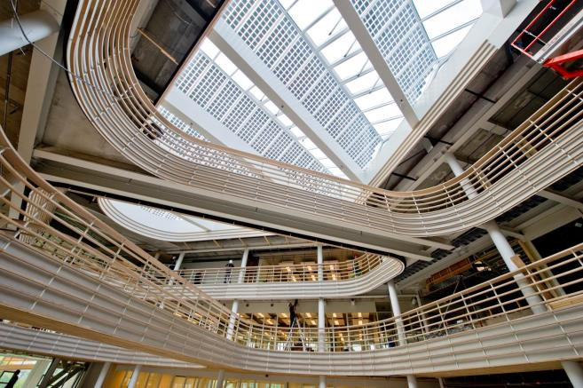
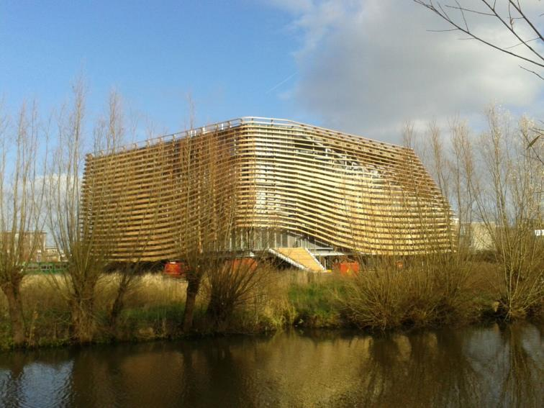
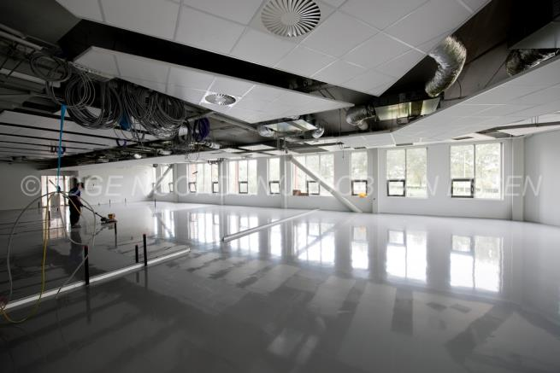
Situation today

Slide 12
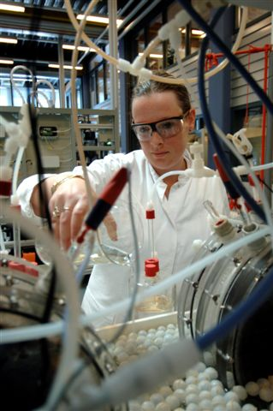
Research
Carried out by PhD`s:
Desalination of seawater
Separation at source
Membrane bioreactor
Fouling of membranes
Energy from water
Sensors
Hydrogen
Hormones and medication in water
Algae
12

Slide 13
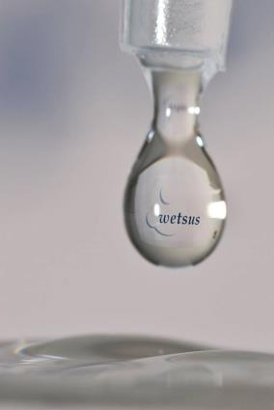
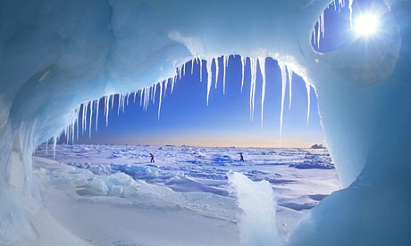
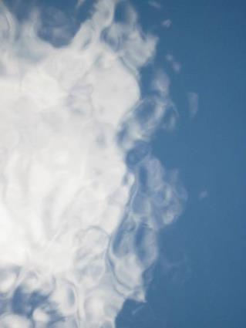
What do we know about water?
Well, not much:
Liquid
Solid
Gas

Slide 14
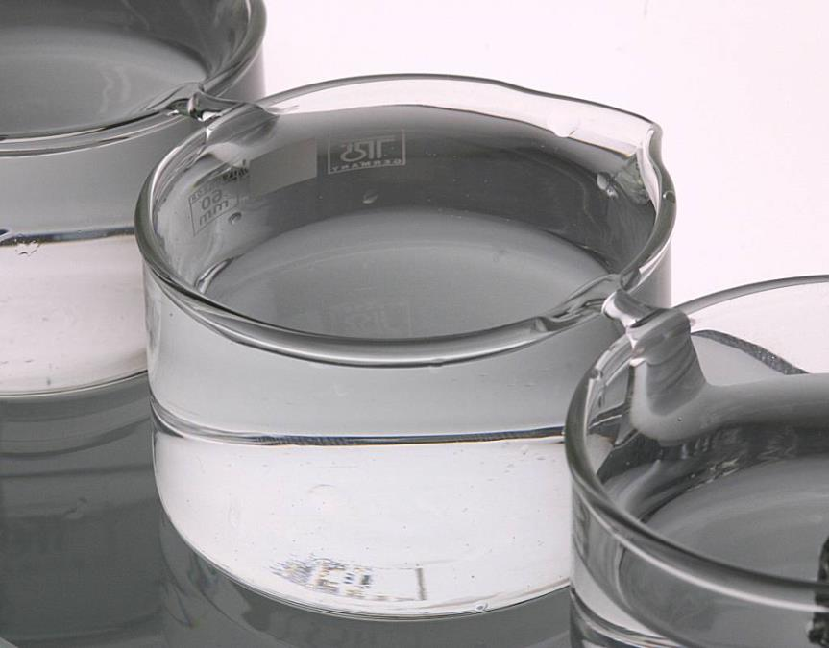
Water Bridge

Slide 15
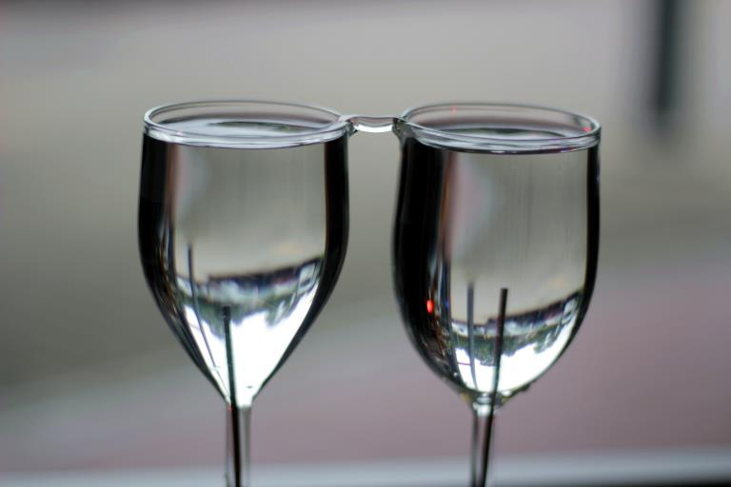
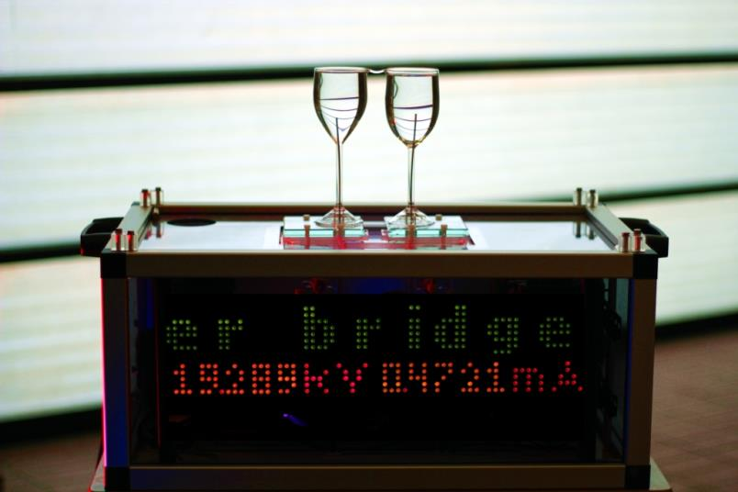
In practice

Slide 16
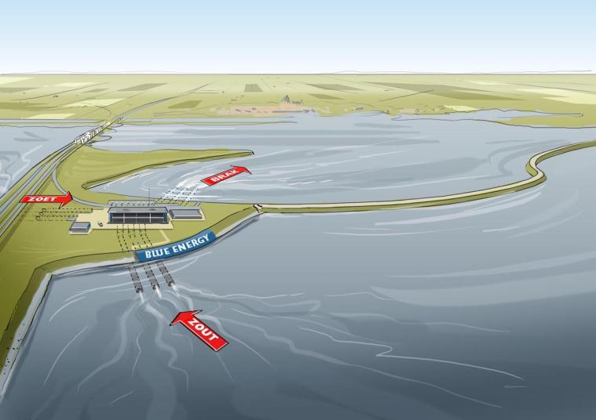
Blue Energy

Slide 17
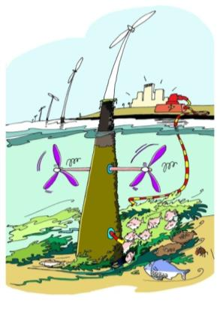
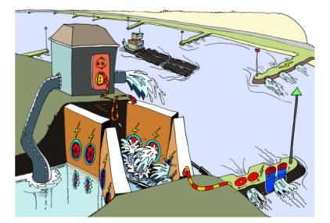
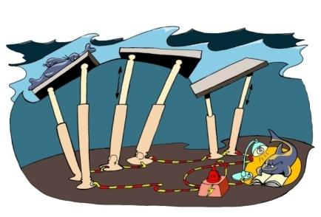
Mechanical energy from water
Gravitational energy
(from rivers):
Limited, but easy to harvest
Feasible at sufficient drop height
Proven technology
Wave energy
Large amount, but distributed
Possible in combination with
offshore wind
Tidal energy
Large amount, but distributed
Feasible at large tidal
velocities (> 2 m/s)
Environmental impact
Notes:
getijden: gestuwd vs vrije stroming
29 mei 2015
17

Slide 18
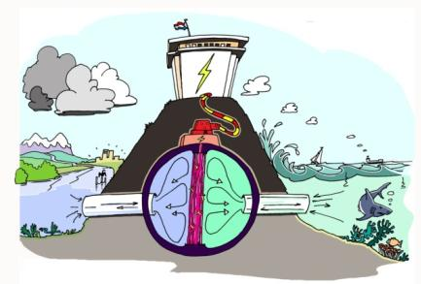
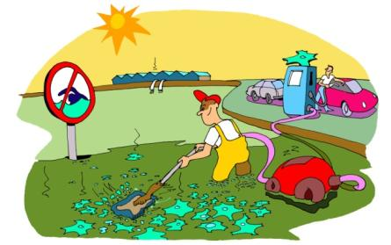

Chemical energy from water
Aquatic biomass energy
Very large amount to produce a fuel.
Flexible source,
Difficult to optimise. Interference with
water quality standards and recreation
Salinity gradient
Large amount, depending on
fresh water flow
Export potential, innovative,
not yet proven at pilot scale
Fouling in practice?
Notes:
blue energy: red; ook pro een optie
aquatische biomassa: kansen op de noordzee

Slide 19
Conversion techniques
Reversible mixing by means of selective membranes, i.e. mixing limited to one of the components
Pressure Retarded Osmosis (PRO):
  Water-permeable membranes
Reverse Electro Dialysis (RED):
  Ion-selective membranes

Slide 20
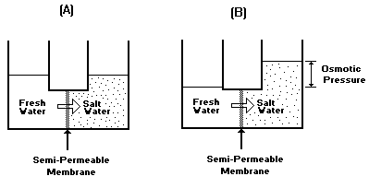
Osmotic pressure

Slide 21
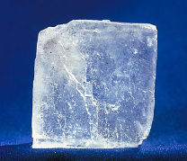
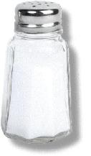
Blue Energy
Salt
Na⁺
Cl⁻

Slide 22
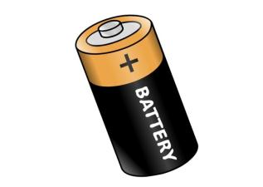
Blue Energy - RED
zoet
zout
zoet
Na⁺
Na⁺
Cl⁻
Na⁺
Na⁺
Cl⁻
Cl⁻
Cl⁻
Na⁺
Cl⁻
Cl⁻
Na⁺
Membrane 1: Selects positive ions
Membrane 2: Selects negative ions

Slide 23
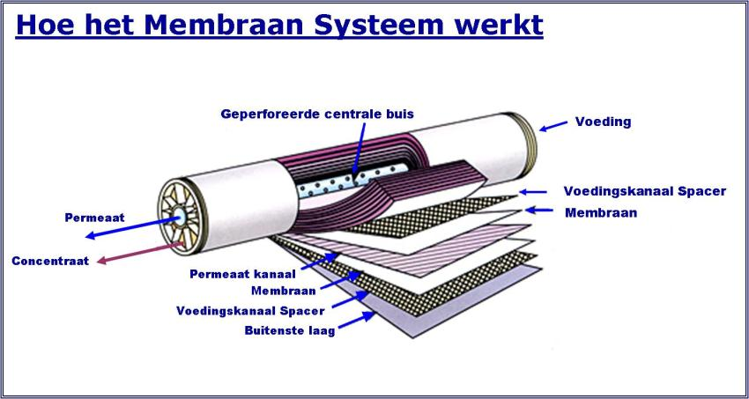
Membraantechnologie

Slide 24
Productie van een membraan
Basis is een organisch polymeer (PAN, PES, CA, PVDF) welke de weerstand en sterkte bepaald.
Gietstroop is een mix van polymeer met een Ion/wisselaar en een organisch oplosmiddel.
Het oplosmiddel lost op in water
Membraan oppervlak
file12
1

Slide 25
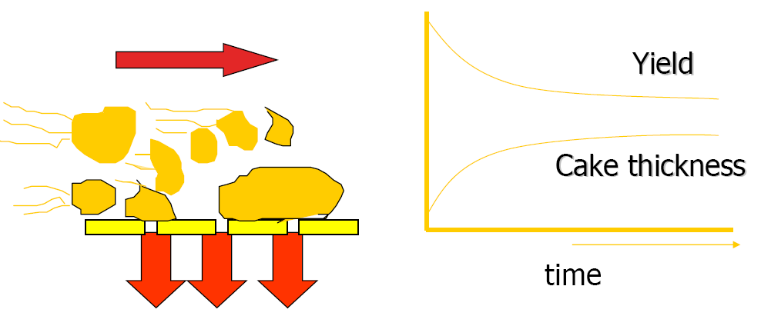
Onderzoek: Biofouling
file12
1

Slide 26
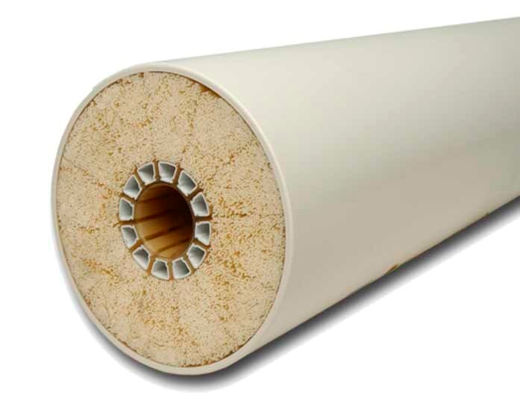
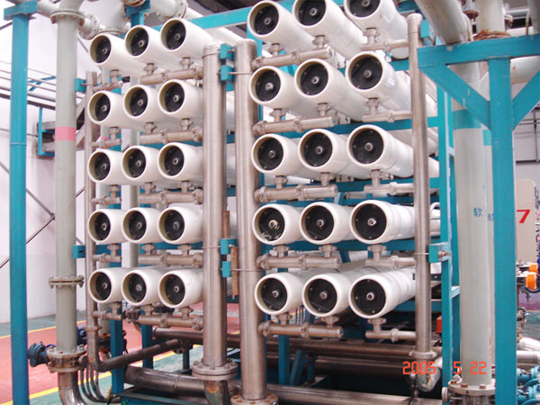

Slide 27
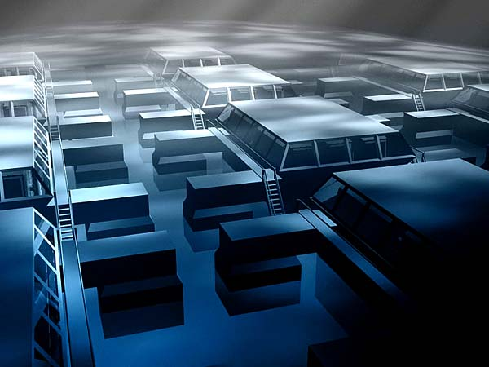
Demonstration Blue Energy

Slide 28
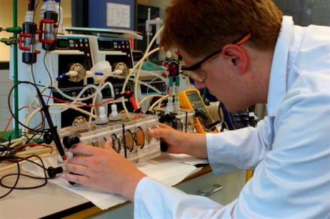
Cooperation
REDstack
Eneco
Alliander (nuon)
Fuji Film
Landustrie
Magneto
Mast Carbon
Frisia Zout

Slide 29
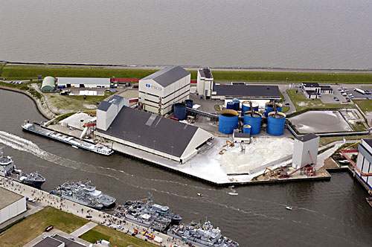
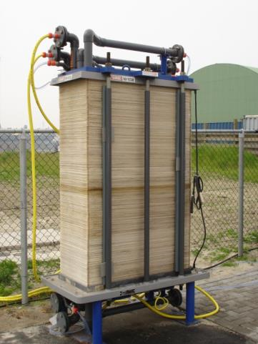

Pilot
Salt factory Harlingen
24/7 experiments
2 stacks
1200 membranes
- target: 1kW / stack

Slide 30
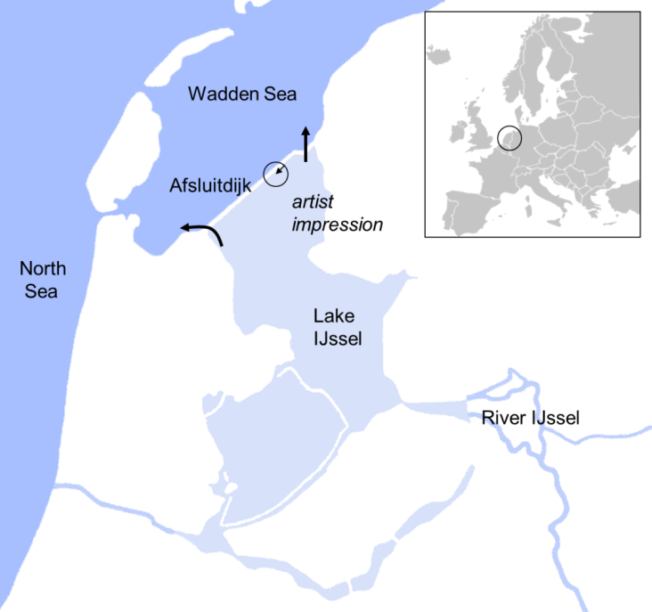
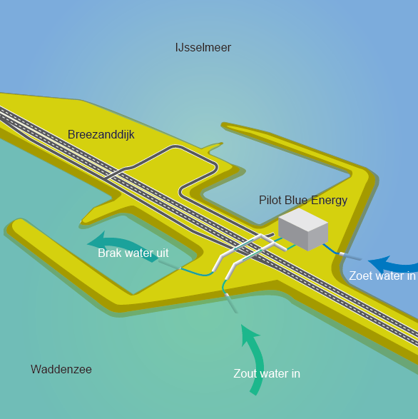
Pilot Afsluitdijk

Slide 31

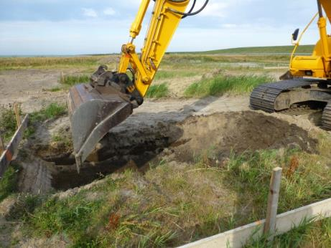
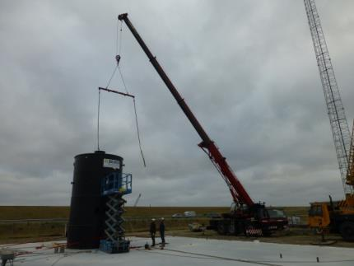
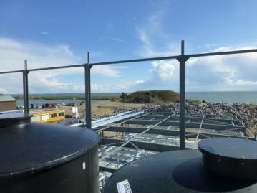
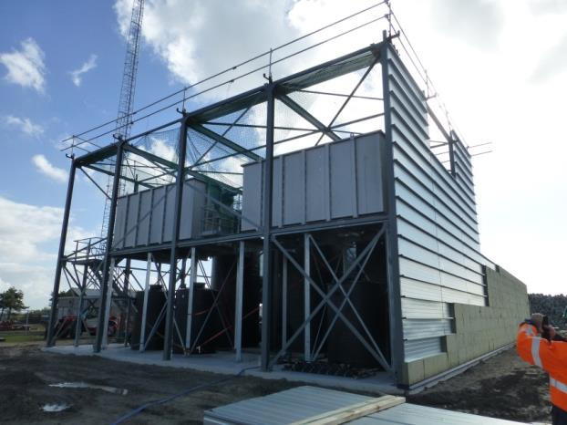
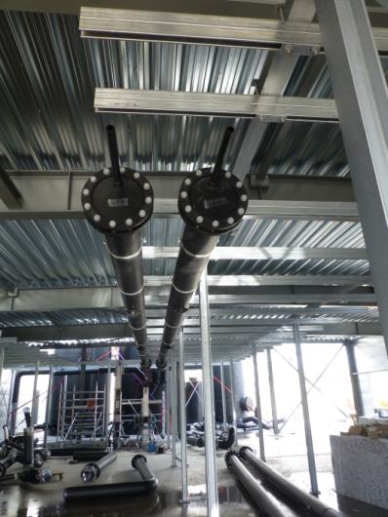
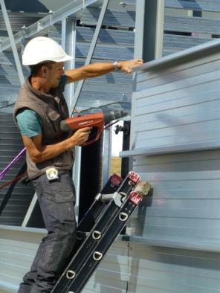
  Demo 50 kW Blue Energy Afsluitdijk

Slide 32

2014
Afsluitdijk

Slide 33

Developments
Low-cost membranes
Pre-treatment and Hydrodynamics
Feasibility
Up scaling

Slide 34
Fouling

Slide 35

Prevention of biofouling
Biofilm hypertextbook, Montana State University Center for Biofilm Engineering

Slide 36
Structure on membrane

Slide 37


Blue Energy
Region | Number of rivers | Avg. discharge (m³/s) | Total power (GW)
Africa | 513 | 170 134 | 310
Asia | 1308 | 215 318 | 338
Australia | 275 | 15 811 | 30
Europe | 767 | 66 308 | 91
North America | 2000 | 190 457 | 319
Oceania | 529 | 147 888 | 275
Oceans* | 11 | 792 | 1
South America | 439 | 319 597 | 314
SUM |  | 1 126 305 | 1 680

Slide 38

Educatie
Implementeren van water en watertechnologie in het onderwijs
Hoe:
Ontwikkelen van lesmateriaal over water.
- Primair onderwijs
- Voortgezet onderwijs
Participeren in nationale initiatieven en projecten
Master Watertechnologie
  Universitaire opleiding
  Leeuwarden
38

Slide 39






Lesmateriaal
Lesmateriaal Blue Energy (5&6 vwo)
Lespakket
Docentenhandleiding
Blue Energy Bouwpakket
200 middelbare scholen
Wetsus 3 Daagse (groep 7&8)
Proefjesles
Excursie
Verwerkingsles
100 basisscholen

Slide 40







Certificering lesmateriaal
nationaal
Natuur, Leven & Technologie
Lesmateriaal
Docentenhandleiding
Bouwpakket
200 middelbare scholen (5/6 vwo)
Sponsoring:

Slide 41


Thank you for your attention
Email: marco.degraaff@wetsus.nl
www.wetsus.nl
wetsusnl

