Slide 1
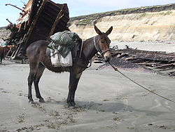
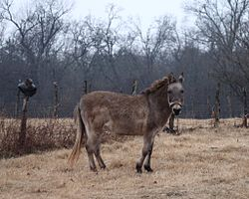
Epigenetica: Lamarckiaanse evolutie?
Hans Breeuwer
muildier
muilezel

Slide 2
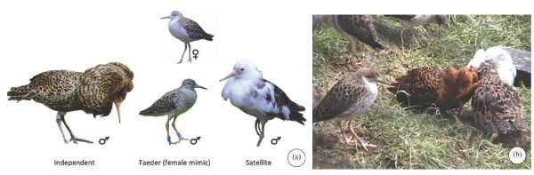
Kemphaan
Notes:
The two alternative mating strategies: (i) are strongly correlated with the
coloration of the breeding plumage, (ii) show a slight
difference in body size, (iii) are maintained for life
and (iv) are consistent with a single-locus, two-allele
autosomal genetic polymorphism (Lank et al. 1995;
Bachman & Widemo 1999). The evolution of these
alternative mating strategies and the maintenance of
their relative frequencies (5–15% of male ruffs are
satellites) appear to reflect female choice (van Rhijn
1983; Hugie & Lank 1997; Widemo 1998).
FROM:
Permanent female mimics
in a lekking shorebird
Joop Jukema and Theunis Piersma
Biol. Lett. (2006) 2, 161–164
doi:10.1098/rsbl.2005.0416

Slide 3
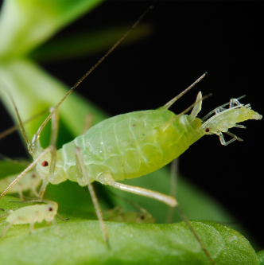
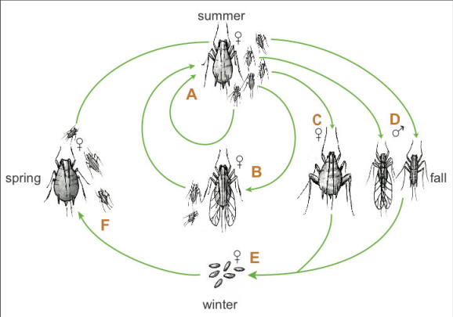
Bladluis (sex versus asex)

Slide 4
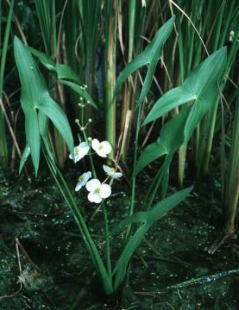
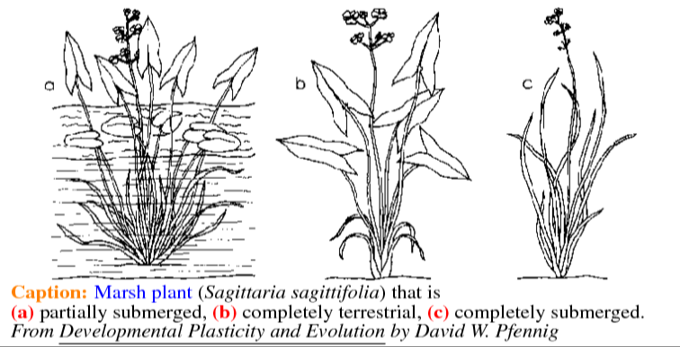
Pijlkruid

Slide 5

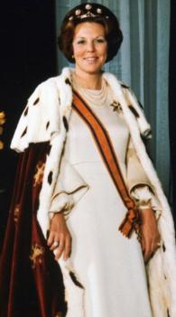
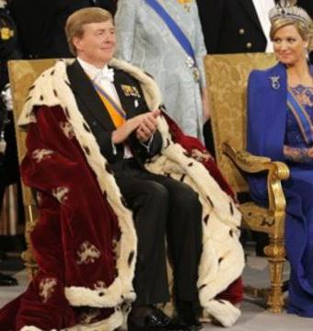


Slide 6
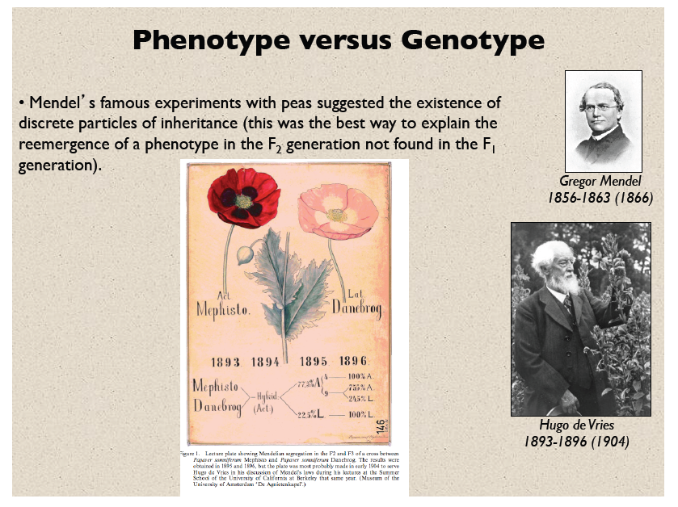
Phenotype versus genotype

Slide 7
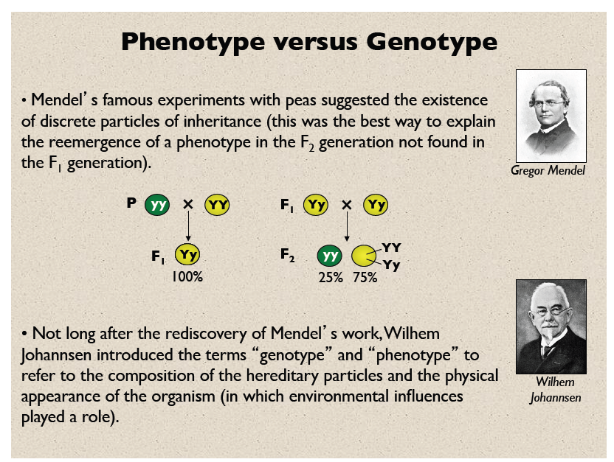
Phenotype versus genotype

Slide 8
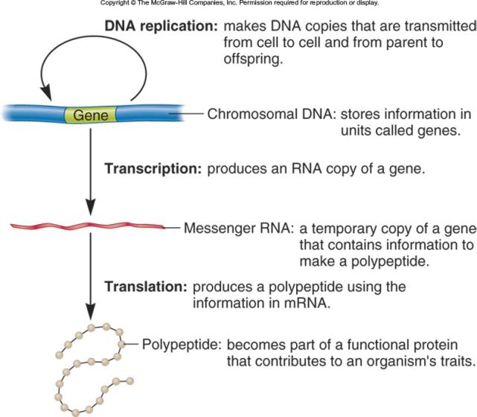
Overdracht van informatie: Het centrale dogma
DNA repair
EPIGENETICA
Notes:
Chromatin remodelling
Transcriptional control

Slide 9
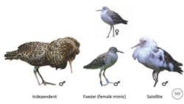


Regulatie van het genoom
Genregulatie
Verschillen tussen cellen
Cel differentiatie en weefsels
Regulatie junk DNA
inactivatie
Omgeving
Genregulatie
Fysiologische Fenotypische
respons plasticiteit

Slide 10
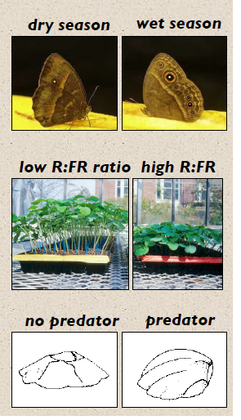
Fenotypische plasticiteit
Vlinder Bicyclus anyana:
heel anders in het droge seizoen dan
in het natte seizoen (twee ‘morphs’)
Springbalsemien Impatiens capensis:
groeit lang en dun onder lage
rood:infrarood (R:FR) ratio (schaduw),
laag en compact onder hoge R:FR ratio (licht)
Zeepok Chthamalus anisopoma:
groeit gekromd (curved) als een predator
aanwezig is (een zeeslak; kust California),
en groeit als een vulkaan zonder predator.

Slide 11
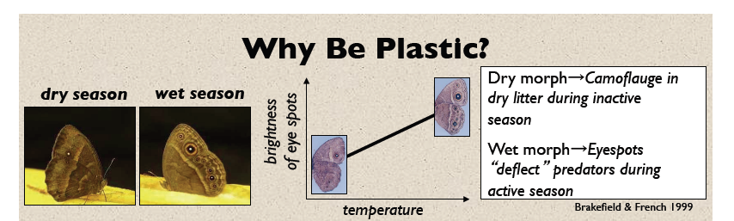

Slide 12
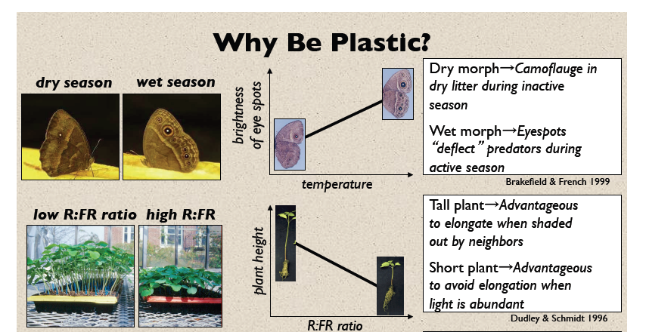

Slide 13
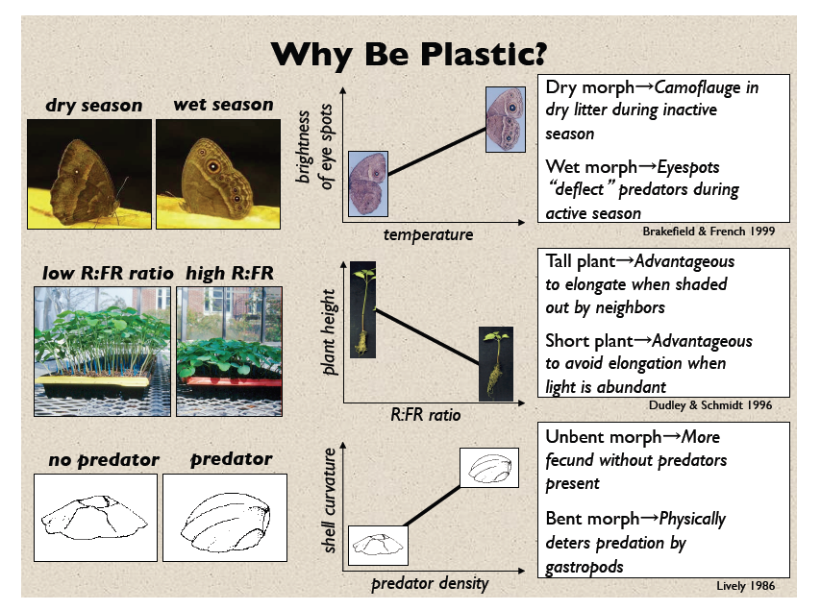

Slide 14
Hoe bestudeer je fenotypische plasticiteit?

Slide 15
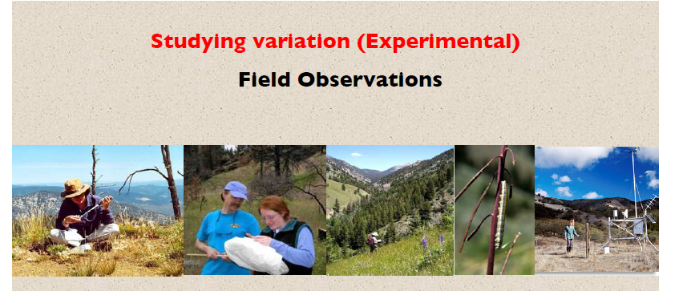
Vaak cruciaal om interacties tussen organismen en hun omgeving te begrijpen
Probleem: moeilijk om exact te bepalen welke omgevingsfactor(en) mogelijk verantwoordelijk zijn voor het uiterlijke kenmerk of de respons van een organisme

Slide 16
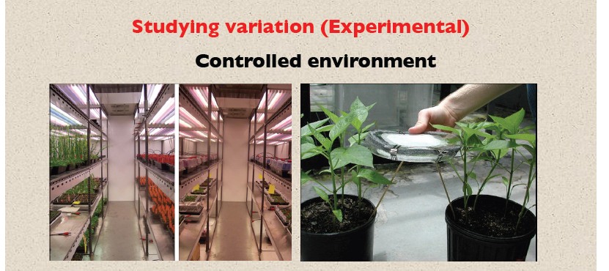
Test organismen in nauwkeurig bepaalde en gecontroleerde omgevingen.
Dan kan een variabele per keer veranderd worden (bv licht, herbivoren)
Probleem: moeilijk aan te tonen dat verschillen die gevonden zijn in gecontroleerde experimenten er echt toe doen in natuurlijke settings.

Slide 17
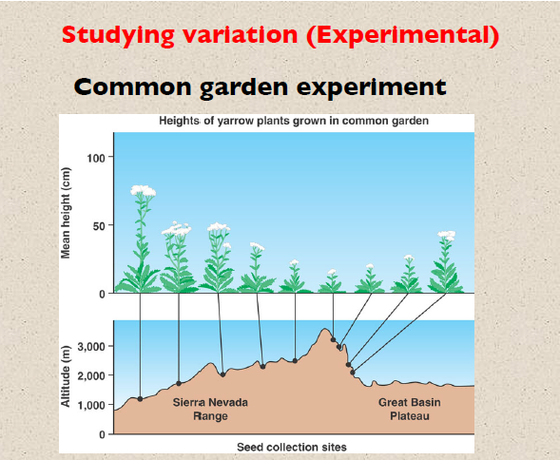
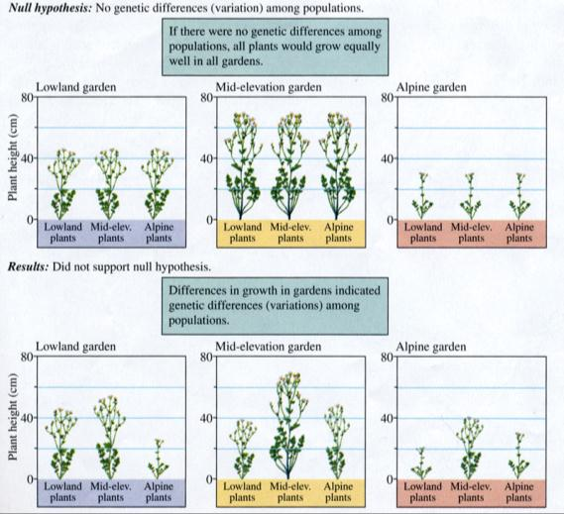
Test organismen in natuurlijke omgevingen.
Zo kan getest worden of verschillen tussen omgevingen genetisch bepaald zijn of geinduceerd door de omgeving.

Slide 18
Hoe bestudeer je fenotypische plasticiteit?
Veld observaties
Gecontroleerde omgeving
Common garden
Reciproke transplantatie
Genetisch en genomisch onderzoek
  Genomics (DNA)
  Transcriptomics (RNA)
  Proteomics (proteïnes)

Slide 19
Kemphaan
Mendelse overerving – een locus
Piermsa , Lank
Notes:
The two alternative mating strategies: (i) are strongly correlated with the
coloration of the breeding plumage, (ii) show a slight
difference in body size, (iii) are maintained for life
and (iv) are consistent with a single-locus, two-allele
autosomal genetic polymorphism (Lank et al. 1995;
Bachman & Widemo 1999). The evolution of these
alternative mating strategies and the maintenance of
their relative frequencies (5–15% of male ruffs are
satellites) appear to reflect female choice (van Rhijn
1983; Hugie & Lank 1997; Widemo 1998).
FROM:
Permanent female mimics
in a lekking shorebird
Joop Jukema and Theunis Piersma
Biol. Lett. (2006) 2, 161–164
doi:10.1098/rsbl.2005.0416

Slide 20
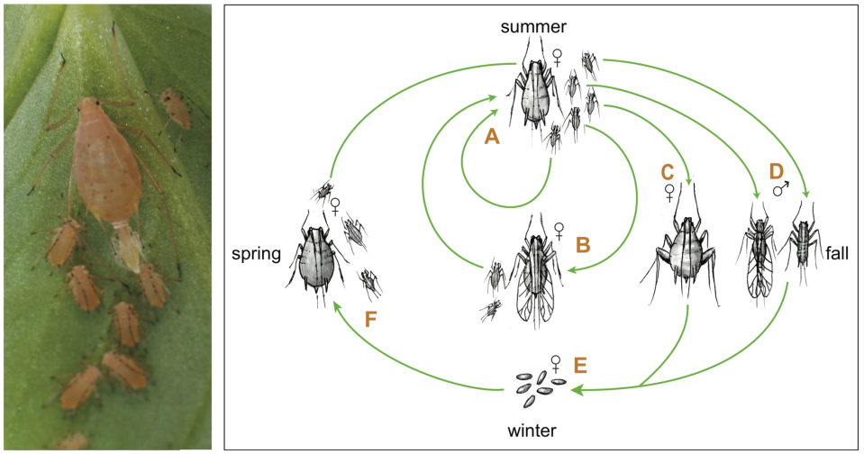
Bladluis (sex versus asex)
Verschillen DNA methylatie patronen
Jonathan Eisen (2010) PLOS Biology
Notes:
Abstract
Aphids are important agricultural pests and also biological models for studies of insect-plant interactions, symbiosis, virus vectoring, and the developmental causes of extreme phenotypic plasticity. Here we present the 464 Mb draft genome assembly of the pea aphid Acyrthosiphon pisum. This first published whole genome sequence of a basal hemimetabolous insect provides an outgroup to the multiple published genomes of holometabolous insects. Pea aphids are host-plant specialists, they can reproduce both sexually and asexually, and they have coevolved with an obligate bacterial symbiont. Here we highlight findings from whole genome analysis that may be related to these unusual biological features. These findings include discovery of extensive gene duplication in more than 2000 gene families as well as loss of evolutionarily conserved genes. Gene family expansions relative to other published genomes include genes involved in chromatin modification, miRNA synthesis, and sugar transport. Gene losses include genes central to the IMD immune pathway, selenoprotein utilization, purine salvage, and the entire urea cycle. The pea aphid genome reveals that only a limited number of genes have been acquired from bacteria; thus the reduced gene count of Buchnera does not reflect gene transfer to the host genome. The inventory of metabolic genes in the pea aphid genome suggests that there is extensive metabolite exchange between the aphid and Buchnera, including sharing of amino acid biosynthesis between the aphid and Buchnera. The pea aphid genome provides a foundation for post-genomic studies of fundamental biological questions and applied agricultural problems.
Author Summary
Aphids are common pests of crops and ornamental plants. Facilitated by their ancient association with intracellular symbiotic bacteria that synthesize essential amino acids, aphids feed on phloem (sap). Exploitation of a diversity of long-lived woody and short-lived herbaceous hosts by many aphid species is a result of specializations that allow aphids to discover and exploit suitable host plants. Such specializations include production by a single genotype of multiple alternative phenotypes including asexual, sexual, winged, and unwinged forms. We have generated a draft genome sequence of the pea aphid, an aphid that is a model for the study of symbiosis, development, and host plant specialization. Some of the many highlights of our genome analysis include an expanded total gene set with remarkable levels of gene duplication, as well as aphid-lineage-specific gene losses. We find that the pea aphid genome contains all genes required for epigenetic regulation by methylation, that genes encoding the synthesis of a number of essential amino acids are distributed between the genomes of the pea aphid and its symbiont, Buchnera aphidicola, and that many genes encoding immune system components are absent. These genome data will form the basis for future aphid research and have already underpinned a variety of genome-wide approaches to understanding aphid biology.
Figure 1. The pea aphid life cycle.
During the spring and summer months, asexual females give birth to live clonal offspring (see photo). These offspring undergo four molts during larval development to become (A) unwinged or (B) winged asexually reproducing adults. Winged individuals, capable of dispersing to new plants, are induced by crowding or stress during prenatal stages. After repeated cycles of asexual reproduction, shorter autumn day lengths trigger the production of (C) unwinged sexual females and (D) males, which can be winged or unwinged in pea aphids, depending on genotype. After mating, oviparous sexual females deposit (E) overwintering eggs, which hatch in the spring to produce (F) wingless, asexual females. In some populations, especially in locations without a cold winter, the sexual and egg-producing portions of the life cycle are eliminated, leading to continuous cycles of asexual reproduction (photo by N. Gerardo; illustration by N. Lowe).
doi:10.1371/journal.pbio.1000313.g001

Slide 21
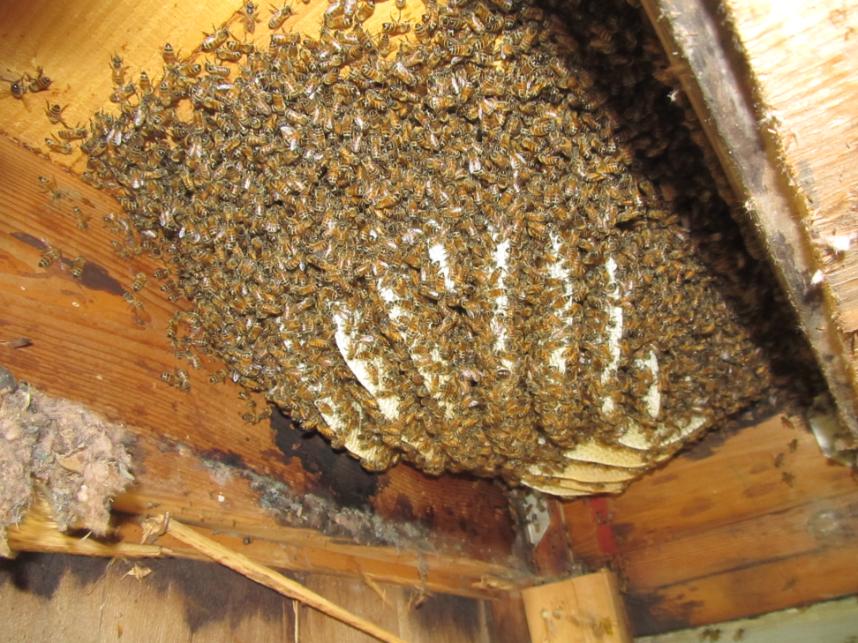

Slide 22
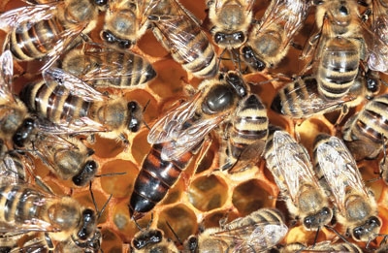
De honingbij: koningin vs werkster
Wat zijn de verschillen? - you are what you eat
Notes:
What is responsible for these dramatic differences? In this case, the phrase "you are what you eat" comes to mind. Both queen and worker bee larvae are initially fed a diet of royal jelly, which is provided by nurse bees. However, the worker bee larvae are rapidly weaned and fed a diet of nectar and pollen. In stark contrast, the queen bees are bathed in royal jelly throughout larval development, and they continue to feast on the royal-jelly diet as adults. What is so special about royal jelly? Recent research has shown that the ingredients in royal jelly are capable of inhibiting an enzyme called cytosine methyltransferase that methylates cytosine bases in honeybee DNA. Indeed, by simply lowering the expression levels of this enzyme in recently hatched honeybee larvae, researchers have mimicked the effects of royal jelly, causing larvae initially destined to become worker bees to exhibit characteristics of queen bees. By comparing the levels of cytosine methylation and gene expression across the genome in queen bees versus worker bees, researchers have also identified potential target genes whose expression is higher in queen bees (presumably because of royal jelly-mediated decreases in methylation) compared to worker bees, which could explain the differences between the two castes

Slide 23
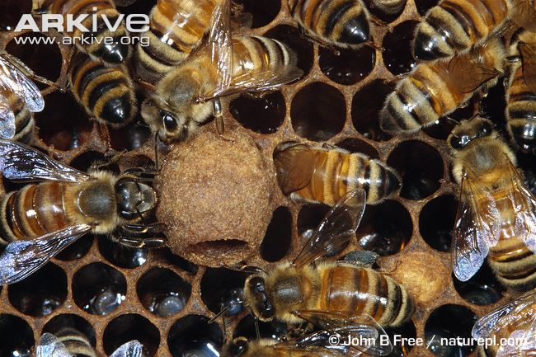

Slide 24
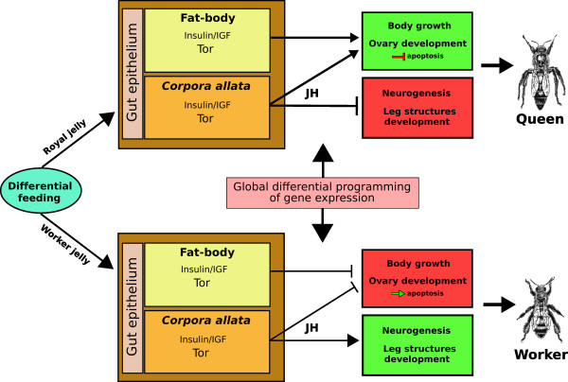
Angel Barchuk et al (2006) BMC Developmental Biology
Notes:
Towards a unified model of caste differentiation in the honeybee
In an attempt to consolidate our results with published data, we propose the following model for caste differentiation in A. mellifera (Figure 4). The type of food eaten by the larva must first be recognised by the receptor system in the gut epithelial cells followed by complex signalling via the stomatogastric nervous system [[56]; Maleszka et al., in preparation] that sends the information to the brain and the retrocerebral endocrine system. Corpora allata (CA) activity and the behavior of target tissues may be even under the upstream regulation of insulin/IGF molecules eventually secreted by the neurosecretory cells of the larval brain [57], as suggested for Drosophila [see [58]]. The other sensing organ, the fat body (FB), receives the information directly from the hemolymph. Thus, high level inputs in these organs in prospective queens result in the activation of the insulin/IGF pathway and the Tor system, which in turn increases the levels of JH synthesis in the CA, and may trigger the ALS-mediated systemic communicational pathway in FB. "Worker jelly", on the other hand, affects insulin/IGF pathway in a less pronounced manner, and may not be able to increase the levels of JH above a specific threshold.
Figure 4. Proposed general model of caste differentiation in Apis mellifera. Arrows thickness indicates the relative action levels of the considered factors. Recent studies by our group suggest that the global differential programming of gene expression in the honeybee is controlled by DNA methylation mechanism in a manner similar to epigenetic transcriptional changes inducible by environmental factors in vertebrates (Maleszka et al., in preparation). For details see Section "Towards a unified model of caste differentiation in the honeybee".
As a result of the activated signaling pathways, the high titres of JH in prospective queens regulate the expression of physiometabolic genes that together with the available nutrients from royal jelly determine the general body growth pattern. In this model, the up-regulation of tor in prospective queen larvae can be seen as a determinant of the observed differential growth rates. On the other hand, low levels of JH combined with limited nutrient availability in prospective workers lead to the development of smaller adults. In this case, the up-regulation of creg and crc (negative growth regulators) in workers may constitute the second determinant of a dual system of growth regulation in response to differential feeding in honeybees.
Furthermore, reaching a JH threshold in prospective queens (Figure 1) not only permits general body growth but also acts by negatively regulating the development of some organismal systems that are characteristic of adult workers and are also present in the original developmental pattern. High levels of JH may, for instance, inhibit the development of worker-specific leg structures [59], as well as prevent cell death in the ovaries, leading to a higher number of ovarioles in adult queens. Moreover, JH is likely to control the extended brain development specifically that of MB, resulting in bigger worker brains when compared to queen brains [26,2]. Thus, JH has contrasting effects on growth and development, at least on certain structures and might be regulating trade-off processes during caste differentiation in A. mellifera.

Slide 25
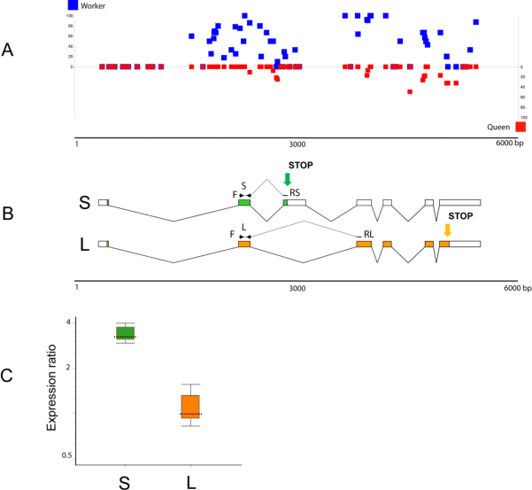
Koningin versus werkvolk
Royal jelly remt expressie DNA methyltransferase (DNMT3) en dus CpG methylation patroon
Nadoen met siRNA
mRNA van een hersengen wordt verschillend gespliced.
S expressie hoog in brein koningin
Frank Lyko et al 2010 PLOS Biology
Notes:
What is responsible for these dramatic differences? In this case, the phrase "you are what you eat" comes to mind. Both queen and worker bee larvae are initially fed a diet of royal jelly, which is provided by nurse bees. However, the worker bee larvae are rapidly weaned and fed a diet of nectar and pollen. In stark contrast, the queen bees are bathed in royal jelly throughout larval development, and they continue to feast on the royal-jelly diet as adults. What is so special about royal jelly? Recent research has shown that the ingredients in royal jelly are capable of inhibiting an enzyme called cytosine methyltransferase that methylates cytosine bases in honeybee DNA. Indeed, by simply lowering the expression levels of this enzyme in recently hatched honeybee larvae, researchers have mimicked the effects of royal jelly, causing larvae initially destined to become worker bees to exhibit characteristics of queen bees. By comparing the levels of cytosine methylation and gene expression across the genome in queen bees versus worker bees, researchers have also identified potential target genes whose expression is higher in queen bees (presumably because of royal jelly-mediated decreases in methylation) compared to worker bees, which could explain the differences between the two castes
Fertile queens and sterile workers are alternative forms of the adult female honeybee that develop from genetically identical larvae following differential feeding with royal jelly. We show that silencing the expression of DNA methyltransferase Dnmt3, a key driver of epigenetic global reprogramming, in newly hatched larvae led to a royal jelly–like effect on the larval developmental trajectory; the majority of Dnmt3 small interfering RNA–treated individuals emerged as queens with fully developed ovaries. Our results suggest that DNA methylation in Apis is used for storing epigenetic information, that the use of that information can be differentially altered by nutritional input, and that the flexibility of epigenetic modifications underpins, profound shifts in developmental fates, with massive implications for reproductive and behavioral status.
The queen honey bee and her worker sisters do not seem to have much in common. Workers are active and intelligent, skillfully navigating the outside world in search of food for the colony. They never reproduce; that task is left entirely to the much larger and longer-lived queen, who is permanently ensconced within the colony and uses a powerful chemical influence to exert control. Remarkably, these two female castes are generated from identical genomes. The key to each female's developmental destiny is her diet as a larva: future queens are raised on royal jelly. This specialized diet is thought to affect a particular chemical modification, methylation, of the bee's DNA, causing the same genome to be deployed differently. To document differences in this epigenomic setting and hypothesize about its effects on behavior, we performed high-resolution bisulphite sequencing of whole genomes from the brains of queen and worker honey bees. In contrast to the heavily methylated human genome, we found that only a small and specific fraction of the honey bee genome is methylated. Most methylation occurred within conserved genes that provide critical cellular functions. Over 550 genes showed significant methylation differences between the queen and the worker, which may contribute to the profound divergence in behavior. How DNA methylation works on these genes remains unclear, but it may change their accessibility to the cellular machinery that controls their expression. We found a tantalizing clue to a mechanism in the clustering of methylation within parts of genes where splicing occurs, suggesting that methylation could control which of several versions of a gene is expressed. Our study provides the first documentation of extensive molecular differences that may allow honey bee
s to generate different phenotypes from the same genome.
The CpG methylation pattern indicating the level of methylation for individual CpGs (blue squares, workers; red squares, queens). (B) Gene model of GB18602 showing the two spliced variants S (short protein) and L (long protein) and the positions of PCR primers used for variant-specific amplifications. The green and orange arrows indicate the positions of two alternative Stop codons. (C) Relative expression of the two spliced variants in brains of queens and workers examined by real-time PCR. The level of transcript S (green) encoding the truncated protein is significantly up-regulated in the queen brain, whereas the L variant (orange) is expressed at the same level in both castes. The queen expression represents a combined set of data from three independent queen samples: 4 mo old (1 brain), 12 mo old (2 brains), and swarm queens of unknown age (2 brains). Workers were 8 d old (6 brains in 3 replicates). The reference gene was calmodulin [2]. Whisker-box plot of expression ratio values: dotted line, median value; box, inter-quartile range of values; whiskers, outer 50% of observations.
Lyko F, Foret S, Kucharski R, Wolf S, et al. (2010) The Honey Bee Epigenomes: Differential Methylation of Brain DNA in Queens and Workers. PLoS Biol 8(11): e1000506. doi:10.1371/journal.pbio.1000506
http://www.plosbiology.org/article/info:doi/10.1371/journal.pbio.1000506

Slide 26
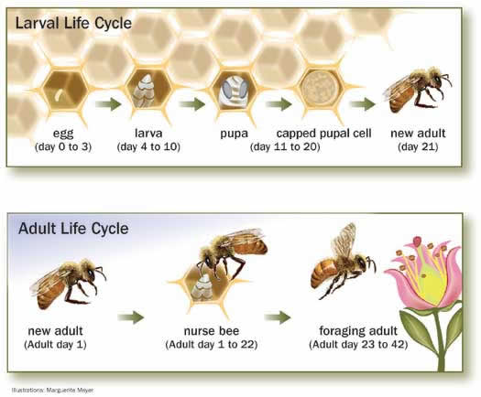
Het leven van een werkster

Slide 27
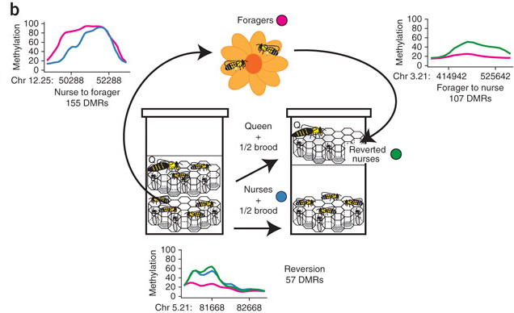
Reversible switching between epigenetic states in honeybee behavioral subcastes
Differential methylated region
Neuron dev
Cytoskelton dev
Brian Herb et al (2012) Nature Neuroscience
Notes:
Honeybees in a hive have different fixed roles, or castes, even though their DNA sequence is often identical. What then decides these differing roles and are there any epigenetic changes that parallel these differences? On page 1371, Herb and colleagues provide some answers to these questions.
It is already known that a deciding factor for the role assigned to a honeybee is its care early in life: female larvae that are fed more royal jelly (a protein-rich secretion from glands in worker bees' heads) grow into queen bees, whereas larvae destined to be worker bees only get limited amounts of this secretion. Queen bees are in charge of laying eggs, whereas worker bees take on differing roles at different ages, ranging from cleaning cells to carrying water.
Such differences in phenotype on the basis of early-life care are suggestive of an epigenetic influence. Accordingly, the authors used whole-genome bisulfite sequencing and high-throughput methylation analysis to look at differences in DNA methylation between sister bees.
Herb and colleagues found no DNA methylation differences between newly emerging worker and queen bees, but did uncover differences between two worker subcastes: nurse bees, which feed other bees, and foragers, which travel outside of the hive to collect food. Although the queen bee's behavior is fixed, and it cannot switch to being a worker, the roles of these worker subcastes are not fixed, and nurse bees can switch to foraging later in life. The transition from nurse to forager bee showed a relationship to DNA methylation, and the authors found over 150 methylated regions that were different in nurses and foragers.
However, these differences could just be linked to the change from nurse to forager bee, rather than reflecting the differences in behavior between these subcastes. To exclude this possibility, the authors tricked some foragers into reverting back to their nurse roles. This behavioral 'U turn' resulted in DNA methylation patterns that were also mostly reverting, showing a pattern more like that seen in nurse bees than that in foragers.
These findings suggest that there is a close link between the pattern of DNA methylation and the role of worker bees. More broadly, these results underline that it is not just the DNA sequence that decides how genes modulate behavior and that epigenetic modulation can be a powerful effector of behavioral patterns.

Slide 28
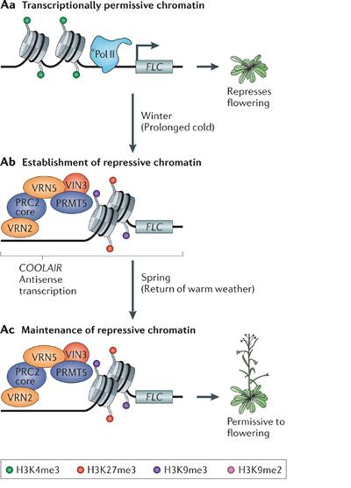
Vernalisatie bij planten
Trimethylated
Expression FLC
Dimethylated
Repression FLC
Robert Feil & Mario Fraga (2012) Nature Review Genetics
Notes:
A | Vernalization in plants. In Arabidopsis thaliana, the FLOWERING LOCUS C (FLC) gene encodes a transcription factor that functions as a repressor of flowering. Before vernalization, the active chromatin mark of histone H3 trimethylated on lysine-4 (H3K4me3; shown by green circles) is linked to FLC expression (Aa). Winter temperatures initially induce the transcription of COOLAIR antisense transcripts⁹⁰. Subsequently, there is recruitment of different Polycomb repressive complex 2 (PRC2) components including VERNALIZATION 2 (VRN2) and the PHD finger proteins VRN5 and VERNALIZATION INSENSITIVE 3 (VIN3; expression of which is cold-induced¹⁴⁰), and of protein arginine N-methyltransferase 5 (PRMT5; also known as SKB1) (Ab). This brings about repressive chromatin, which is characterized by H3K27me3, H3K9me3 and H4 arginine-3 symmetrical dimethylation (H4R3me2s). After the winter period the repressive chromatin is maintained, thus preventing FLC expression and allowing early flowering of the growing plant (Ac). B | Agouti viable yellow (A ^{vy} ) mice. The A ^{vy} allele originated through retrotransposition of an intracisternal A-particle (IAP) upstream of the canonical wild-type transcription start site (shown by grey right-angled arrows) of the agouti gene¹⁴¹. These mice are heterozygous for the A ^{vy} allele, and the other allele (a) produces no functional agouti protein. Alternative transcription (shown by black right-angled arrows) of the A ^{vy} allele starts from a cryptic promoter at the IAP element, and is inhibited by methylation of surrounding CpG dinucleotides¹⁴². IAP methylation is established in the early embryo, and is somatically maintained throughout subsequent development (central panels). Aberrant (high) A ^{vy} expression leads to the agouti (yellow) phenotype; unperturbed (low) expression results in the pseudo-agouti (brown) phenotype; and intermediate expression states produce a large variety of variegated phenotypes. Because A ^{vy} expression depends on the methylation status of the IAP, the coat colour of A ^{vy} mice ultimately depends on this epigenetic trait. Maternal diet supplementation with folate and other compounds that affect the methionine cycle leads to IAP methylation and A ^{vy} repression in the offspring, which are consequently pseudo-agouti⁹⁵ (right panel). Maternal exposure to endocrine disruptors or toxic compounds can induce the overexpression of A ^{vy} through hypomethylation of IAP (left panel)^{96, 97, 99}. As a result, the offspring exhibit the agouti (yellow) phenotype. In the published studies, the mothers were generally pseudo-agouti or mottled. C | Eye colour changes in Drosophila melanogaster. Red eye colour in D. melanogaster depends on the expression of the White gene. Translocation of White next to pericentric heterochromatin (the speak white-mottled-4 mutation) leads to a mosaic pattern of expression of White, and thus a variegated (white or red) eye colour. In white cells, the stress-responsive transcription factor ATF2 mediates White repression. This process could be mediated by the recruitment of histone methyltransferases (HMTs) that establish repressive H3K9me2 marks⁹¹ (Ca). Heat shock or osmotic stress during early larval development lead to p38-dependent ATF2 phosphorylation, release of ATF2 from the White promoter, and subsequent gene activation⁹¹ (Cb). The resulting active chromatin state is somatically maintained and adult flies display completely red eyes. Pol II, RNA polymerase II.
Epigenetics and the environment: emerging patterns and implications
Robert Feil & Mario F. Fraga
Nature Reviews Genetics 13, 97-109 (February 2012)
doi:10.1038/nrg3142

Slide 29
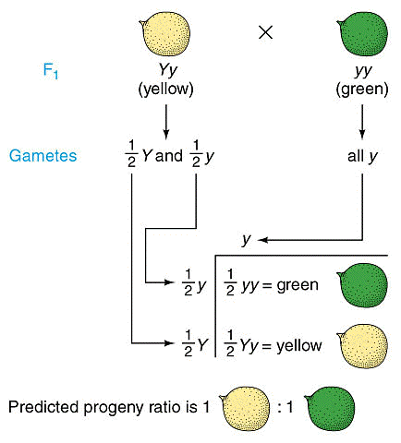
Genetics is fair…
Laws of Mendel
Equal segregation of alleles (splitsingswet)
Independent assortment of pairs of genes (onafhankelijkheidswet)
Notes:
One additional reason that many of us believe that the genome operates as a harmonious unit comes from the observations of Mendel that boils down to the laws of genetics that we all have learned in the past.
Like humans, whenever there are laws there will be elements that try to escape from these laws and gain advantage at the cost of others.

Slide 30
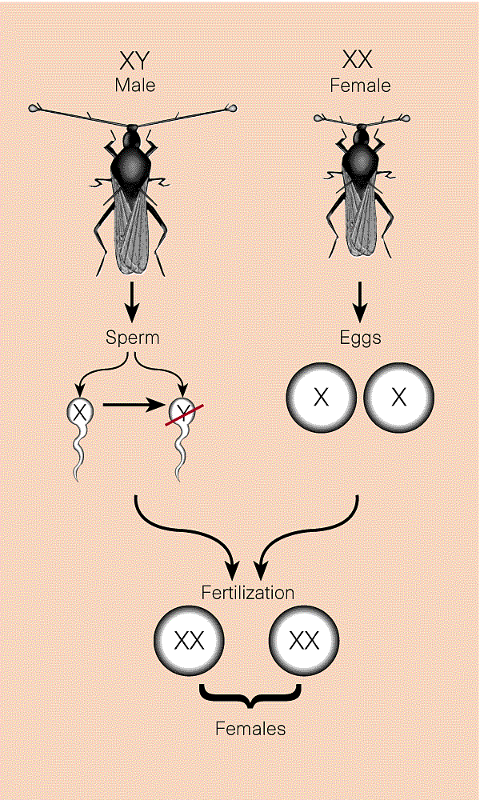
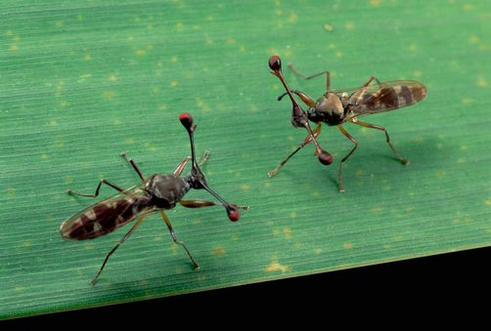
…but not always!
Wilkinson, Presgraves and Crymes (1998)
Stalk-eyed flies
Some populations female-biased
Meiotic drive X-chromosomes

Slide 31
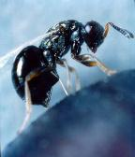
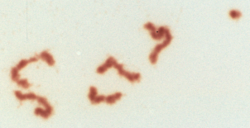
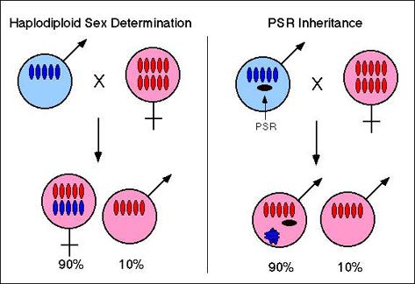
PSR – Paternal Sex Ratio –
Nasonia vitripennis
PSR
Beukeboom, Werren, Reed

Slide 32
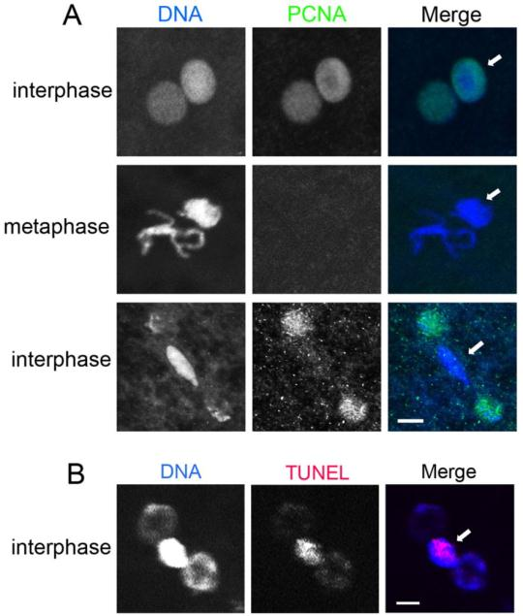
Replicatie van de paternale chromsomen stopt na de eerste mitotische deling als PSR aanwezig is
Proliferating Cell Nuclear Antigen (PCNA) is een ringvormige cofactor van DNA-polymerases
TUNEL is detectiemethode voor gefragmenteerd DNA
PSR veroorzaakt abnormale fosforylering van serine in histon 3 aan het einde van mitose 1
Hypercondensatie van paternale chromosomen
Notes:
In the presence of PSR, the paternal chromatin undergoes the first but not subsequent rounds of DNA replication, and incurs DNA damage during the first mitosis. (A) Both maternal and paternal chromatin become enriched for PCNA (green) during the first round of DNA replication (top row), and lose this mark upon entry into the first mitosis (middle row). White arrows indicate the paternal chromatin mass. Maternally derived nuclei become enriched for PCNA upon entry into the second round of replication, while the paternal chromatin mass shows no PCNA localization (bottom row). DNA is blue. Scale bar: 5 µm. (B) The paternal chromatin mass (white arrow) becomes positive for TUNEL (red) during the first mitosis (top row). This pattern resembles yolk nuclei (white arrows in the bottom panel), which are present in the middle of later stage embryo and become TUNEL positive as they become degraded by apoptosis. DNA is blue. Scale bar: 8 µm in the top row and 50 µm in the bottom panel.
Proliferating Cell Nuclear Antigen (PCNA) is een ringvormige cofactor van DNA-polymerases. Het vormt een ring om DNA waar alle proteïnen die betrokken zijn bij de DNA-replicatie aan kunnen binden en het reguleert hun processen. PCNA wordt de 'Maestro van de replicatievork' genoemd.
Terminal deoxynucleotidyl transferase dUTP nick end labeling (TUNEL) is a method for detecting DNA fragmentation by labeling the terminal end of nucleic acids.

Slide 33
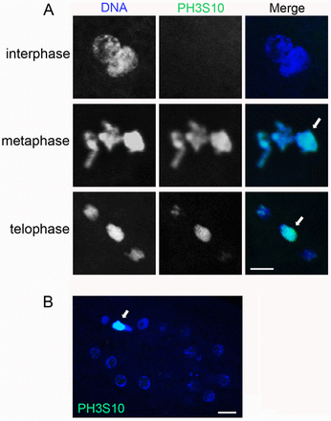
PSR causes the paternal chromatin to abnormally retain phosphorylation of Histone H3 (PH3) at serine residue 10 upon exit from the first mitosis
Nodig voor de binding van condensins
Hypercondensatie van paternale chromosomen
Notes:
PSR causes the paternal chromatin to abnormally retain phosphorylation of Histone H3 (PH3) at serine residue 10 upon exit from the first mitosis. (A) Neither set of chromatin exhibits the PH3S10 mark (green) before entry into the first mitosis (top row). However, both sets are PH3S10 positive during the first metaphase (middle row). Maternally derived daughter nuclei lose PH3S10 while the paternal chromatin mass abnormally retains this mark (bottom row). (B) A later stage cleavage embryo in interphase; the paternal chromatin mass retains the PH3S10 mark while the maternally derived nuclei do not. White arrows indicate the paternal chromatin. DNA is blue. Scale bar: 12 µm.
The PH3S10 mark is functionally associated with the proper condensation of chromatin into chromosomes at the onset of mitosis (Koshland and Strunnikov, 1996; Strahl and Allis, 2000). Specifically, this mark is thought to be necessary for the loading of Condensins to chromatin (Ono et al., 2003; Hirano, 2005; Cobbe et al., 2006).

Slide 34
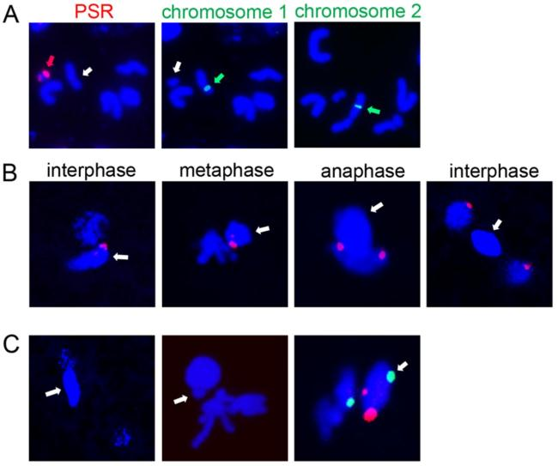
PSR localizes at the periphery of the paternal nucleus and migrates from the paternal to maternal chromatin during the first anaphase
Notes:
PSR localizes at the periphery of the paternal nucleus and migrates from the paternal to maternal chromatin during the first anaphase. (A) Meiotic chromosome spreads from male testes hybridized with different probes that recognize specific satellite DNA repeats on PSR and the normal wasp chromosomes. The red arrow in the first panel indicates PSR; the probes recognize two satellite blocks, one on each end of the PSR chromosome. The white arrow indicates the normal chromosome carrying the rDNA locus. The green arrow in the second panel indicates a single satellite block that overlaps with the nucleolar organizer region (NOR) seen in the first panel (white arrow). The green arrow in the third panel indicates a single satellite block on a different normal wasp chromosome. (B) Different stages of the first mitosis in PSR-positive embryos are shown. White arrows indicate the paternal chromatin. PSR is red. (C) The first panel depicts the paternal chromatin mass (white arrow) co-segregating with a maternally derived daughter nucleus following the first mitosis. The second panel shows metaphase of the first mitosis; PSR resides just outside the paternal nucleus (white arrow). The third panel shows prophase of the first mitosis; both PSR (red) and the rDNA locus (green) associate with the periphery of the nuclear envelope. DNA is blue. The rDNA locus is shown in green in A and C.
B chromosomes are centric chromosomal fragments present in thousands of eukaryotic genomes. Because most B chromosomes are non-essential, they can be lost without consequence. In order to persist, however, some B chromosomes can impose strong forms of intra-genomic conflict. An extreme case is the paternal sex ratio (PSR) B chromosome in the jewel wasp Nasonia vitripennis. Transmitted solely via the sperm, PSR ‘imprints’ the paternal chromatin so that it is destroyed during the first mitosis of the embryo. Owing to the haplo-diploid reproduction of N. vitripennis, PSR-induced loss of the paternal chromatin converts embryos that should become females into PSR-transmitting males. This conversion is key to the persistence of PSR, although the underlying mechanisms are largely unexplored. We assessed how PSR affects the paternal chromatin and then investigated how PSR is transmitted efficiently at the cellular level. We found that PSR does not affect progression of the paternal chromatin through the cell cycle but, instead, alters its normal Histone H3 phosphorylation and loading of the Condensin complex. PSR localizes to the outer periphery of the paternal nucleus, a position that we propose is crucial for it to escape from the defective paternal set. In sperm, PSR consistently localizes to the extreme anterior tip of the elongated nucleus, while the normal wasp chromosomes localize broadly across the nucleus. Thus, PSR may alter or bypass normal nuclear organizational processes to achieve its position. These findings provide new insights into how selfish genetic elements can impact chromatin-based processes for their survival.

Slide 35

PSR – Paternal Sex Ratio –
Nasonia vitripennis
PSR
Beukeboom, Werren, Reed
Leo Beukeboom & Jack Werren

Slide 36
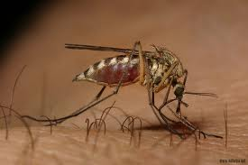

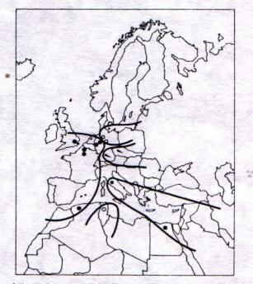
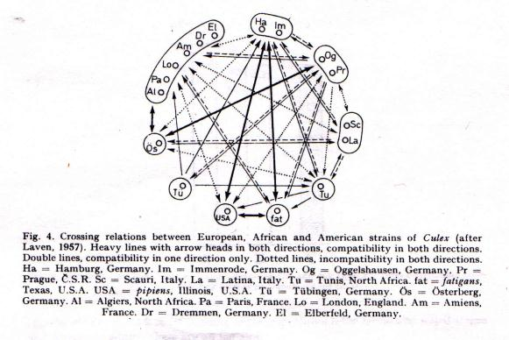
Hannes Laven - 1951/1953 -
Crossing experiments with Culex strains

Slide 37
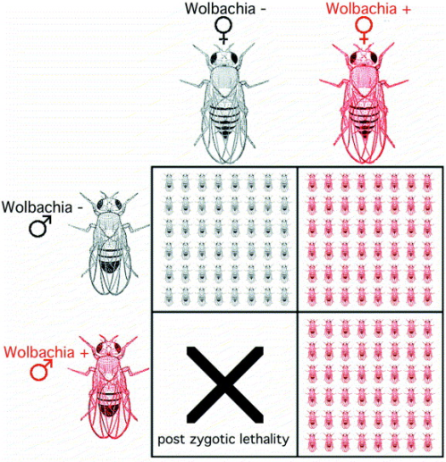
Unidirectional incompatibility eenrichtingsweg

Slide 38
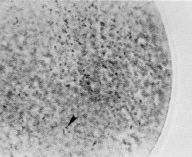
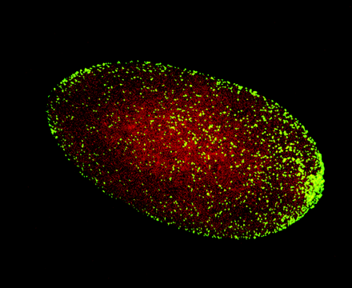
Wolbachia (and Cardinium) in their host

Slide 39
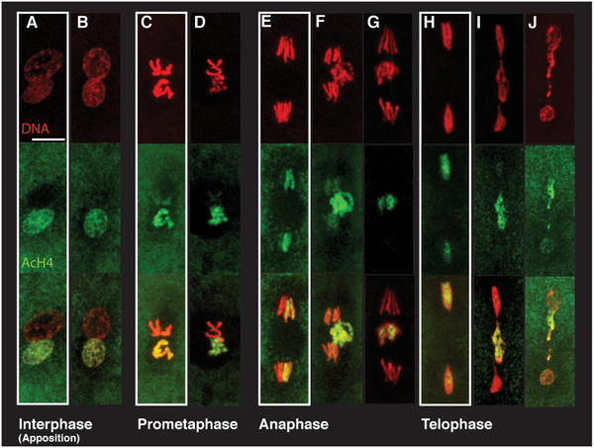
Kamikazisperma

Slide 40
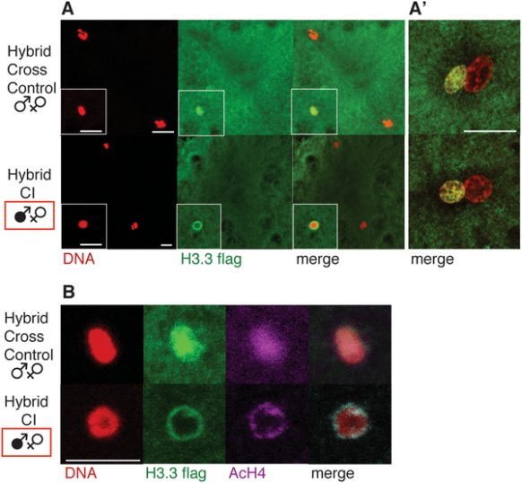
CI Affects Histone Deposition in the Male Pronucleus
Landman et al 2009 Plos Pathogens
Notes:
CI Affects Histone Deposition in the Male Pronucleus
Immediately following the removal of protamines from the male pronucleus, paternal nucleosomes are assembled using maternally supplied histones. This replication-independent nucleosome assembly specifically involves the H3.3 histone variant, which is deposited along with H4, followed by H2A and H2B [19]. H3.3 is thus specifically deposited in the male pronucleus before the completion of the female meiosis and remains enriched in paternal chromosomes throughout the first mitotic division. The paternal chromosomes lose H3.3 by incorporation of canonical histone H3 with each new round of replication [20].
In order to take advantage of both the strong CI of D. simulans and of transgenic markers only available in D. melanogaster, we performed hybrid crosses between D. simulans males and D. melanogaster females. Previous studies demonstrated that this hybrid cross exhibits a robust CI and Rescue and is an appropriate system for studying CI [21]. Infected or non-infected D. simulans males were crossed with non-infected transgenic D. melanogaster females expressing a tagged H3.3-FLAG histone (CI and control crosses, respectively). In all embryos examined from the above control hybrid cross (n = 51), a robust H3.3 deposition was observed in the male pronucleus prior to completion of female meiosis, similar to the H3.3 deposition observed in single species D. melanogaster control crosses (not shown). All exhibited normal H3.3 deposition in the male pronucleus before the completion of female meiosis (n = 30, Figure 3A). However in hybrid CI crosses, 22% of the embryos exhibited an abnormal H3.3 accumulation at the periphery of the male pronucleus before the completion of female meiosis (n = 63, Figure 3A). In all nuclei with an abnormal accumulation at the periphery, no H3.3 staining was observed inside the nucleus suggesting a failure or an altered pattern of early H3.3 deposition. No lamin is detected at this stage (Figure S1), which suggests that nucleosome assembly occurs prior to the formation of the pronuclear envelope, ruling out a general nuclear import defect. Double immunostaining experiments showed that histone H4 colocalized with H3.3 in peripheral rings in CI embryos (Figure 3B). These abnormal rings of H3.3 and H4 are never observed during pronuclei apposition (Figure 3A′, n>30 for control and CI crosses). This suggests that CI results in a delayed, but not complete inhibition of H3.3/H4 nuclear deposition
Landmann F, Orsi GA, Loppin B, Sullivan W (2009) Wolbachia-Mediated Cytoplasmic Incompatibility Is Associated with Impaired Histone Deposition in the Male Pronucleus. PLoS Pathog 5(3): e1000343. doi:10.1371/journal.ppat.1000343
http://www.plospathogens.org/article/info:doi/10.1371/journal.ppat.1000343

Slide 41
Unidirectional incompatibility eenrichtingsweg

Slide 42
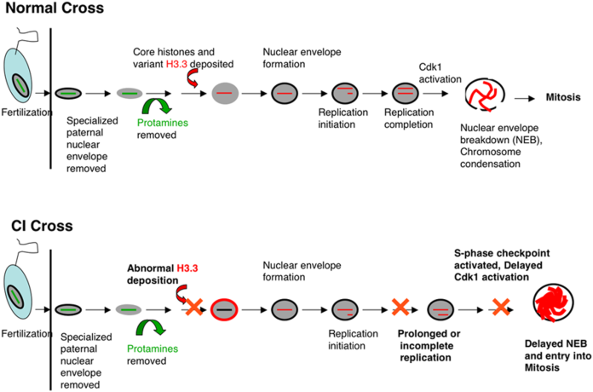
Notes:
Normal cross: Immediately following fertilization, the specialized nuclear envelope (lacking nuclear pores) of the male pronucleus is removed. Next, the protamines are removed and replaced by maternally supplied histones, including the replication-independent histone H3.3. This event is followed by lamin deposition and formation of a conventional nuclear envelope containing nuclear pores. Next, S-phase is initiated and upon completion, Cdk1 is activated driving nuclear envelope breakdown, chromosome condensation, and spindle assembly. CI cross: At the cytological level, removal of the sperm nuclear envelope and protamines appear normal. Often however, histone H3.3 deposition is abnormal, resulting in a ring of histone H3.3 encompassing the paternal pronucleus. This is the earliest documented CI phenotype in embryos and is similar to that observed for mutants in the chromatin remodeling protein Chd1. Imaging PCNA, a marker for replicating chromosomes, indicates that replication initiates normally in CI embryos, but is prolonged or incomplete. This may be a direct result of the earlier defects in H3.3 deposition. Replication delays activate S-phase checkpoints and thus are likely the cause of the previously described delays in Cdk1 activation and nuclear envelope breakdown.

Slide 43
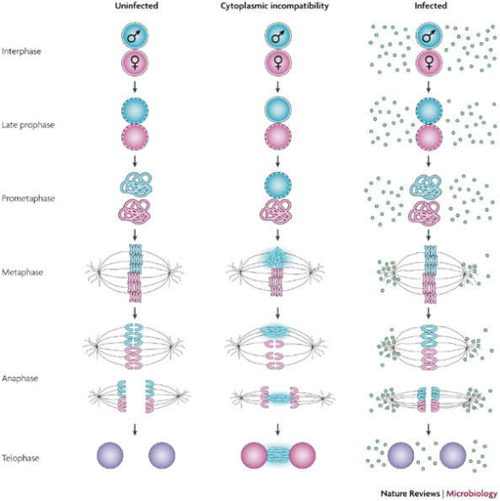

Slide 44
Symbiont transmission: evolutionary conflict
However: Vertical transmission: maternally
P
X
Male: dead end
F1
Different interests host-symbiont
Notes:
Nuclear genes: biparental; plasma genes: uniparental. Nuclear: optimal sexratio 50:50; plasma: more daughters.

Slide 45
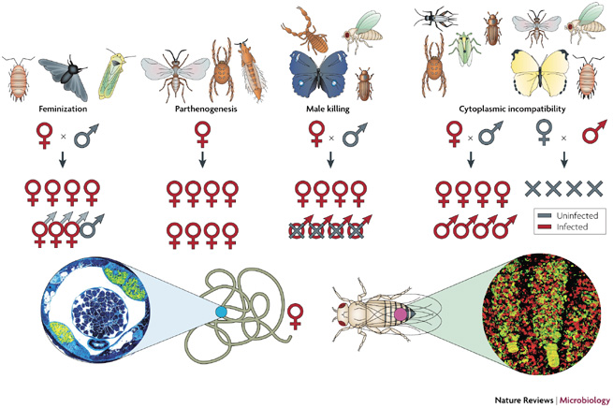

Slide 46

Phylogenetic placement of symbiotic bacteria
Moran & Wernegreen, 2000
TREE

Slide 47



Epigenetica en soortvorming
bluebird
Nasonia
blowfly

Slide 48


Distribution of Nasonia
Nasonia longicornis
Nasonia vitripennis
Nasonia giraulti

Slide 49


Interspecific crosses Nasonia
Wolbachia infected

Slide 50
Interspecific crosses Nasonia
Wolbachia infected

Slide 51
Interspecific crosses Nasonia
Wolbachia infected

Slide 52
Interspecific crosses Nasonia
Wolbachia infected
After antibiotic treatment

Slide 53
Interspecific crosses Nasonia
Wolbachia infected
After antibiotic treatment

Slide 54
Distribution of Nasonia
Nasonia longicornis
Nasonia vitripennis
Nasonia giraulti

Slide 55
Kemphaan
Notes:
The two alternative mating strategies: (i) are strongly correlated with the
coloration of the breeding plumage, (ii) show a slight
difference in body size, (iii) are maintained for life
and (iv) are consistent with a single-locus, two-allele
autosomal genetic polymorphism (Lank et al. 1995;
Bachman & Widemo 1999). The evolution of these
alternative mating strategies and the maintenance of
their relative frequencies (5–15% of male ruffs are
satellites) appear to reflect female choice (van Rhijn
1983; Hugie & Lank 1997; Widemo 1998).
FROM:
Permanent female mimics
in a lekking shorebird
Joop Jukema and Theunis Piersma
Biol. Lett. (2006) 2, 161–164
doi:10.1098/rsbl.2005.0416

Slide 56
Epiloog:
Epigenetica bepaalt veel cellulaire processen doordat het gen-expressie stuurt en stabiliteit van het genoom bepaalt.
Epigenetische modificaties zijn dynamisch (‘writers / erasers’) en daardoor beinvloedbaar door interne en externe factoren
- Voeding, Omgeving, Gedrag, Levensstijl, etc.
Er kunnen relatief eenvoudig fouten/veranderingen optreden.
- Met ziekten als gevolg, waaronder kanker, mentale stoornissen, etc.
Epigenetica is een bron voor fenotypische variatie; naast genetische ook epigenetische variatie
- Aangrijpingspunt voor selectie, adaptatie, drift; kortom evolutie.

Slide 57


Epigenetica: acquired traits
Lamarck

