Slide 1
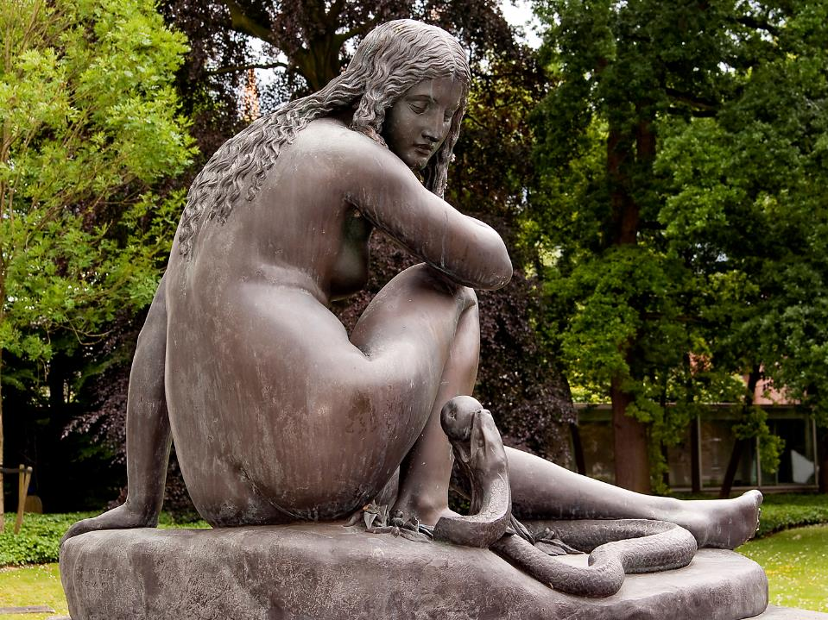
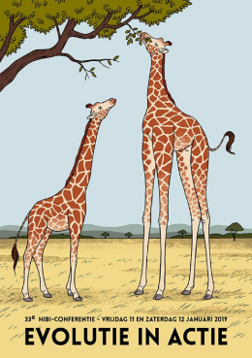

De slang, die Eva verleidde: hoe de slang haar poten verloor.
Eric W.A. Mulder
J.A. van der Ven: De bekoring van Eva, 1841
Afg. in brons, 1985, Noordbr. Museum, ‘s-Hertogenbosch

Slide 2


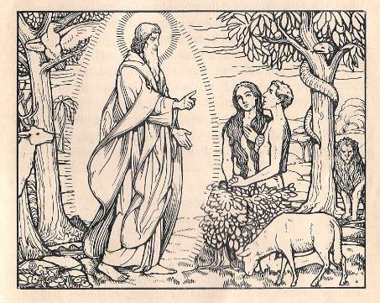
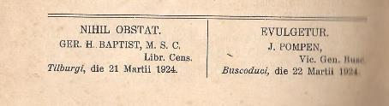

Slide 3
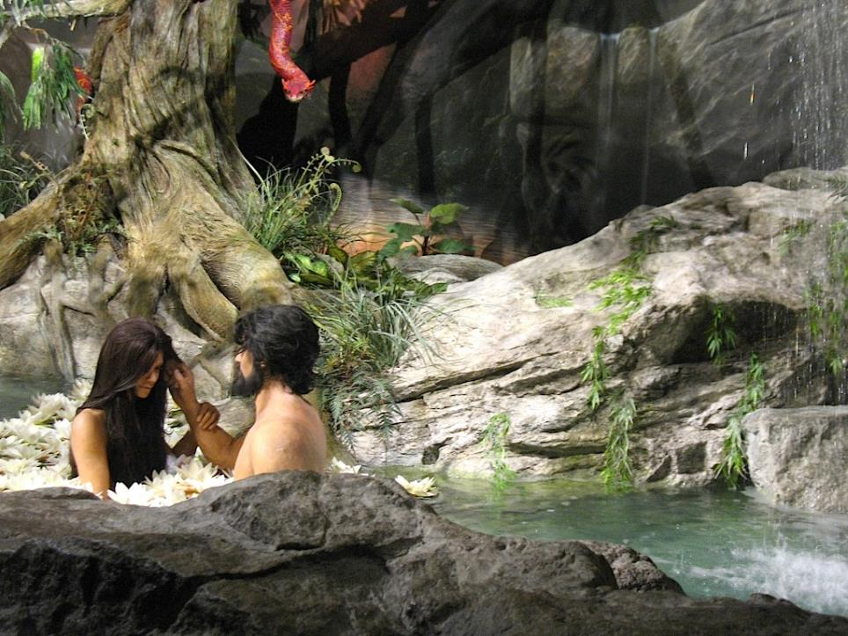

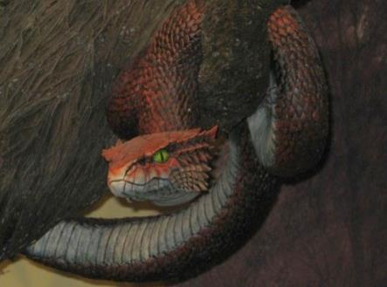

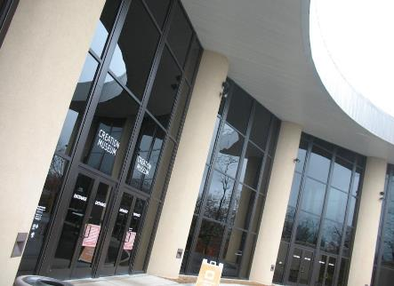
Creation Museum Petersburg, Kentucky, VS

Slide 4
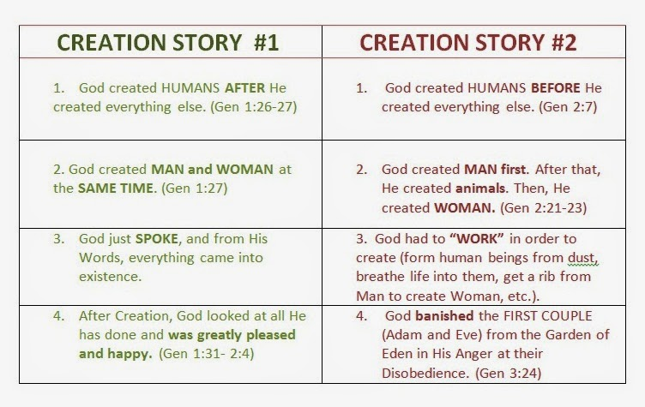
28th century b.p.: 30th century b.p.:

Slide 5
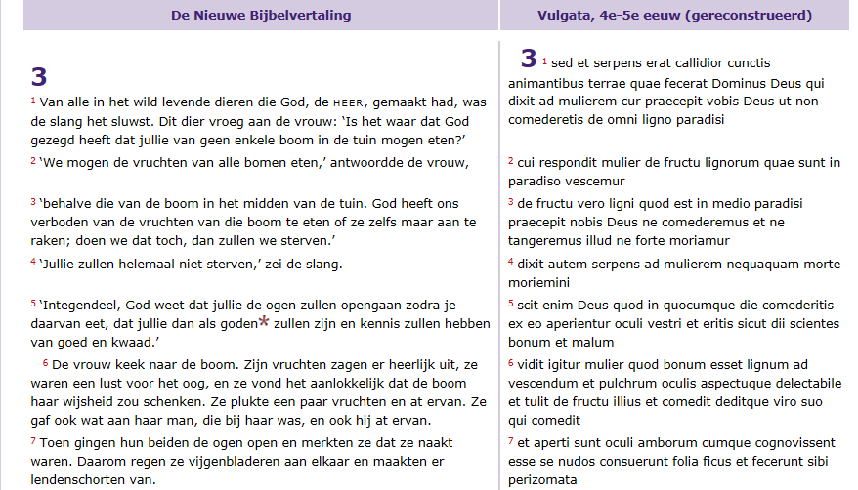
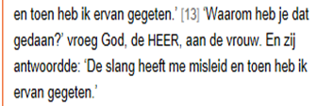

Nieuwe Bijbelvertaling: Willibrordvertaling:
LATIJN: serpens decepit me

Slide 6
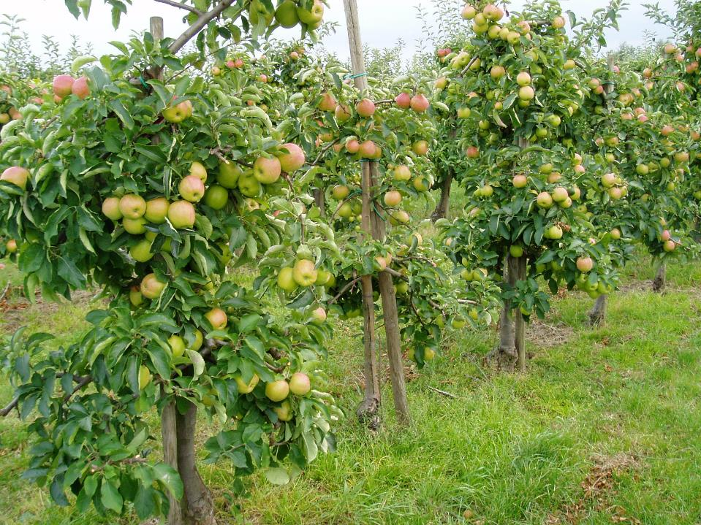
Gecultiveerde appel: Malus domestica

Slide 7
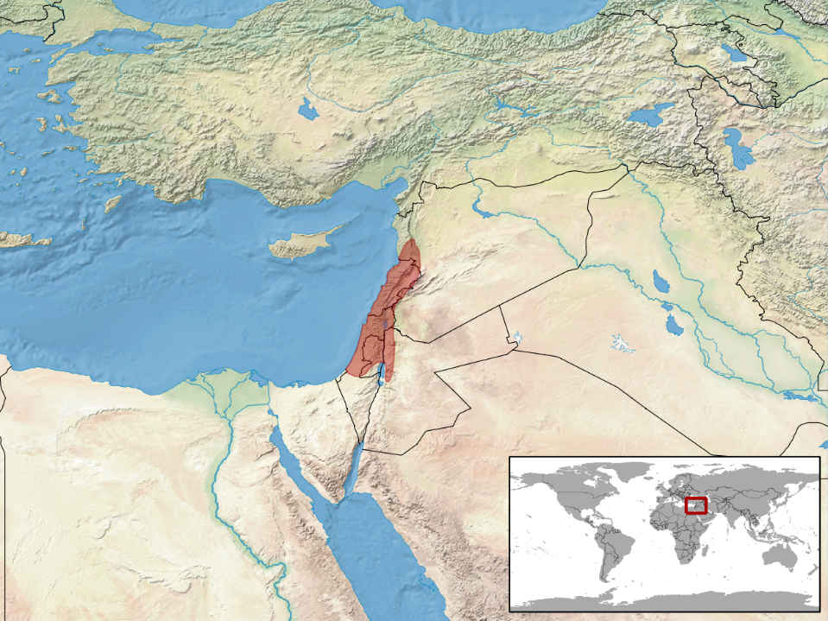

Slide 8

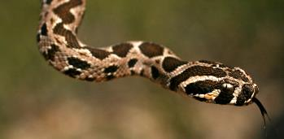

Slide 9
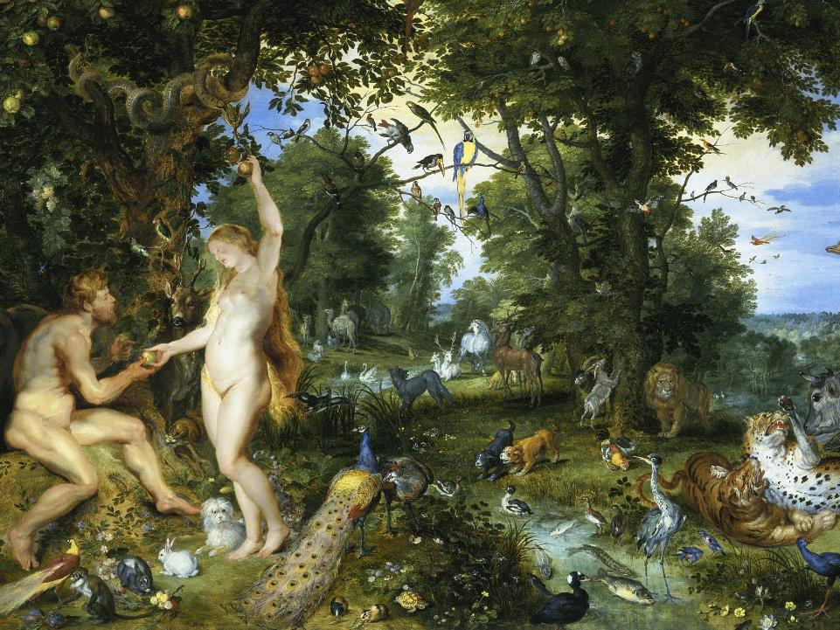
Peter Paul Rubens and Jan Breughel, Hof van Eden, 1615, Mauritshuis, ‘s-Gravenhage

Slide 10
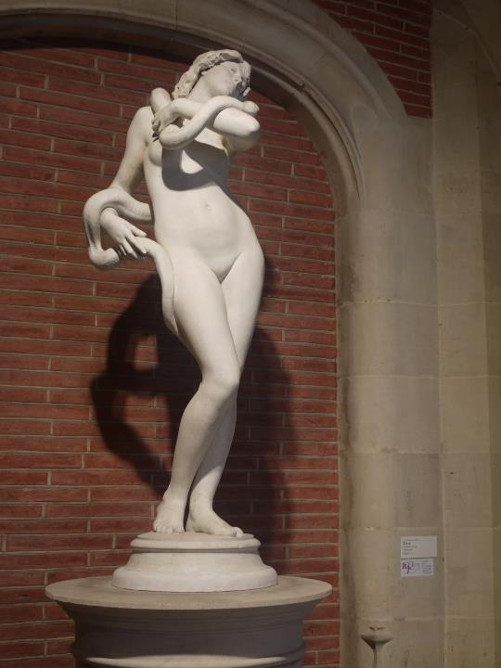
Antonin Idrac
(1849–1884):
Ève et le serpent
Musée des Augustins,
Toulouse

Slide 11
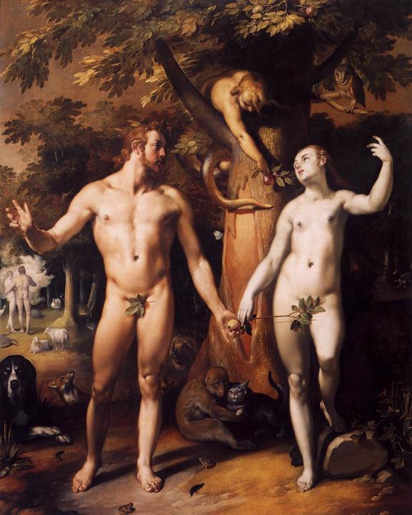
Cornelis van Haarlem,
De Zondeval,
1592,
Rijksmuseum
Amsterdam

Slide 12
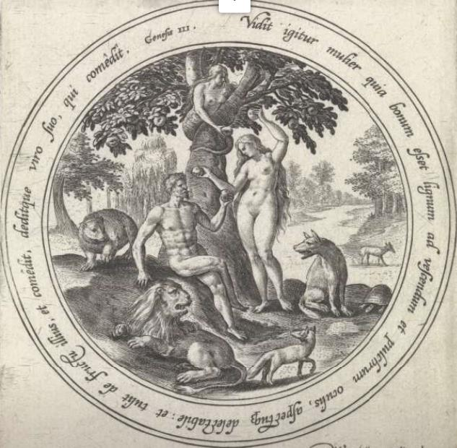

Eva biedt Adam de verboden vrucht aan.
Maerten de Vos,
± 1585

Slide 13
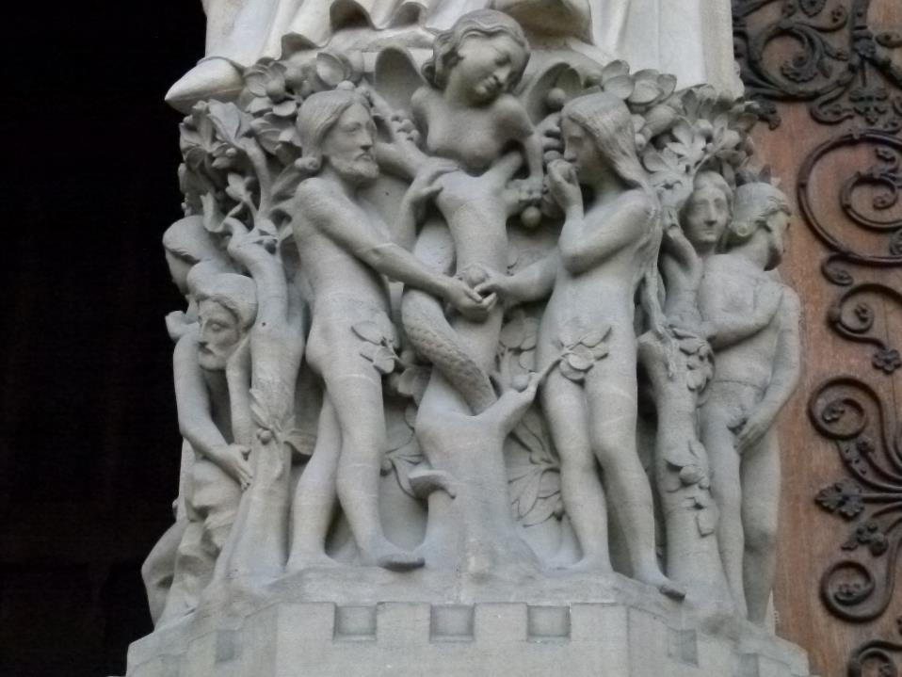
Ingang Notre Dame, Parijs

Slide 14
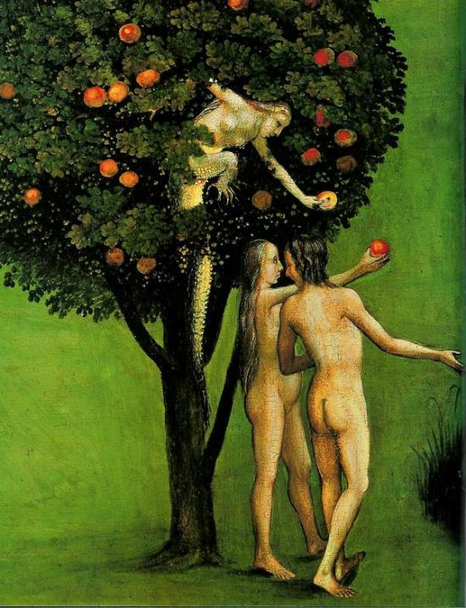
Jheronimus Bosch,
De Erfzonde, ca. 1482,
Ac. v. Beeldende
Kunsten, Wenen

Slide 15
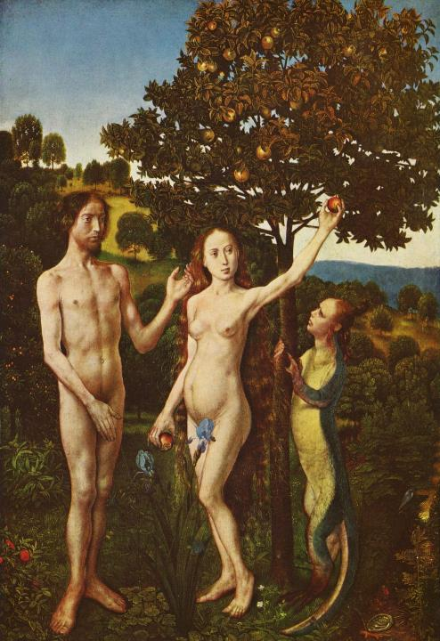
Hugo van der Goes,
De Zondeval, ca. 1467,
Rijksmuseum
Amsterdam

Slide 16
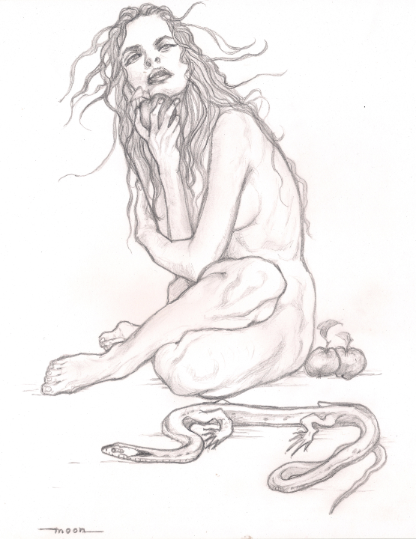
Het moment van de verleiding volgens de letterlijke interpretatie van Genesis, hfdst. 3 potloodtekening
Monique Aarnink,
Denekamp, 2016

Slide 17
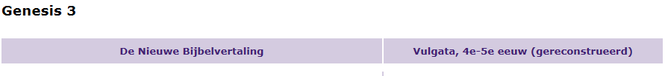
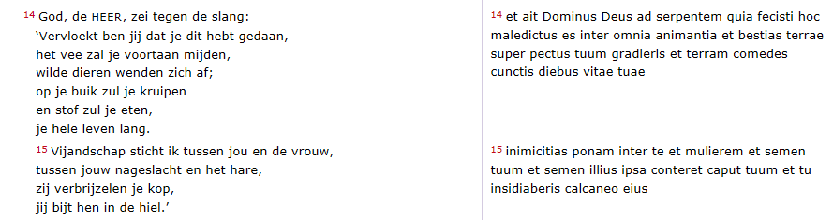

Slide 18
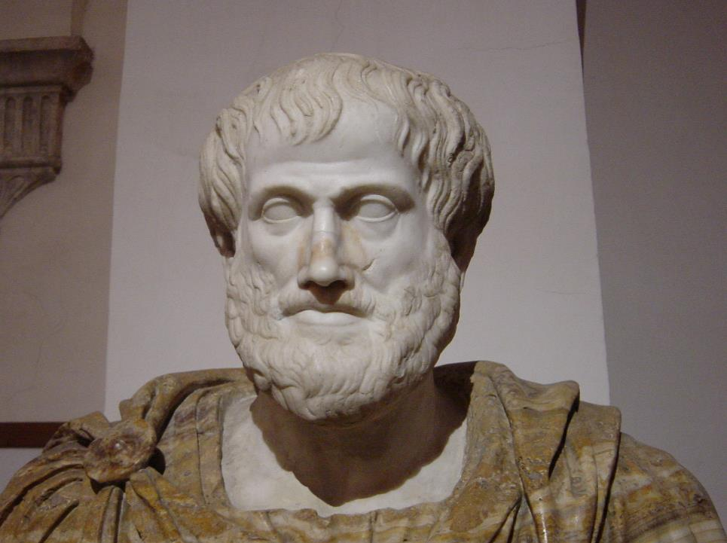
Aristoteles, 24ste eeuw (± 2350) b.p.
Τοῖς μὲν γὰρ ὄρνισιν ἄνω αἱ πτέρυγές εἰσι, τοῖς δὲ πτερύγια δύο ἐν τῷ πρανεῖ· καὶ τοῖς μὲν ἐν τοῖς ὑπτίοις οἱ πόδες, τοῖς δὲ ἔν τε τοῖς ὑπτίοις καὶ ἐγγὺς τῶν πρανῶν πτερύγια τοῖς πλείστοις·
Birds in a way resemble fishes. For birds have their wings in the upper part of their bodies and fishes have two fins in the front part of their bodies. Birds have feet on their underpart and most fishes have a second pair of fins in their under-part and near their front fins.

Slide 19
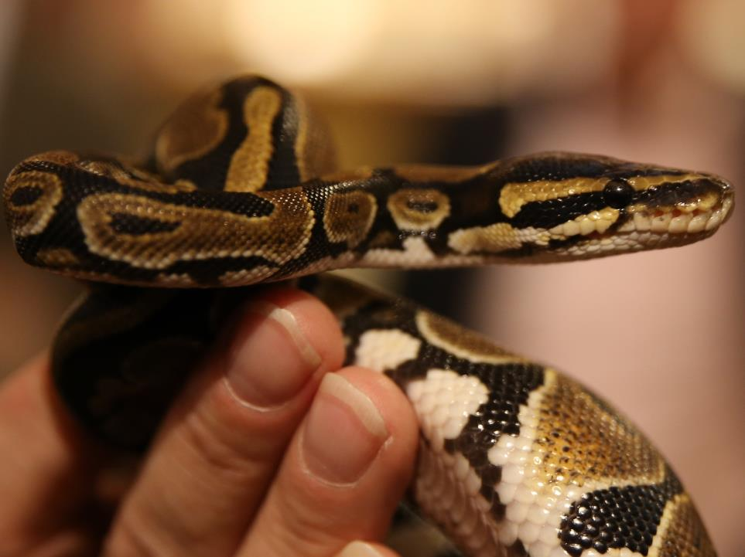
Koningspython (Python regius)

Slide 20
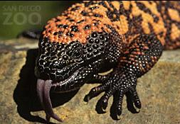
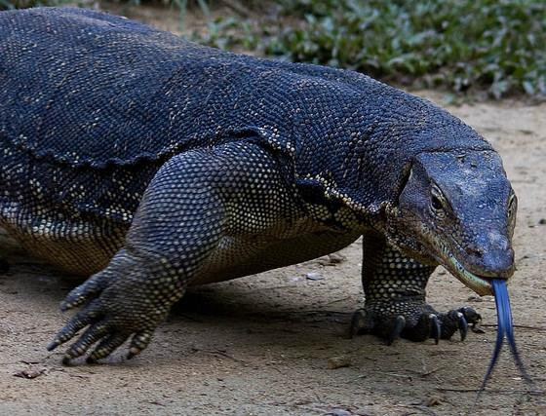
←
Gilamonster (Heloderma suspectum)
→
Komodovaraan
(V. komodoensis)

Slide 21
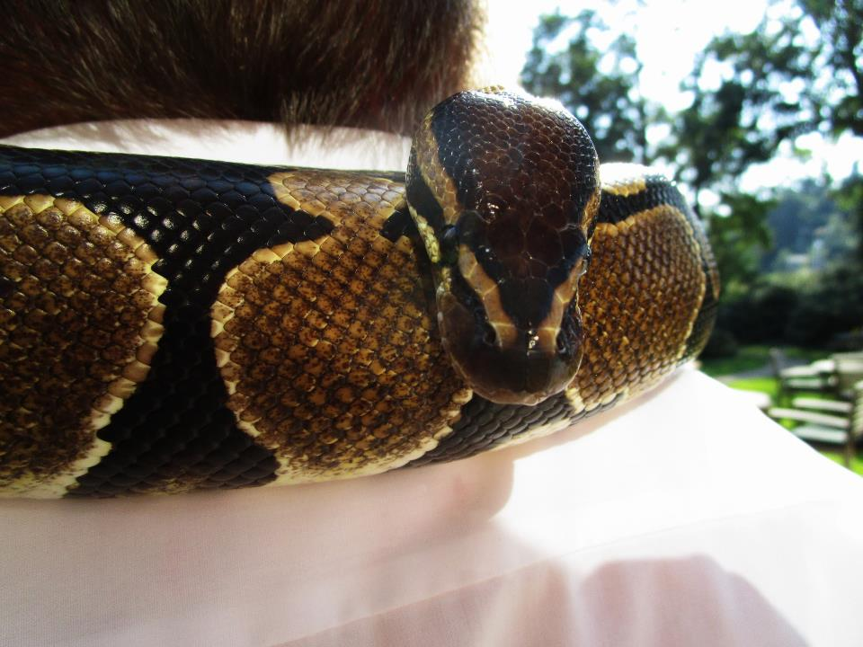

Slide 22
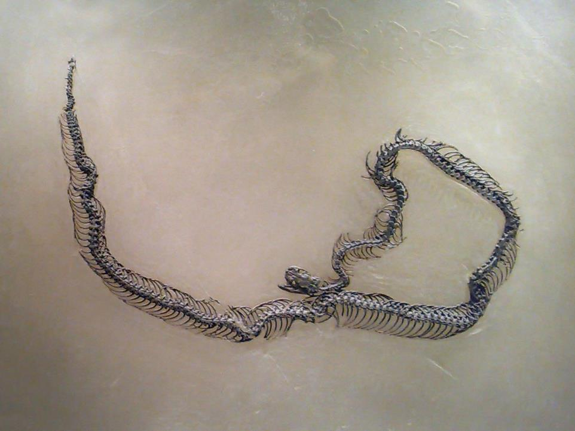
Messelophis (fam. Boidae), groeve Messel b. Darmstadt, Eoceen: plm. 50 miljoen jaar oud https://commons.wikimedia.org/wiki/File:Messelophis_ermannorum_02.jpg

Slide 23
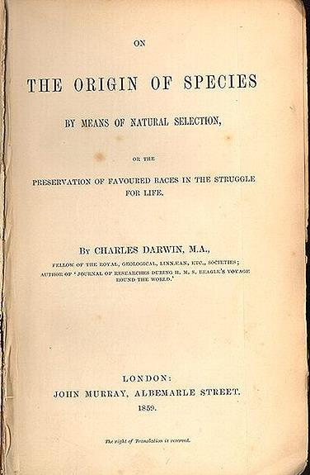
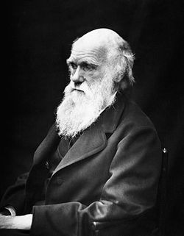
2009: een dubbel jubileum
150 jaar geleden verschenen: 200 jaar geleden geboren:

Slide 24
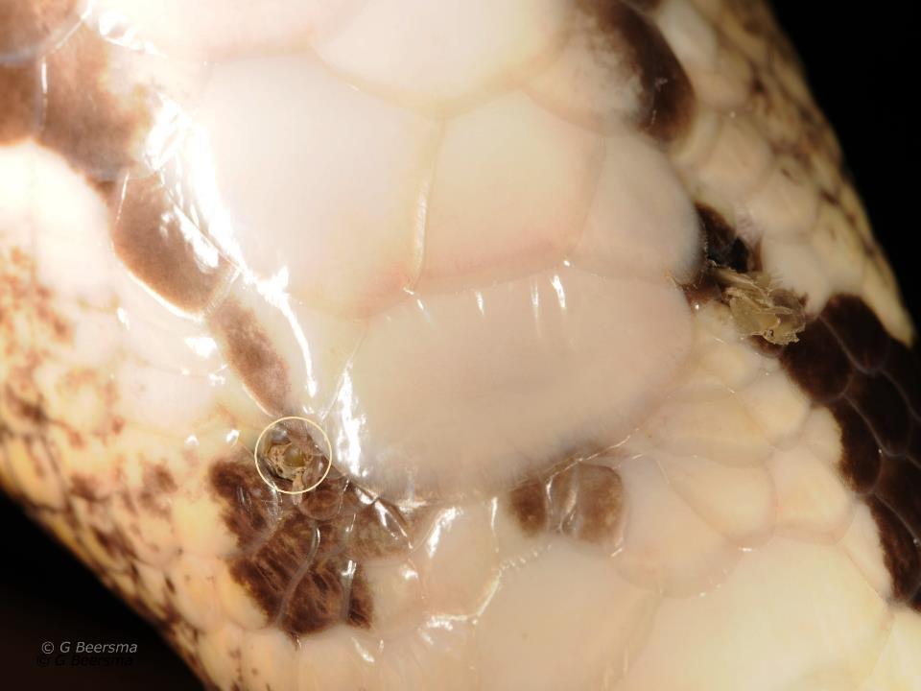
Koningspython (Python regius)

Slide 25
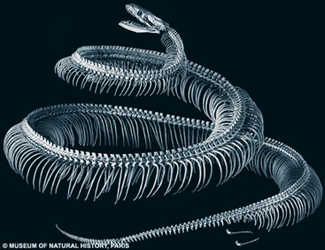
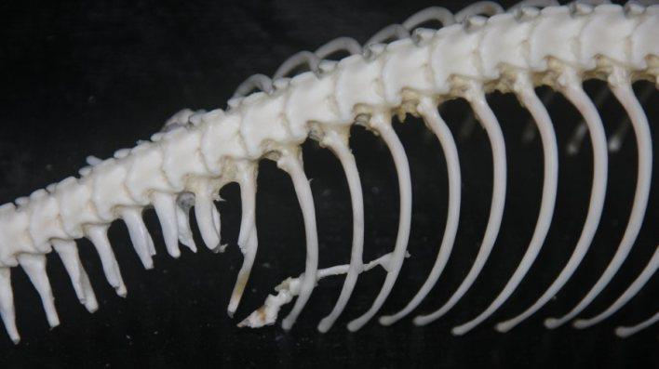

Slide 26
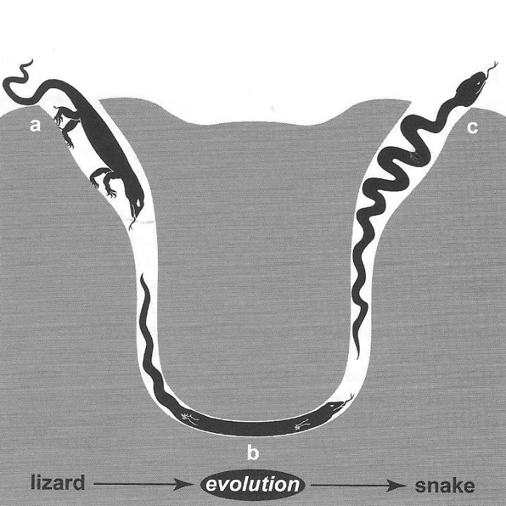



Courtesy: Lewis I. Held,
Texas Tech University (2014) varaan evolutie slang

Slide 27
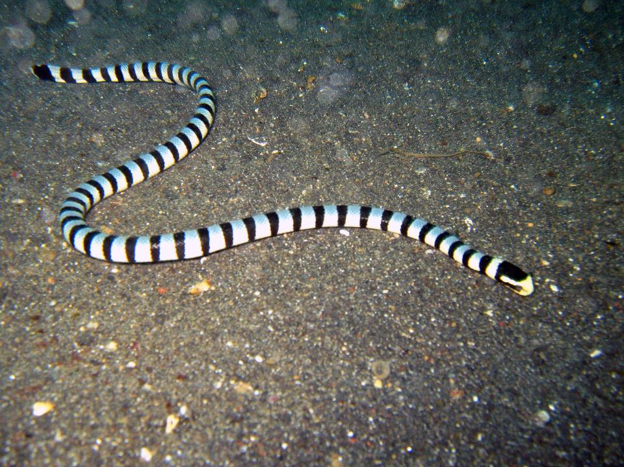
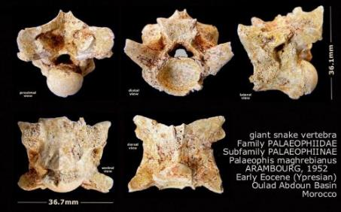
Foto: Jens Petersen

Slide 28
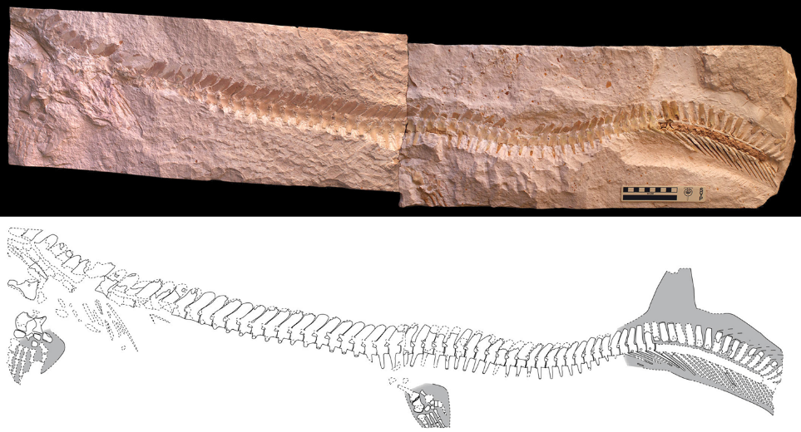
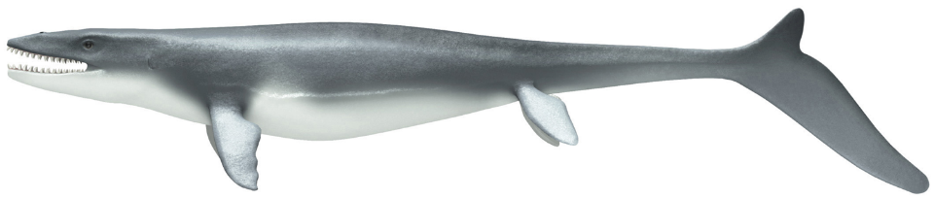
From: Lindgren, J., et al. 2013. Soft tissue preservation in a fossil marine lizard with a bilobed tail fin .
Nature Communications 4

Slide 29
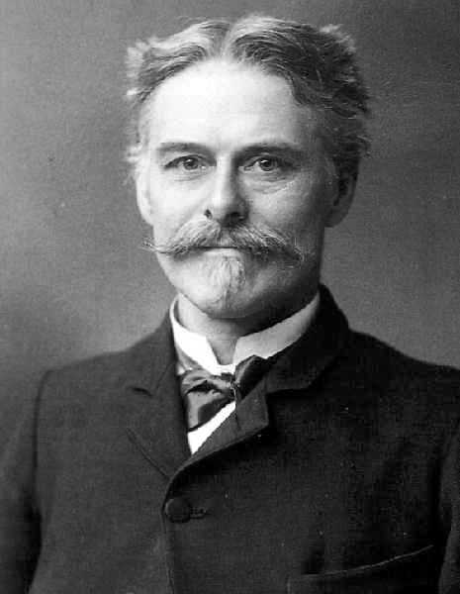

Slide 30
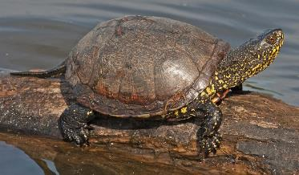
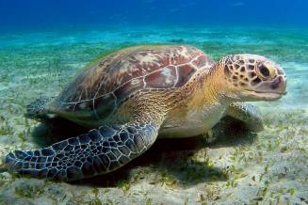
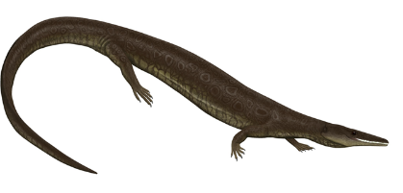
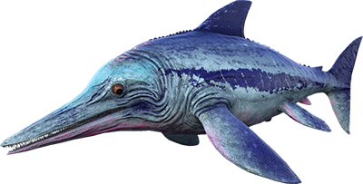


►
►
►

Slide 31
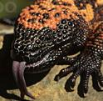
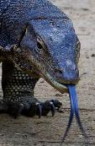
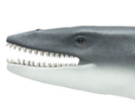
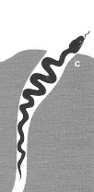
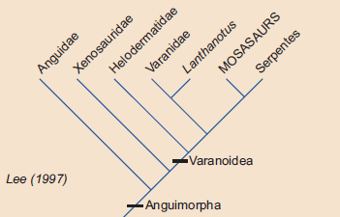
↑ ↑
↗ ↗

Slide 32
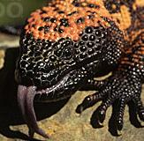




↗
↑ ↑ ↗
Schulp, Mulder & Schwenk, 2005

Slide 33





Pachyrhachis problematicus (Haas 1979)
Lee, M.S.Y. & Caldwell, M.W., 1998: Phil.Trans. R. Soc. Lond. B 353, pp. 1521-1552

Slide 34

Najash rionegrina, Laat Krijt, Argentinië
Sebastián Apesteguía & Hussam Zaher, Nature 440, 1037-1040 (20 April 2006)

Slide 35

± 95 ± 90 0 miljoen jaar geleden
A Cretaceous terrestrial snake with robust hindlimbs and a sacrum:
Sebastián Apesteguía & Hussam Zaher,
Nature 440, 1037-1040(20 April 2006)

Slide 36

Tetrapodophis amplectus https://commons.wikimedia.org/wiki/File:Tetrapodophis_amplectus_3483.jpg

Slide 37

©: Martill et al. (2015) Science, vol. 349: pp. 416–419.

Slide 38

Credit: Julius T. Cstonyi

Slide 39


©: Caldwell et al. Nature Communications vol. 6 (2015)

Slide 40

Portugalophis lignites (Late Jura) illustr.:Julius Csotonyi

Slide 41

Parviraptor estesi (Late Jura / Vroeg Krijt) illustr.:Julius Csotonyi

Slide 42

https://www.geol.umd.edu/~jmerck/honr219d/notes/10a.html

Slide 43

From Lizard to Snake; Behind the Evolution of an Extreme Body Plan:
Joost M. Woltering,
Current Genomics 13(4), 289–299 (2012)

Slide 44

Progressive Loss of Function in a Limb Enhancer during Snake Evolution:
Evgeny Z. Kvon et al.,
Cell 167, 633–642 (2016)

Slide 45

https://commons.wikimedia.org/wiki/File:Fishapods.png
Graphic by Dave Souza

Slide 46



▲ Acanthostega, ± 60 cm, 8 vingers (L. Devoon)
▼ Tulerpeton , 150 cm, 6 vingers (L. Devoon)
Dendrerpeton, 100 cm, 5 vingers (Carboon)►
https://en.wikipedia.org

Slide 47


Slide 48

©: Wilkinson M, Sherratt E, Starace F, Gower DJ (2013)
Wormsalamanders (Gymnophiona)

Slide 49


Slide 50


Slide 51


Rhynchonkos, Vroeg Perm, Oklahoma https://en.wikipedia.org

Slide 52

Lethiscus, Vroeg Carboon, Schotland https://en.wikipedia.org

Slide 54


Slide 55

Hazelworm https://nl.wikipedia.org

Slide 56

Mexicaanse wormhagedis (Bipes biporus) https://en.wikipedia.org

Slide 57

Kaapse pootjesslang (Chamaesaura anguina)

Slide 58


▲Baars: ± 40 wervels
▼Murene: ± 150 wervels

Slide 59


Slide 60

Durodon, Eoceen, U.S.A. & Egypte

Slide 61

©: De Muizon, C.(2001)
Nature 413: 259-260

Slide 62


Slide 63


