Slide 1
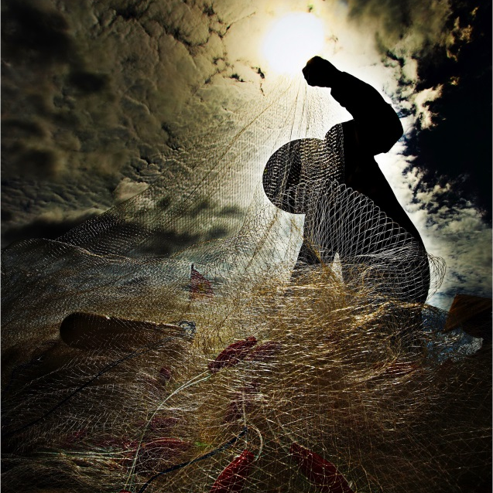

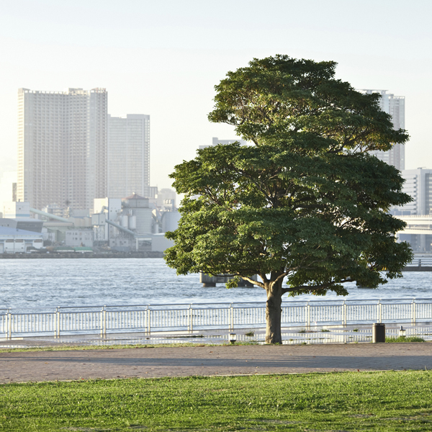
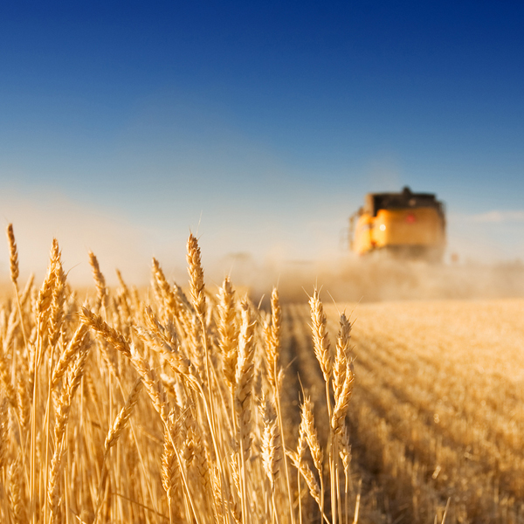
Duurzame vis
Hoe gaat het met de visbestanden?
16 Januari, Jan Jaap Poos (IMARES)

Slide 2
2048

Slide 3
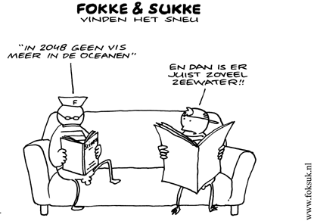
Text slide

Slide 4
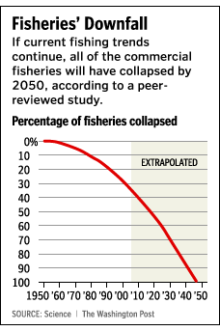
Global loss of species from Marine Ecosystems
Annual
Cumulative
Worm et al 2006 in Science

Slide 5
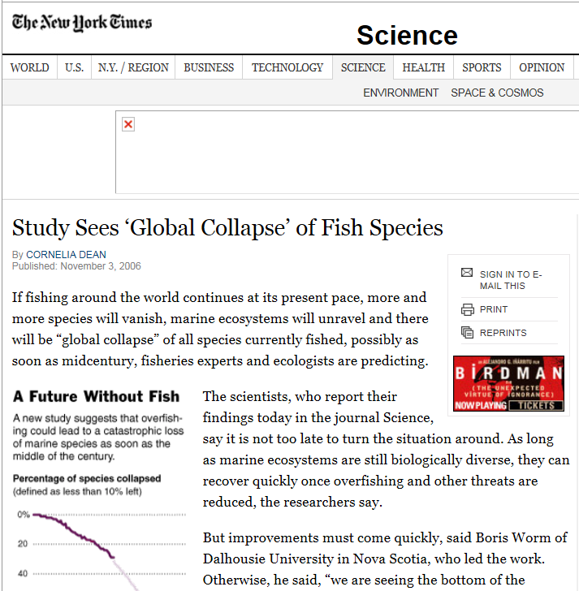
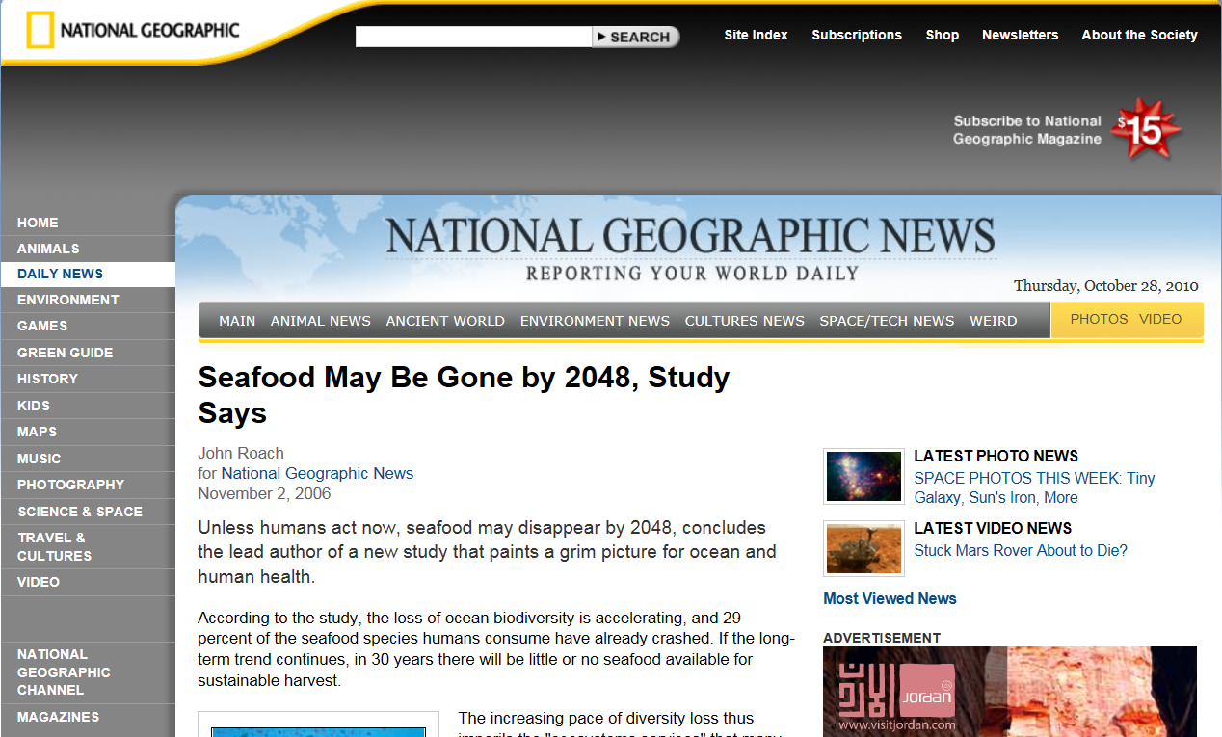

Slide 6

“There will be a point in the future where we will run out ...”

Slide 7
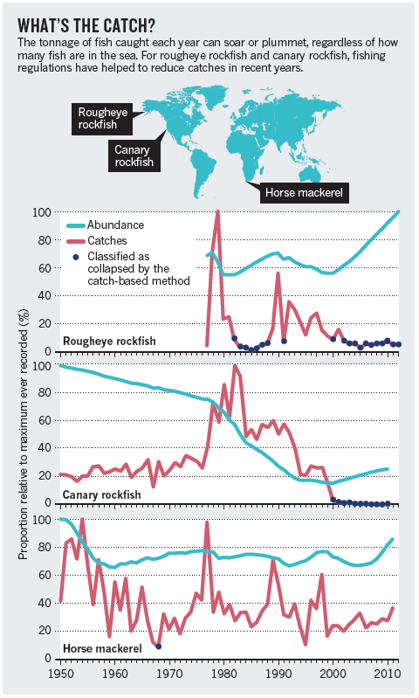
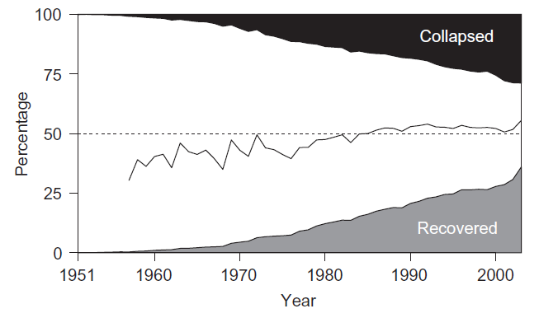
Commentaren op “2048” schatting
Hilborn and Branch 2013 in Nature
It is misleading to use catch data to assess the health of fish stocks
Branch 2008 in Marine Policy
“[...] even if all fisheries collapsed at least once, 50–55% would be recovered in any given year.”

Slide 8
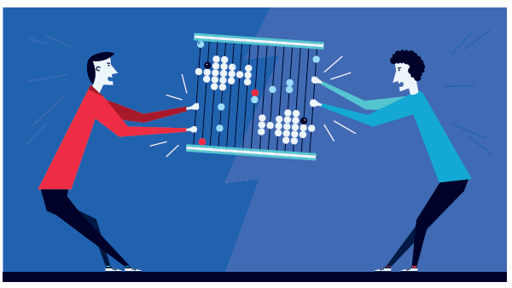
Hoe gaat het met de visbestanden?

Slide 9
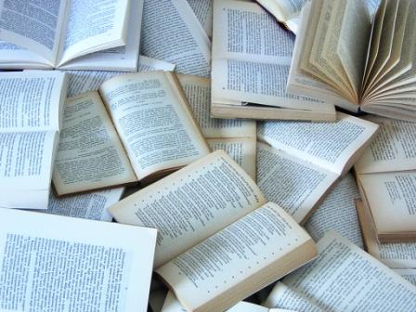
Analysis of “2048” in scientific literature
Notes:
Analysis of 664 citing papers revealed
11% referred to the 2048 projection,
39% referred to fisheries collapse in general
40% to biodiversity and ecosystem services.
The 2048 projection was mentioned more often in papers published soon after the original paper [...] and in journals outside of fields that would be expected to focus on biodiversity.
Citing papers also mentioned the 2048 projection more often if they had few authors (28% of single-author papers vs. 2% of papers with 10 or more authors). These factors suggest that the more knowledgeable the authors of citing papers were about the controversy over the 2048 projection, the less likely they were to refer to it.
If the original authors were also involved in the citing papers, they rarely (1 of 55 papers, 2%) mentioned the 2048 projection.

Slide 10
Wat zijn dan de regels?

Slide 11
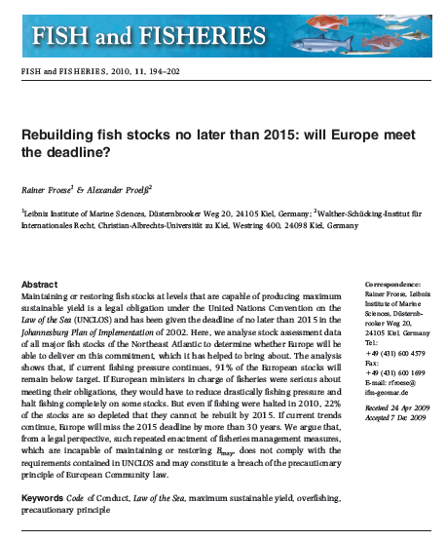
Hoe gaan we daar in Europa mee om?
Froese and Proelss 2010 in fish and Fisheries
“[...] if European Governments are serious about meeting their obligations to [...] the Johannesburg Plan of Implementation[...] they will have to reduce drastically fishing pressure and halt fishing completely on some of the European stocks.
CFP
Visserijbeleid in Europa geformuleerd in Common Fisheries Policy. De regels voor beheer van visbestanden in Europa

Slide 12
Population models,
MSY &
overfishing

Slide 13
Generiek populatiemodel
Natural
Mortality
Growth
Population
-
+
Recruitment
Fishing

Slide 14
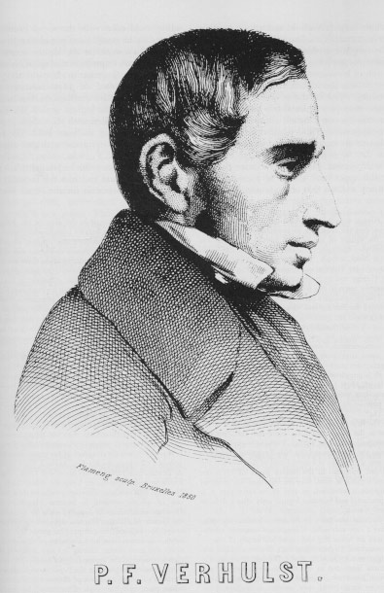

Generiek populatiemodel
Dichtheidsafhankelijke groei en sterfte
Biomass
Exponentiele groei
Time

Slide 15
Generiek populatiemodel
Carrying capacity K, B_{max}
Biomass
B = population biomass
t = time
r = intrinsic population growth rate
K = carrying capacity
Time

Slide 16
Generiek populatiemodel
Carrying capacity
Biomass
Maximum population growth
Time

Slide 17
Generiek populatiemodel
We know population growth:
At what biomass do we find maximum growth?
Carrying capacity K
Biomass
Max population growth
Time

Slide 18
Generiek populatiemodel
Carrying capacity
Biomass
Maximum growth
Time

Slide 19
Generiek populatiemodel
Max population growth
Population growth
K
Biomass

Slide 20
Van populatie groei naar surplus productie
Schaeffer model
B = population biomass
t = time
r = intrinsic population growth rate
K = carrying capacity
Y = Yield (also called catches)
growth
mortality
Yield
Population growth
Max pop growth
Biomass

Slide 21
Populatie in evenwicht als Yield = groei
=
maximum surplus
=
Maximum sustainable yield
Max pop growth
Population growth
Biomass

Slide 22
Visserij druk
B = population biomass
Y = Yield (also called catches)
q = catchability
E = fishing effort
Population growth
Biomass
Yield
Fishing effort

Slide 23
Eindresultaat: de yield curve
Yield
Fishing effort (or fishing mortality)

Slide 24
Eindresultaat: de yield curve
Fisheries “want”
to go here
costs
Yield
F_{MEY}
F_{MSY}
Fishing effort (or fishing mortality)

Slide 25
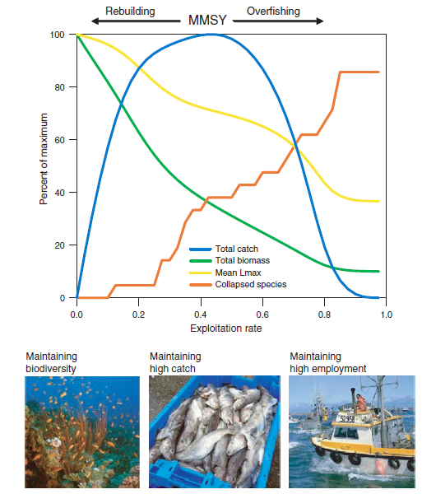
“Yield curves” voor visgemeenschappen
Worm et al. 2009 in Science
biodiversity is maintained at low exploitation rate, maximum catch is maintained at intermediate exploitation rate, and high employment is often maintained at intermediate to high exploitation rate”

Slide 26
Where do we stand

Slide 27
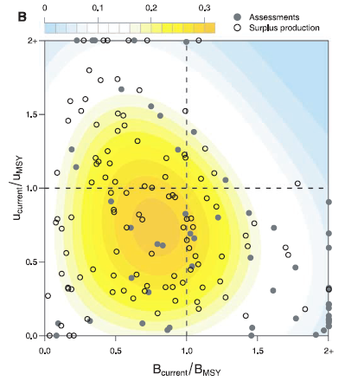
So where do we stand?
Worm et al. 2009 in Science
Global analysis of 166 stocks
For 63% of the examined stocks biomass has dropped below the traditional single-species management target of MSY, that is, B < B_{MSY}.
About half of those stocks (28% of total) have exploitation rates that would allow for rebuilding to B_{MSY}

Slide 28
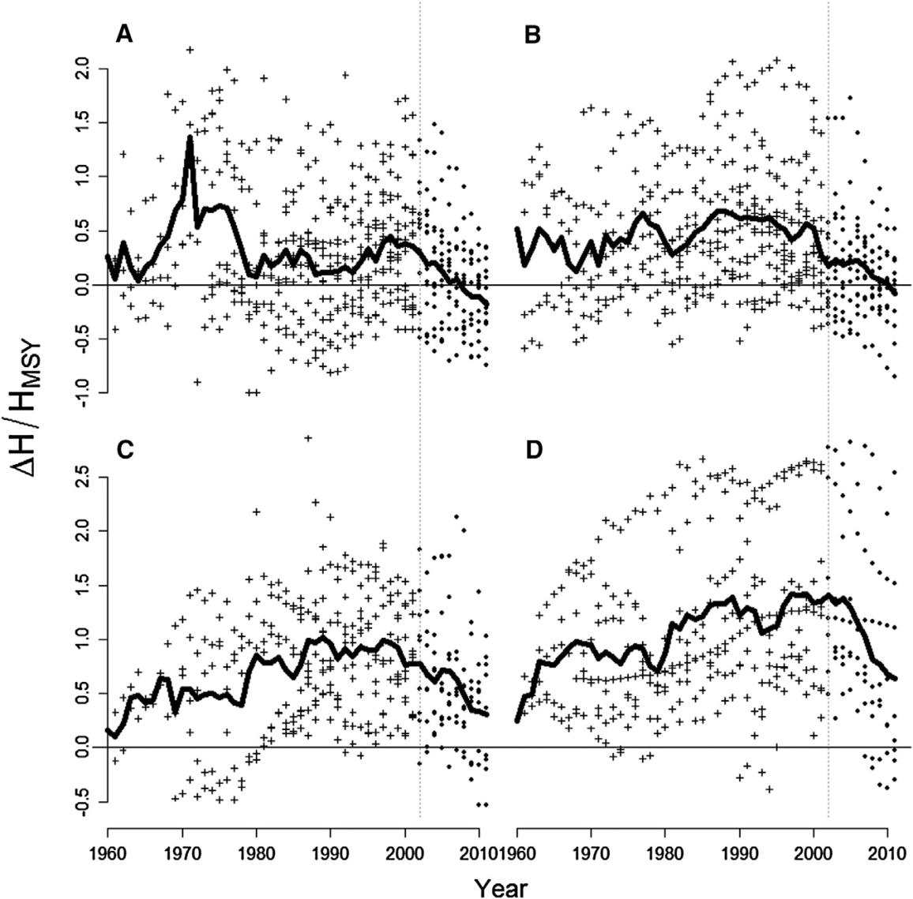
Hoe gaat het in Europa?
Fernandes and Cook 2013 in Current Biology
Analyse visbestanden NO Atlantic
A) Pelagische vis (haring, makreel, sprot, ...)
B) bodemvis (schelvis, koolvis, wijting, ...)
C) platvis (schol, tong, heilbot, ...);
D) kabeljauwbestanden.

Slide 29
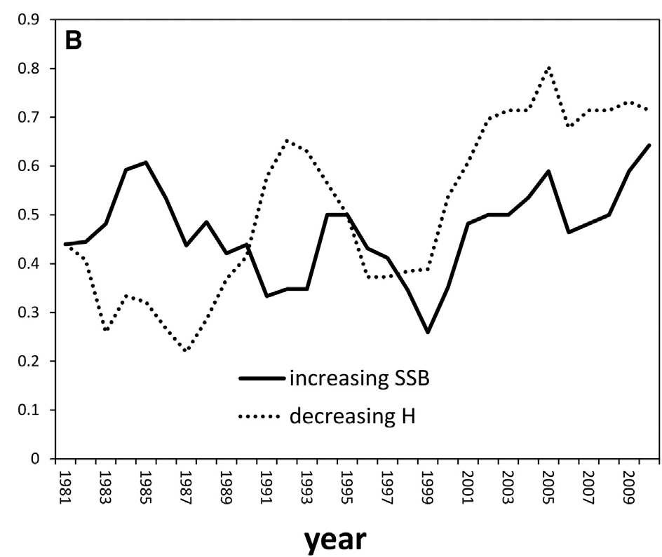

Wat is het effect van verlaging visserijdruk?
Fernandes and Cook 2013 in Current Biology
Afname visserijdruk, toename biomassas

Slide 30
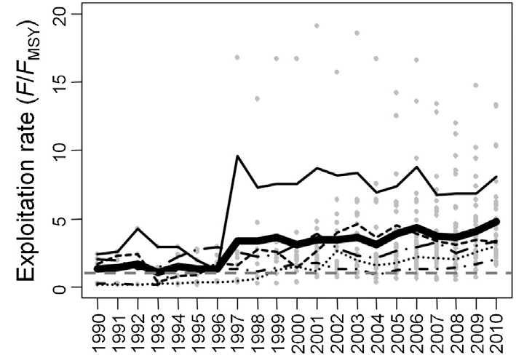
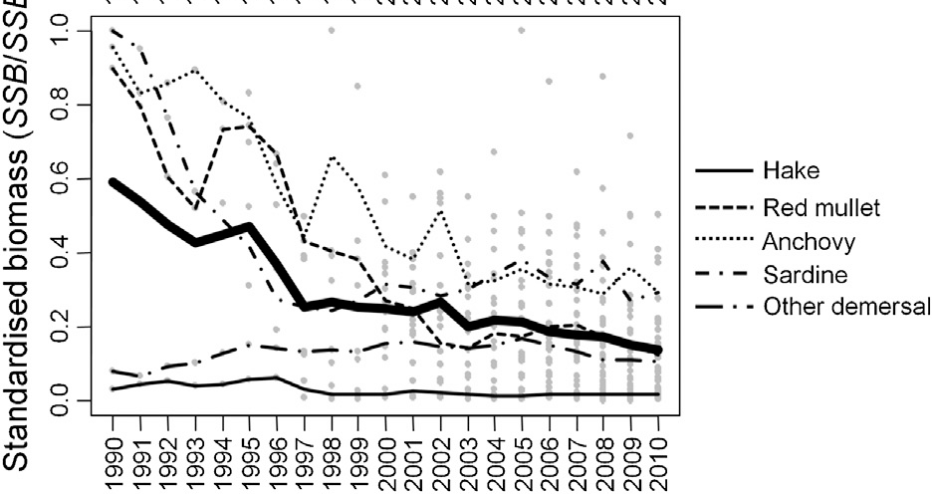
Situatie is anders in de Middellandse zee
Visserijdruk
Biomassa
Vasilakopoulos et al. 2014 in Current Biology
[...] the CFP has not succeeded in improving the state of European Mediterranean commercial fish stocks over the past two decades
“data limitations, low levels of compliance, and poor enforcement”

Slide 31
Wat kan er mis gaan: beheerscyclus
beheer:
reguleren
implementeren
advies
regels
onderzoek:
Dynamiek van
visbestanden
Ecosystemen
visserij:
vangsten
Inspanning
Aanpassen aan beheer
Gegevens
Economy

Slide 32
Wat kan er mis gaan: beheerscyclus
beheer:
onderzoek:
incorrect
assessment
visserij:
Notes:
Fisheries science: the three players within a governance structure
Failure of management may be due to problems in each of the corners
Focus on SCIENCE

Slide 33
De CFP (en certificering)

Slide 34
De Common Fisheries Policy
Environmentally sustainability while achieving economic, social and employment benefits
Apply the precautionary approach
The maximum sustainable yield exploitation rate shall be achieved by 2015 where possible and at the latest by 2020 for all stocks
implement the ecosystem-based approach to minimize negative impacts of fishing on the marine ecosystem

Slide 35
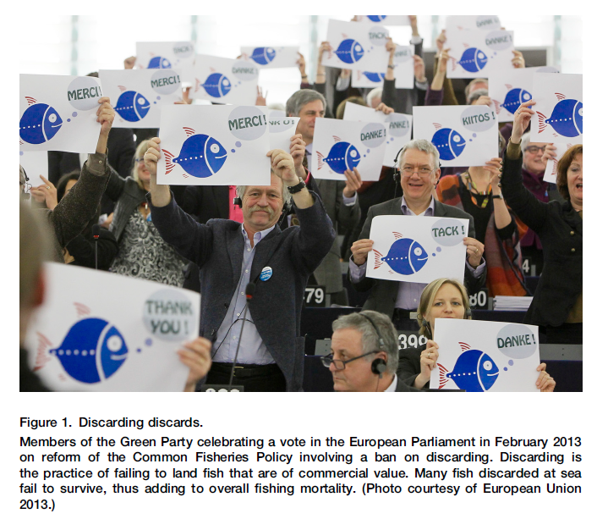
Laatste hervorming CFP in 2013
Uit Smith 2013 in Current Biology

Slide 36
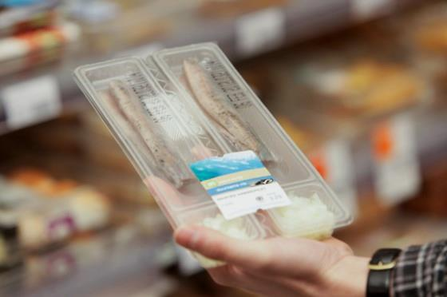
Certificering
  MSC
  RFS
  Viswijzer
  Friends of the Sea
  Waddengoud

Slide 37
Marine Stewardship Council
MSC Fisheries standard
MSC chain of custody standard
Third party certification
Reviewing standards
Principle 1: sustainable fish stocks
Fishing activity must be at a level which ensures it can continue indefinitely
Principle 2: Minimising environmental impact
Fishing operations must be managed to maintain the structure, productivity, function and diversity of the ecosystem
Principle 3: Effective management
The fishery must comply with relevant laws and have a management system that is responsive to changing circumstances

Slide 38
Marine Stewardship Council
MSC Fisheries standard
MSC chain of custody standard
Third party certification
Reviewing standards
Also the MSC label is hotly debated:
Jacquet et al. 2010 in nature
“The MSC is growing rapidly; the organization is also rapidly failing on its promise.”
“In our view, the certification system creates a potential financial conflict of interest, because certifiers that leniently interpret existing criteria might expect to receive more work and profit from ongoing annual audits.”
Kaiser and Hill 2010 in Nature
“We believe that the MSC process has refocused the behaviour and attitudes of fishermen in these areas, and has delivered conservation benefits more effectively than formal non-participatory legislation would have.”

Slide 39
Thank you
Notes:
Easy messages get picked up by media
There are no easy answers, perception is continuously changing
Perceptions and choices depend on personal values

